Slide 1
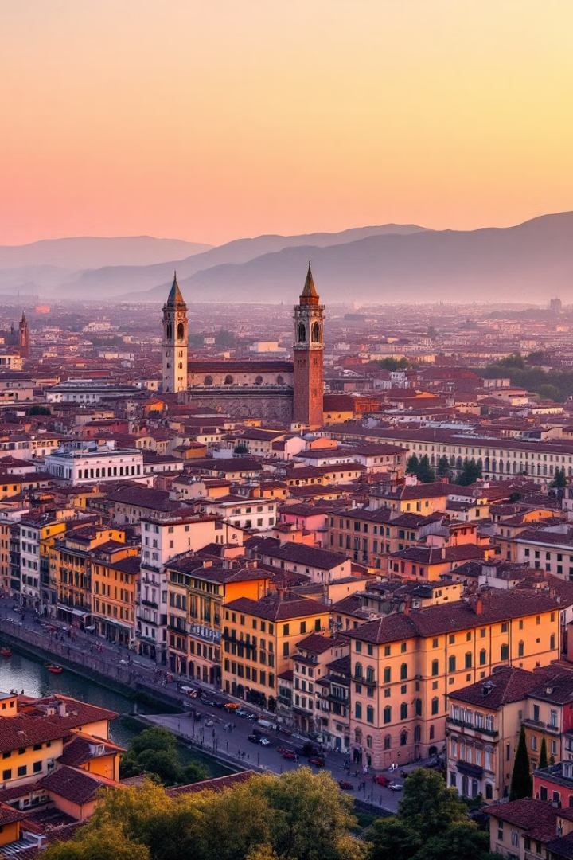

# The Renaissance: Rebirth of Art and Culture
Europe experienced a profound transformation from the 14th to 17th centuries. This era marked a transition from the Medieval to the Modern world. It witnessed a remarkable surge of creativity and an emphasis on human potential.
by eir kous

Slide 2
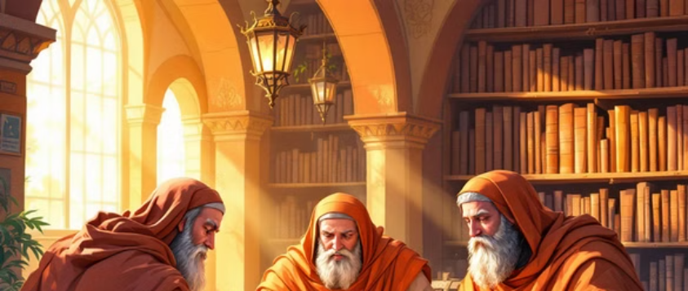

Historical Context
The Renaissance emerged from the Medieval period. The rise of wealthy merchant class in Italy spurred growth. Increased trade and cultural exchange were key. The rediscovery of classical Greek and Roman knowledge fueled the movement.

Slide 3
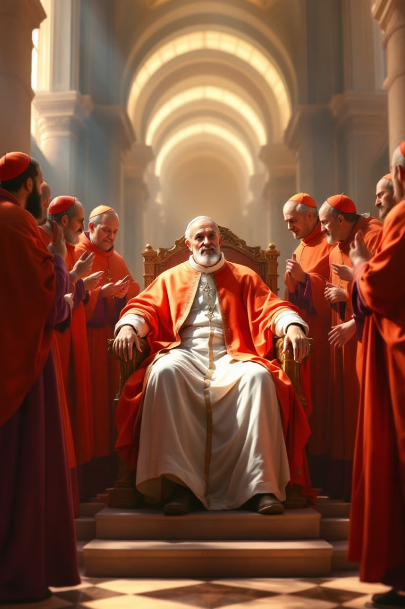
The Medici family played a crucial role in art patronage. The Pope also commissioned iconic pieces. Florence was the economic and cultural center. It produced the most influential artists of the period. The city was a hub of innovation.

Slide 4
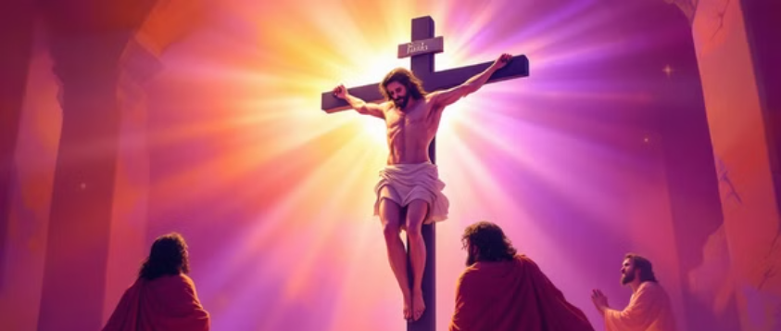

Artistic Innovations
Perspective revolutionized painting. Realistic human anatomy became central. Contrast between light and shadow created depth and drama. Religious themes, such as the Crucifixion and Pietà, were prevalent.

Slide 5
Leonardo da Vinci was an artist, scientist, and inventor. His masterpieces include the Mona Lisa and The Last Supper. Da Vinci's anatomical studies were decades ahead of his time. He embodied Renaissance intellectual curiosity.

Slide 6
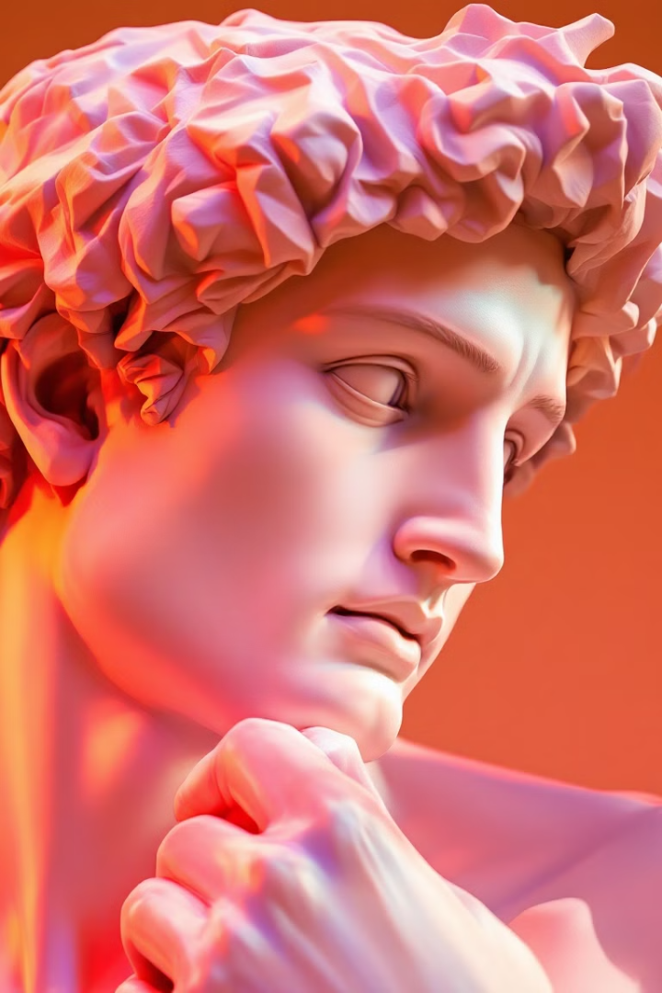
Michelangelo's Sistine Chapel ceiling is a masterpiece. The David sculpture represents the idealized human form. He worked in multiple artistic mediums. Michelangelo pushed the boundaries of artistic expression.

Slide 7
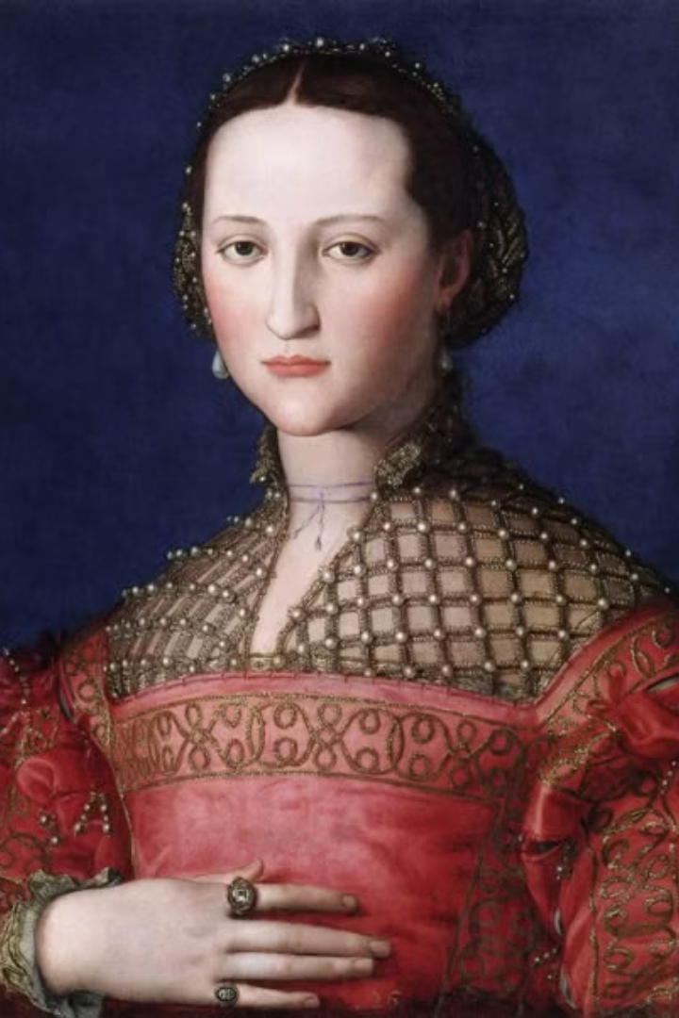

Slide 8
Renaissance Painting Techniques
Oil painting replaced tempera. Detailed, realistic portraiture emerged. Complex compositions and symbolism were common. Painters achieved an unprecedented level of human detail.

Slide 9
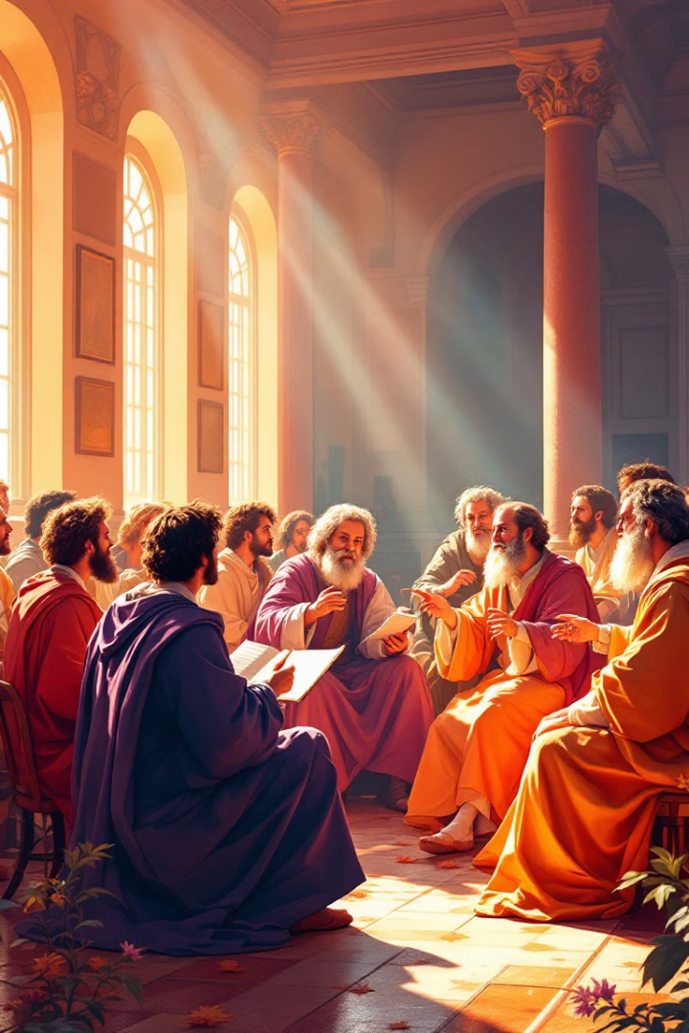
Humanism became a major philosophical movement. Individual achievement was celebrated. Knowledge and learning were prioritized. This era marked a break from medieval theological limitations.

Slide 10
The Renaissance spread from Italy across Europe. It influenced art, science, and philosophy. It laid the groundwork for modern scientific thinking. The era transformed our understanding of human potential.

