Slide 1
MY IDEAL SCHOOL

Slide 2
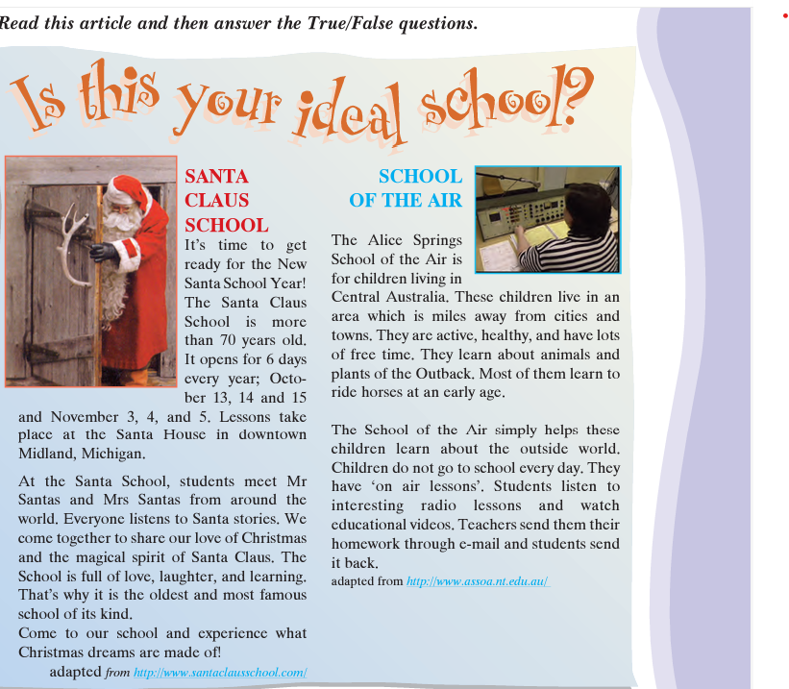

Slide 3
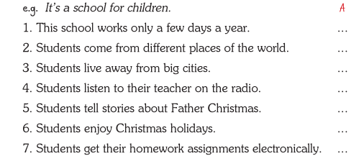

Slide 4
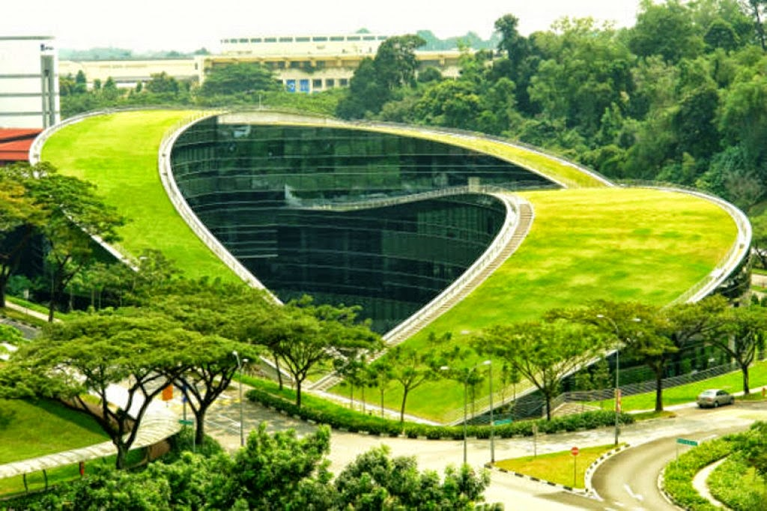
The Green Roof Art School in Singapore
The 5-story structure blends in so well with its environment
A plethora of glass walls allows plenty of natural light to illuminate the interior
the grassy roof is used as a meeting space for students.
The green roof also insulates the building, cools the surrounding air, and harvests rainwater for landscape irrigation.

Slide 5
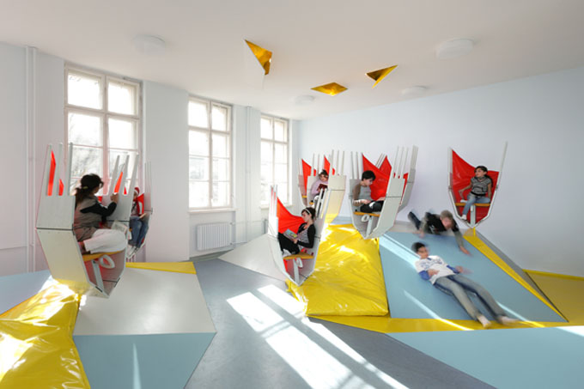
The Erika Mann elementary school in Berlin
It has been designed by students themselves with the help of a group of architecture students

Slide 6
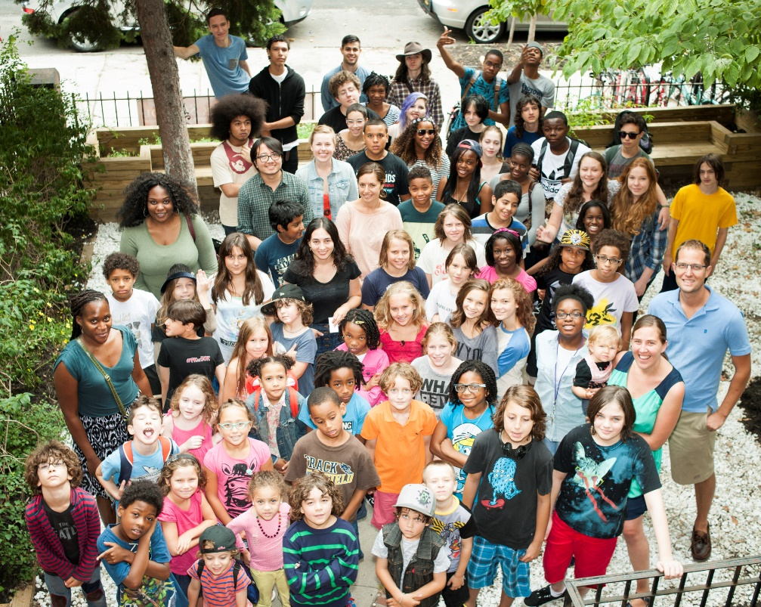
The Free School, Brooklyn
children are naturally curious and learn best when they want to, not when forced to
Subjects include:chess, debate, filming horror movies, and making caves for Teenage Mutant Ninja Turtles
No grades
No homework
No tests
Democratic meetings /all students have equal votes in governing the school

Slide 7
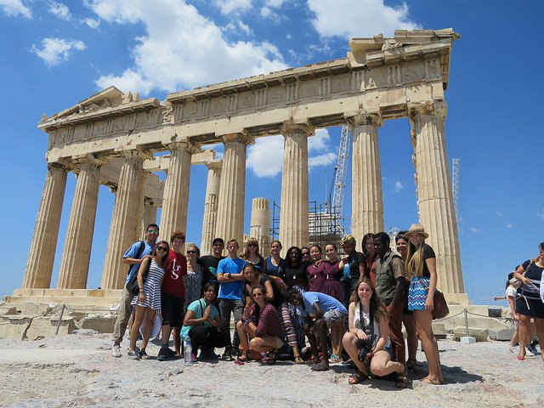
THINK GLOBAL SCHOOL (TGS)
a traveling boarding school with no official home base.
The student body is made up of 45 teenagers in grades 10-12 from over 28 different countries.
Each semester, the teachers and students change location
emphasizes learning that focuses on where students live
Focus on adaptability/critical thinking

Slide 8
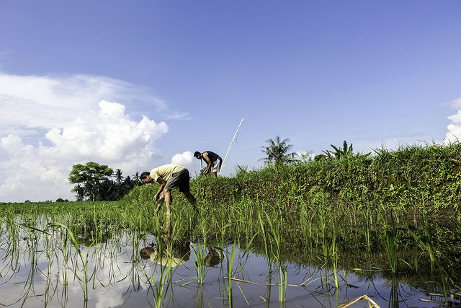
Green School in Bali, Indonesia
400 students
Green studies curriculum
Respect for the natural world
Environmental awareness
the campus is entirely constructed from sustainably-harvested bamboo

Slide 9
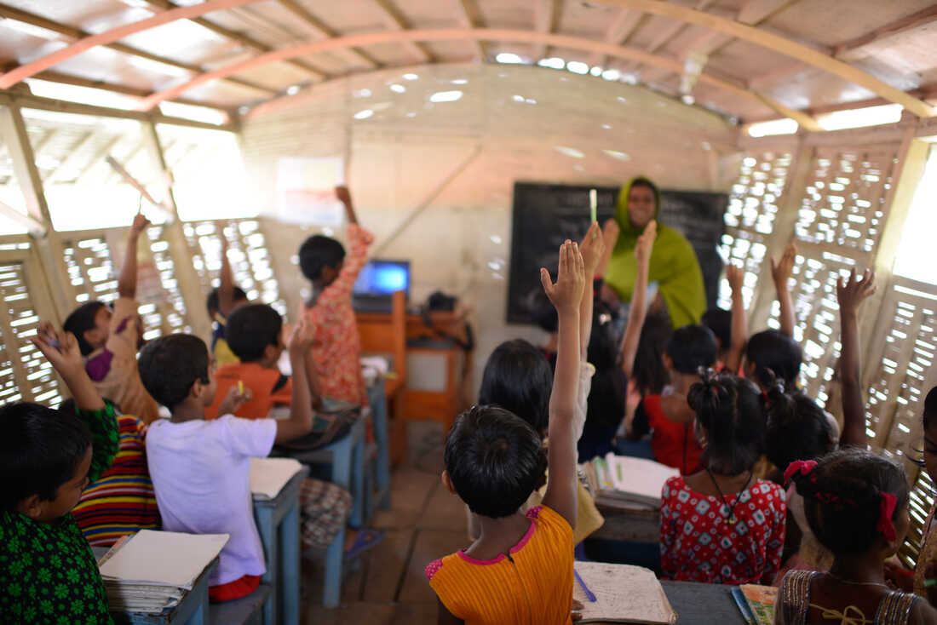
Boat Schools in Bangladesh
Climate change/floods
Some villages cut off
23 Solar powered schools on boats

Slide 10
How about YOUR ideal school?
What does it look like?
What subjects do you do?
Think about: teachers, students, parents and what their role is
Think about: times, breaks, school trips
Think about how students learn better
Think about how your school is not boring
Write about this school. If you like, you can also draw a picture for us.

