Slide 1
Εγκέφαλος και Συμπεριφορά

Slide 2
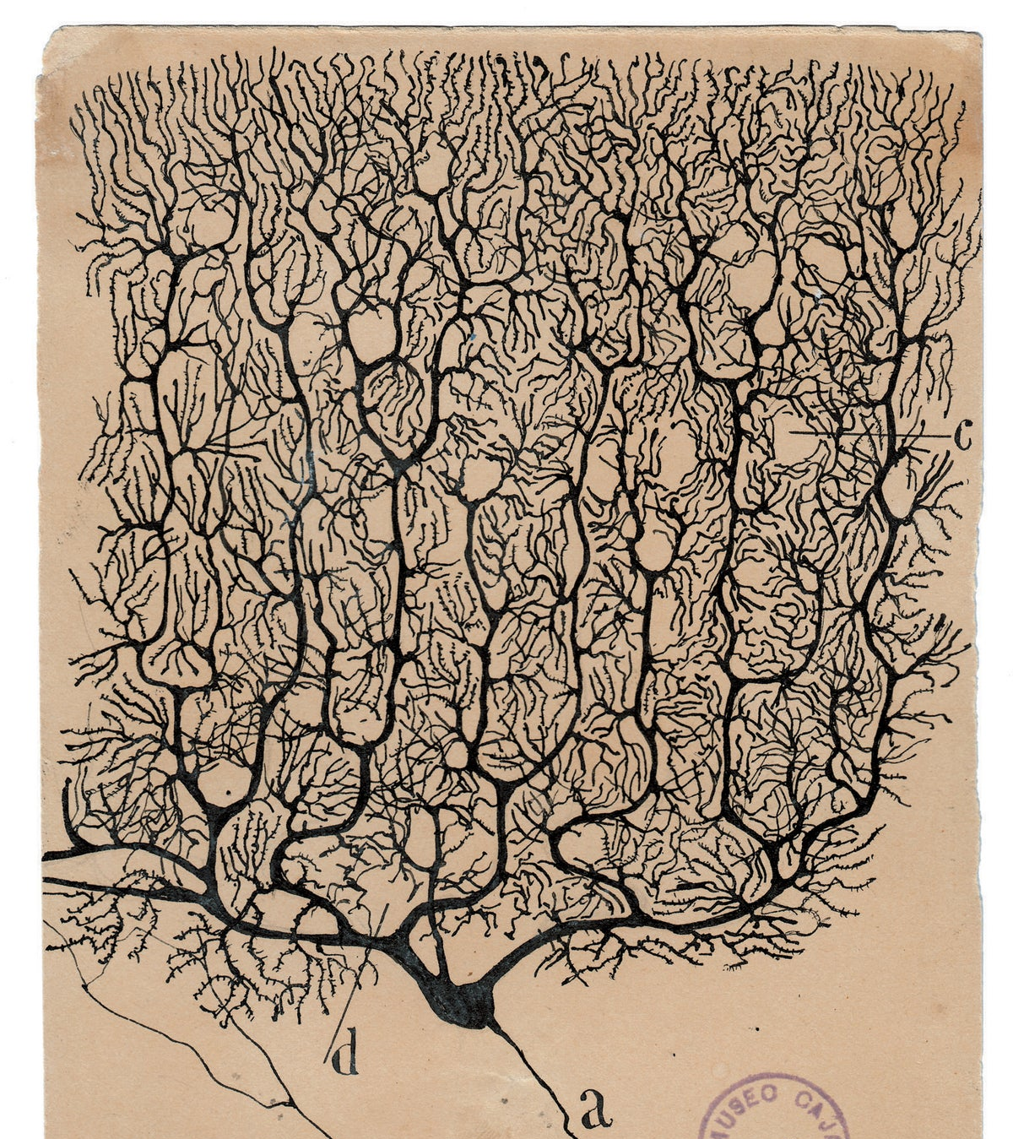
1700s - Luigi Galvani discovered that muscle and nerve cells produce electricity
1873 - Camillo Golgi developes black reaction (Golgi Staining Technique)
Late 1880s – Early 1900s Santiago Ramon y Cajal provides evidence that neurons are distinct cells
1950s – electron microscopy confirms the presence of synapses thus proving the neuron doctrine

Slide 3
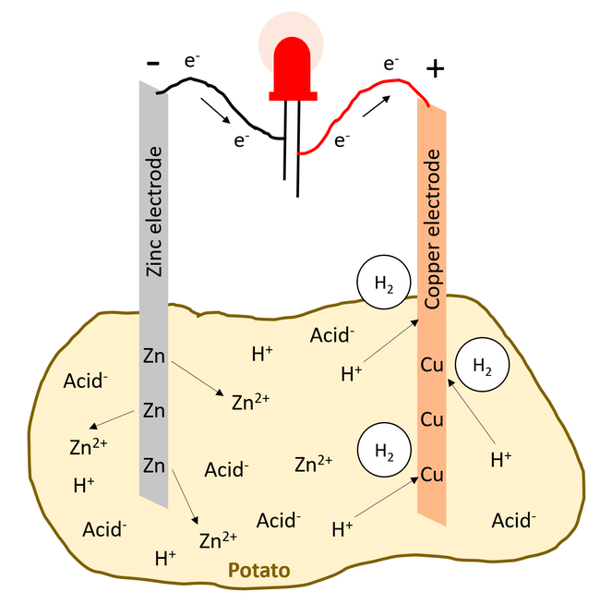
Potato battery: chemical energy is converted into electrical energy
Zn→Zn²⁺+2e⁻ (oxidation: electrons are released from zinc electrode)
2H⁺+2e⁻→H₂ (reduction: protons take up the electrons from the copper electrode)
Electrons flow from the zinc to the copper electrode

Slide 4
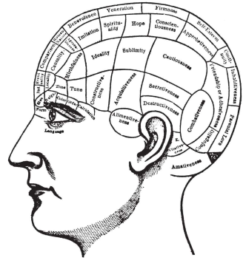
Brain is the organ of the mind
Descartes dualist view;
Brain for perception, movement, passions
Mind for higher mental functions and conscious experience (soul located in pineal gland)
1800, Gall: Brain is the organ of the mind, cerebral cortex contains many organs. Phrenology

Slide 5
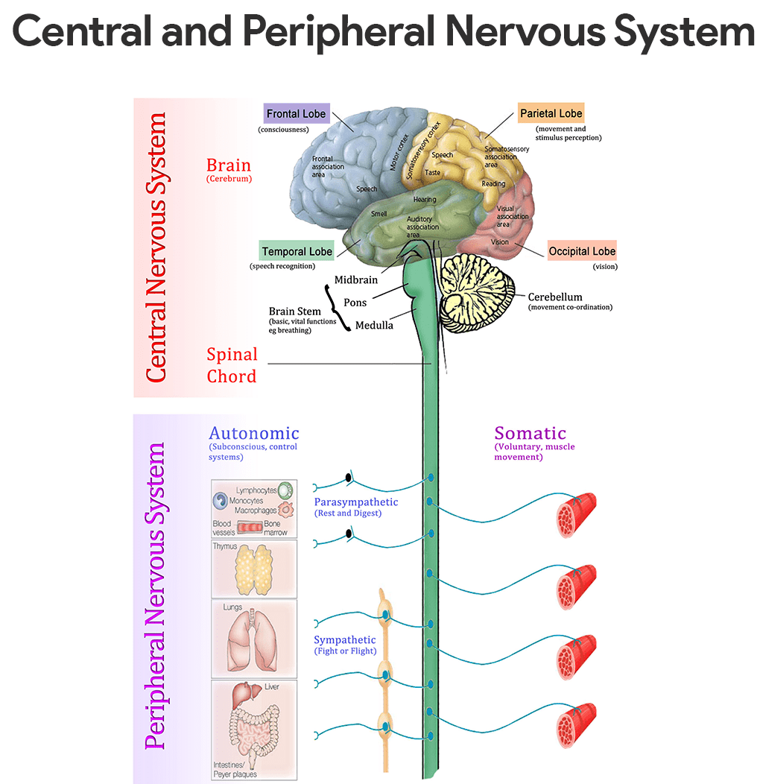
Hughlings Jackson: focal epilepsy (19th century)
Fritsch & Hitzig: movements can be produced when stimulating discrete regions of precentral gyrus (1870)

Slide 6
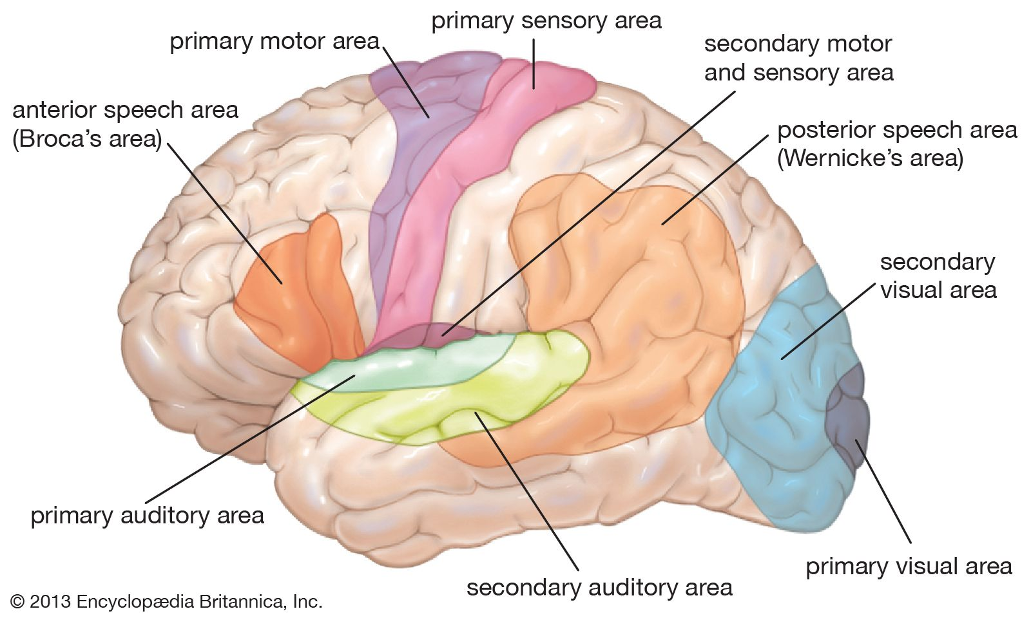
Localization of cognitive abilities
Broca: brain lesions correlated with aphasia (1861)
Wernicke: patient can speak but cant understand language

Slide 7
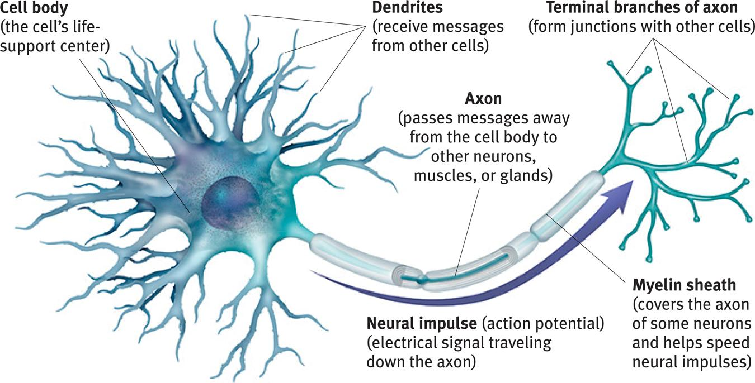
Neurons and Neuronal Communication: The Structure of a Neuron
There are billions of neurons
(nerve cells) throughout the body.
Notes:
No animation.
Most of the neurons are in the brain but there are motor and sensory neurons throughout the body. The message does not travel down the axon in the same way an electrical signal does down a wire; in fact electricity in a wire travels 3 million times faster. In the body, neural signals travel about 2 to 180 miles per hour. However, the chemical signal has an advantage; it does not decrease in intensity as it travels down the axon. No signal is lost.
You could demonstrate speed of signal transmission by having it travel across all the students hand to brain to hand across the room (or hand to shoulder to possibly bypass the brain).
Note the myelin sheath. Multiple sclerosis involves the degeneration of this layer, thus interfering with neural communication with muscles and other areas.

Slide 8
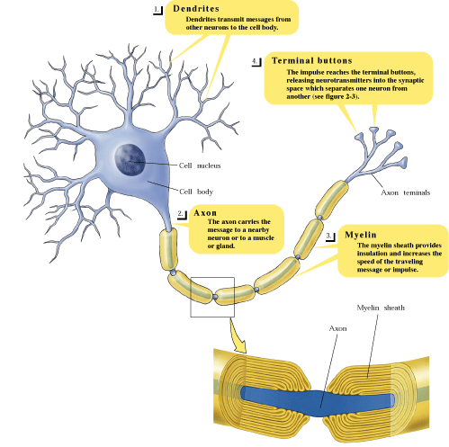
Structure
Dendrites
Carry information to the cell body from other neurons
Cell Body (Soma)
Contains nucleus
Axon
Carries information to the next cell
Myelin Sheath
Insulates the axon and speeds up the neural impulse

Slide 9
Types of Neurons
Sensory neurons
Carry information from sensory systems to the brain
Also referred to as afferent
Motor neurons
Carry information from the brain to muscles and glands
Also referred to as efferent
Interneurons
Carry information between other neurons
Glial Cells (insulate, support, clean up, nourish)

Slide 10
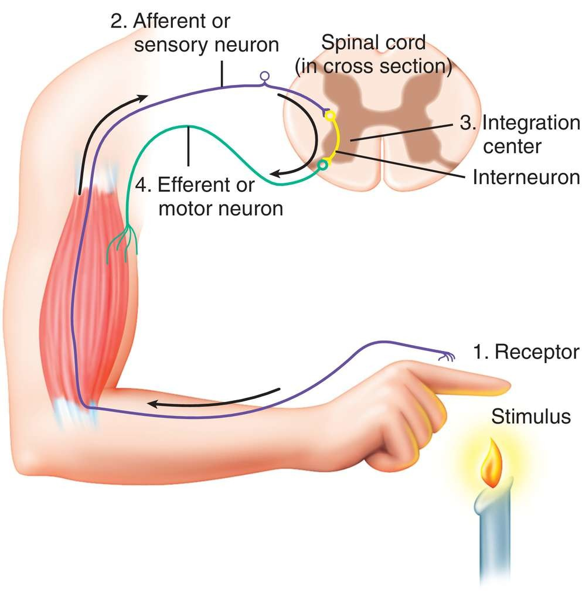
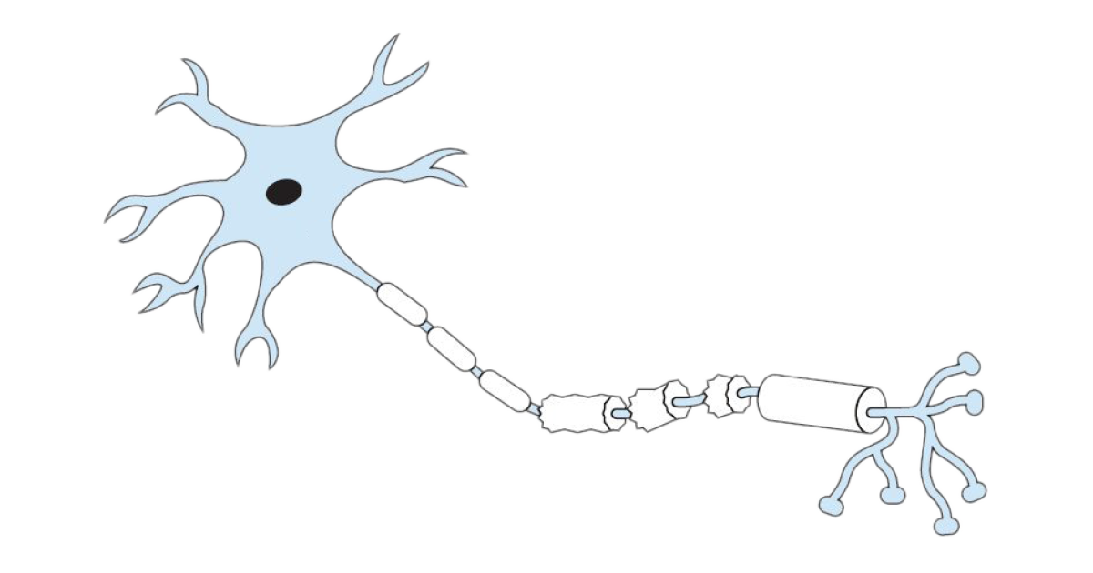
Neurons form networks
Reflex arc: a tiny neural network
Neural computation
Stimulus
Response
muscles
glands
neurons!
Notes:
Τ: Τι δυνατότητες έχουν δίκτυα με περισσότερους νευρώνες;

Slide 11
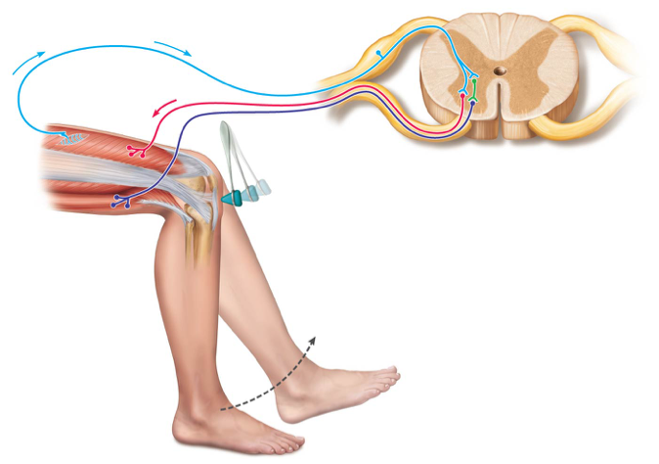
Stimulus Type | Reaction Time
Visual | 200–250 ms
Auditory | 150–200 ms
Tactile (Touch) | 130–170 ms
Withdrawal Reflex | ~50-70 ms
Knee-Jerk (monosynaptic) | ~30-40 ms
Pain (Conscious) | 700–1000 ms

Slide 12
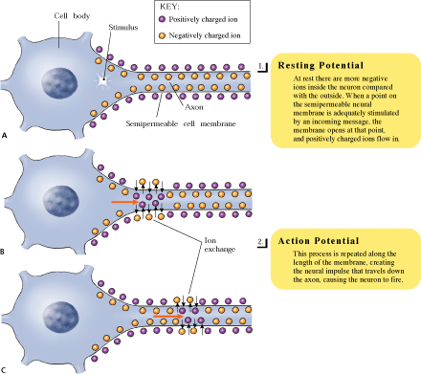
The neural impulse
Ions
Charged molecules
Resting Potential
When more negative ions are inside the neuron than outside
Charge is approximately -70mV
Neuron is not transmitting information
Polarization
When the electrical charge of a cell moves away from zero
Depolarization
When the electrical charge of a cell moves toward zero

Slide 13
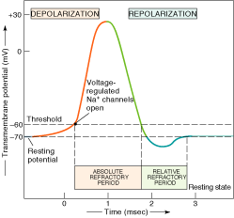
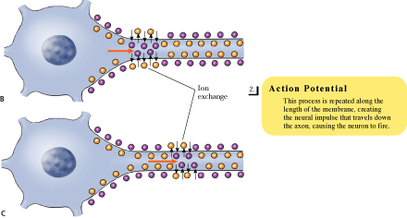
The neural impulse
Action Potential
Sudden, massive change in charge in the neuron
Occurs when depolarization reaches the threshold of excitation
Ions flow across cell membrane

Slide 14
https://phet.colorado.edu/sims/html/neuron/latest/neuron_all.html

Slide 15
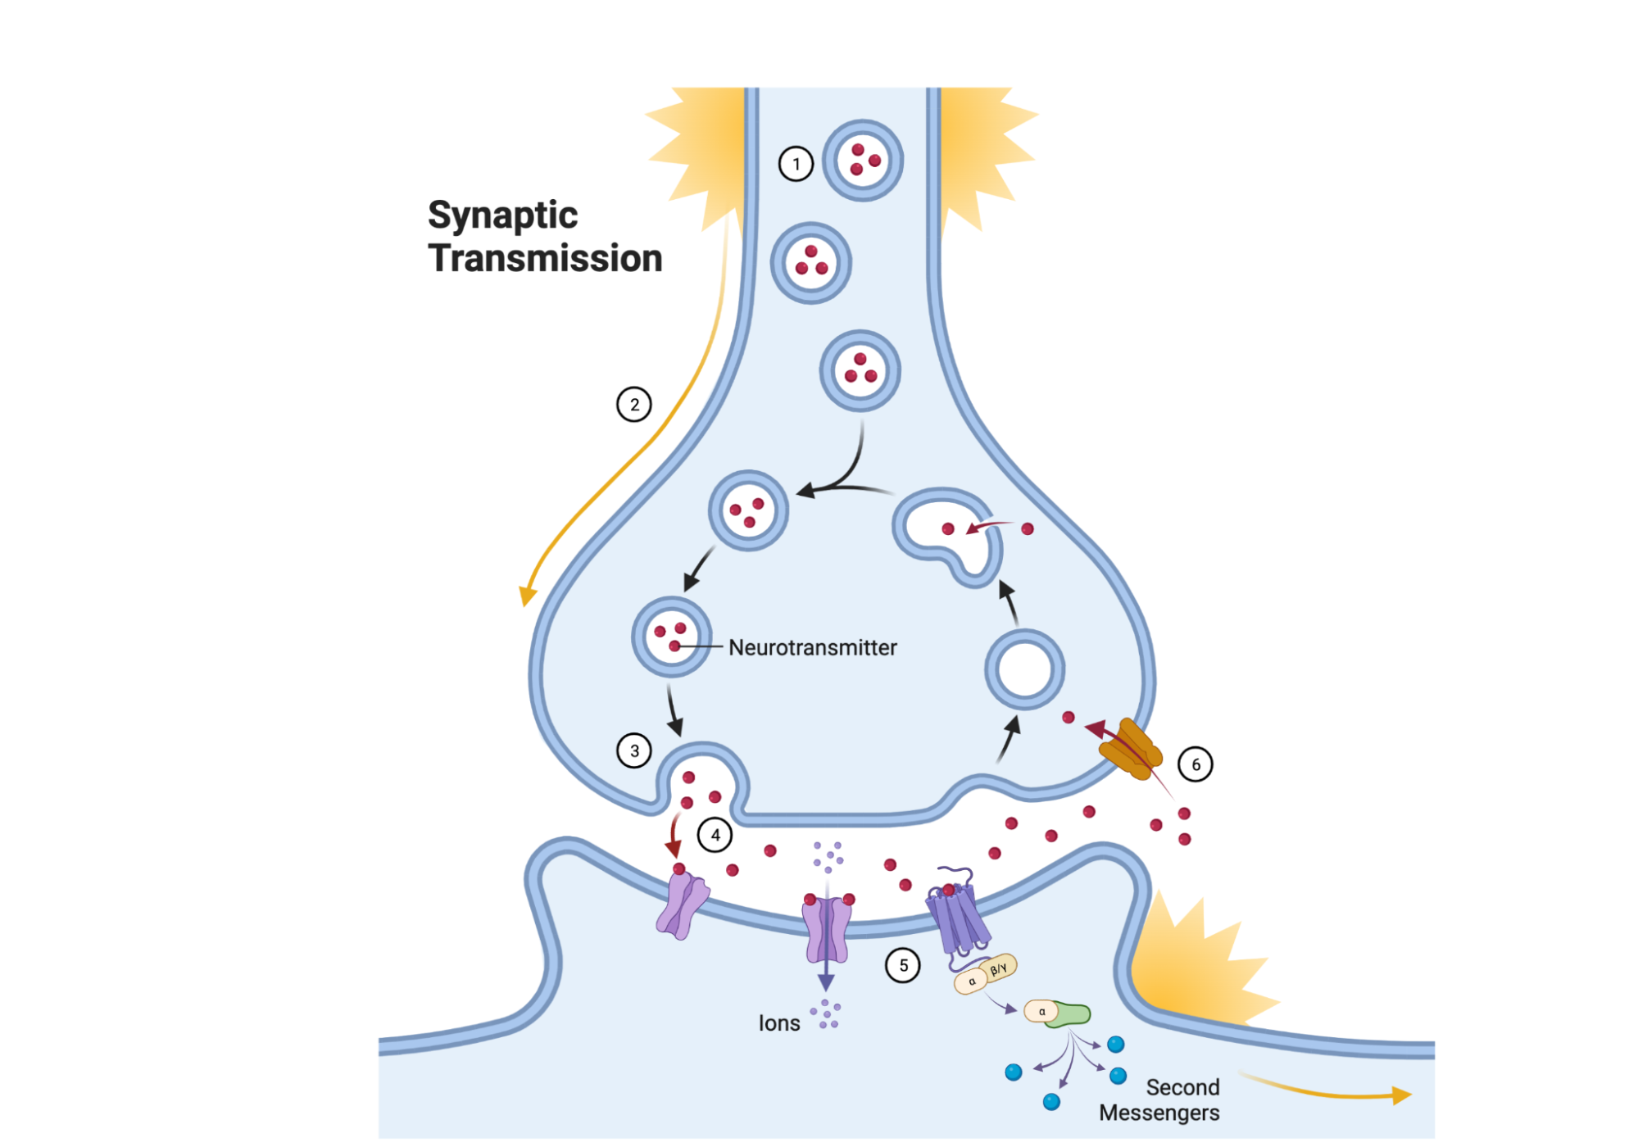
Synaptic Transmission
Synaptic vesicles
Sacs in terminal button that release chemicals into synaptic space
Neurotransmitters
Chemicals released by synaptic vesicles
Receptor sites
Location on receptor neuron for specific neurotransmitter

Slide 17
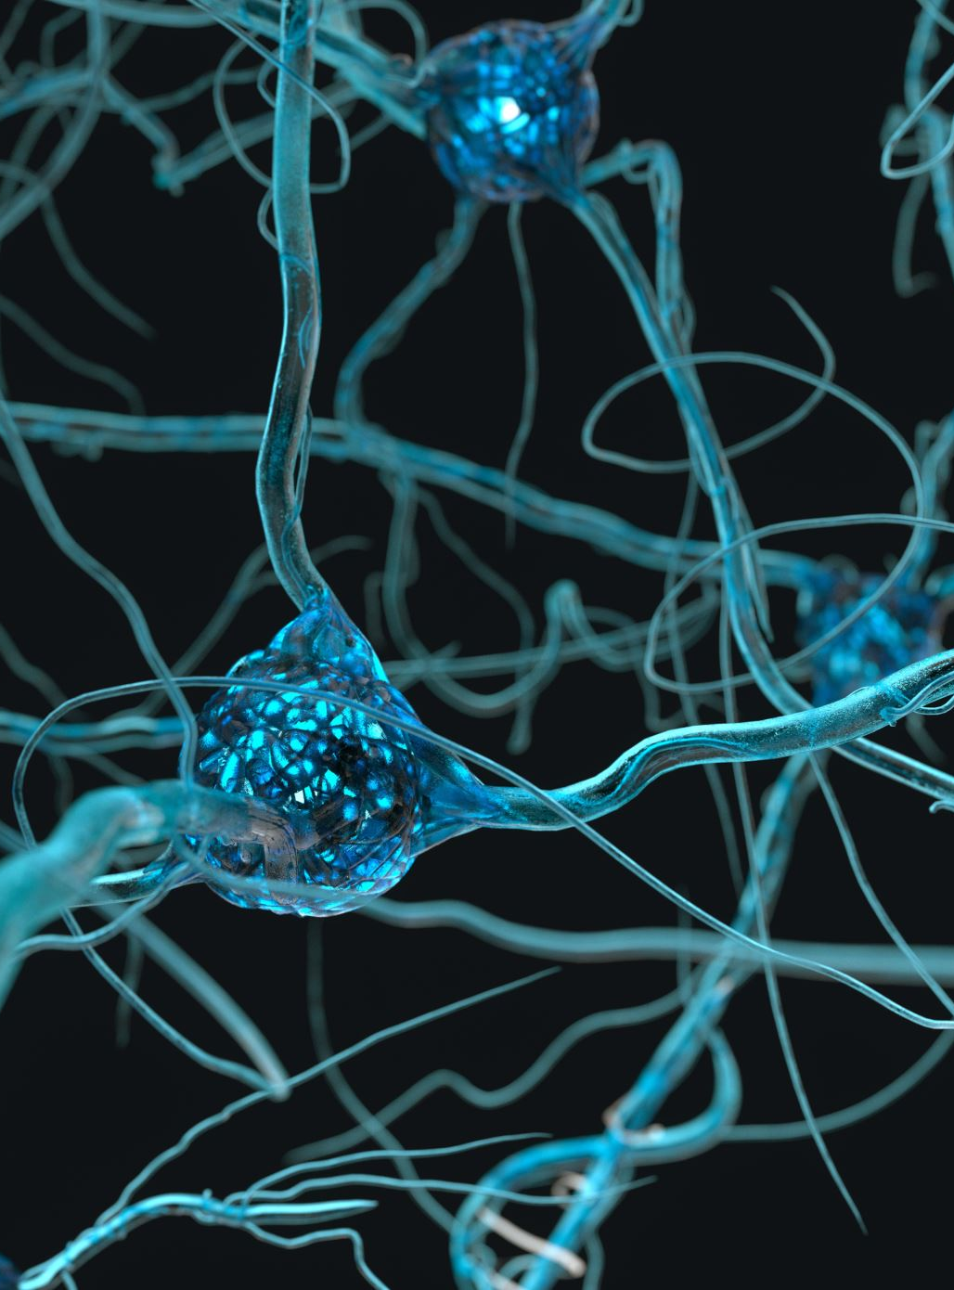
Some Well-Known Neurotransmitters
Acetylcholine (ACh)
Released at the neuromuscular junction
Plays an important role in arousal and attention
Loss of ACh producing cells is linked to Alzheimer’s Disease
Dopamine
Affects neurons associated with voluntary movement
Plays a role in learning, memory, and emotions
Loss of dopamine-producing cells causes symptoms of Parkinson’s Disease

Slide 18
Some Well-Known Neurotransmitters
Serotonin
Found throughout the brain
Appears to sets an “emotional tone”
Low serotonin levels are implicated in depression
Endorphins
Reduce pain by inhibiting or “turning down” neurons that transmit pain information

Slide 19
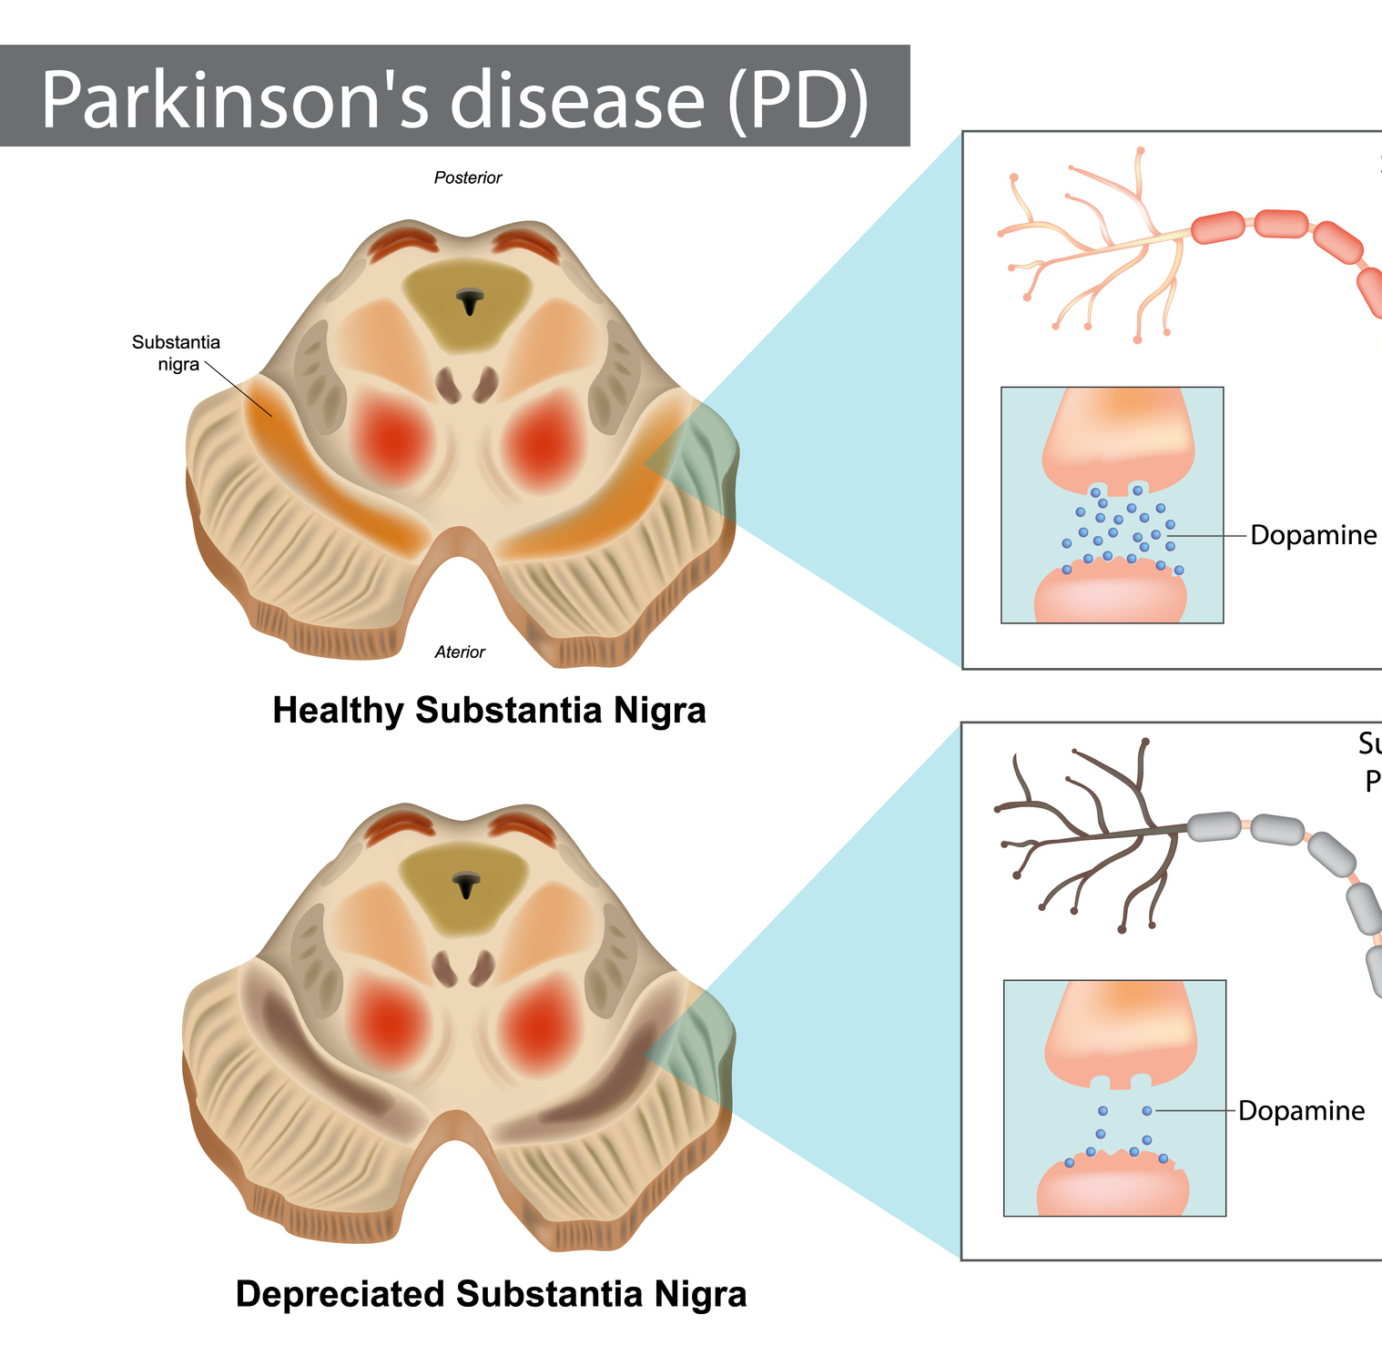
Neurodegenerative disorders
Parkinson’s Disease (PD)
Key Features:
Loss of dopamine-producing neurons in the substantia nigra.
Presence of Lewy bodies (alpha-synuclein aggregates).
Affected Area: Basal ganglia, especially the substantia nigra.
Common Symptoms: Tremor, bradykinesia, rigidity, postural instability, and non-motor symptoms like depression and sleep disturbances.

Slide 20
Stages of Synaptic Transmission
Action Potential Arrival
An action potential travels down the axon and reaches the presynaptic terminal.
Calcium Influx
Voltage-gated calcium channels open, allowing Ca²⁺ ions to enter the presynaptic terminal.
Neurotransmitter Release
Calcium triggers the fusion of synaptic vesicles with the presynaptic membrane, releasing neurotransmitters into the synaptic cleft via exocytosis.
Neurotransmitter Binding
Neurotransmitters diffuse across the synaptic cleft and bind to specific receptors on the postsynaptic membrane.
Postsynaptic Response
Binding of neurotransmitters causes ion channels to open, leading to changes in the postsynaptic membrane potential (excitation or inhibition).
Neurotransmitter Removal
Neurotransmitters are cleared from the synaptic cleft via:
Reuptake into the presynaptic cell.
Enzymatic degradation.
Diffusion away from the synapse.

Slide 21
Drugs for Parkinson’s Disease
Levodopa + Carbidopa
Function: Converts to dopamine in the brain.
Use: Most effective for motor symptoms.
Side Effects: Dyskinesias, "on-off" fluctuations.
MAO-B InhibDopamine Agonists
Examples: Pramipexole, Ropinirole.
Function: Mimic dopamine by stimulating receptors.
Side Effects: Nausea, hallucinations, impulse control issues.
MAO-B InhibitorsExamples: Selegiline, Rasagiline.
Function: Block dopamine breakdown.
Use: Early-stage or adjunct to levodopa.

Slide 22
Drugs for Parkinson’s Disease
COMT Inhibitors
Examples: Entacapone, Tolcapone.
Function: Prolong levodopa's effects.
Use: Reduces "off" periods.
Anticholinergics
Examples: Benztropine, Trihexyphenidyl.
Function: Control tremors.
Side Effects: Dry mouth, confusion.
Amantadine
Function: Reduces dyskinesias, mild motor symptoms.
Side Effects: Swelling, hallucinations.

