Slide 1
Vision

Slide 3
The eye

Slide 4
Retina

Slide 5
Visual field

Slide 6
Visual field

Slide 7
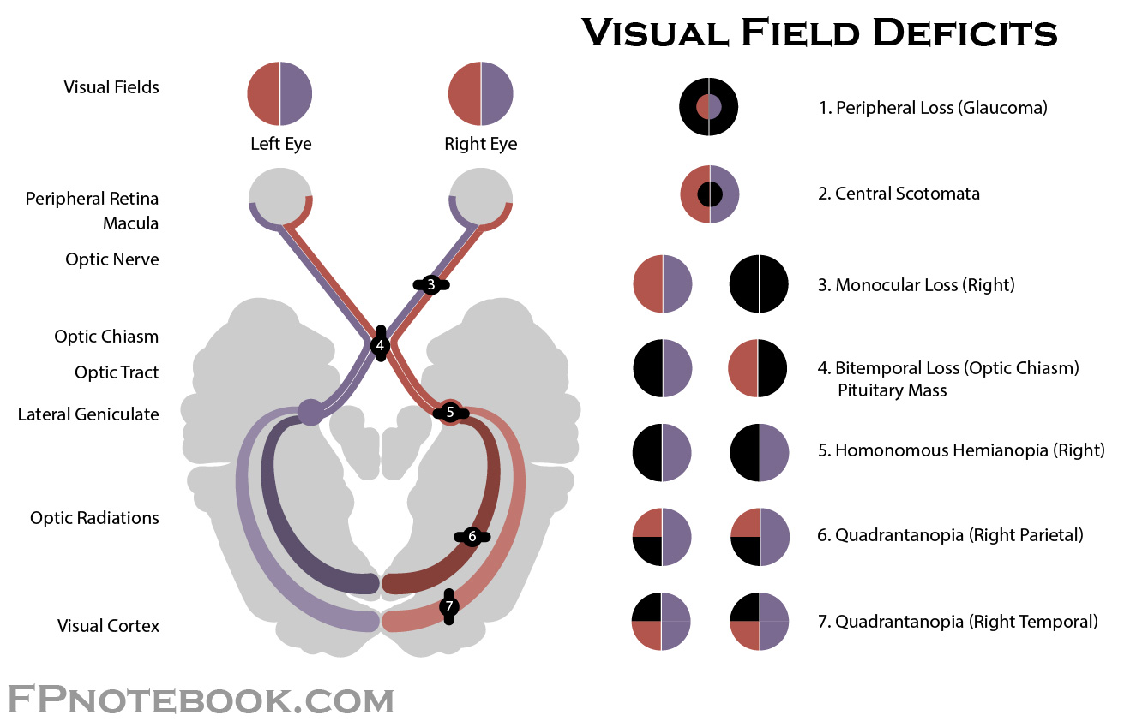

Slide 8
On – Off cells and edge detection

Slide 11
The Hermann Grid

Slide 12
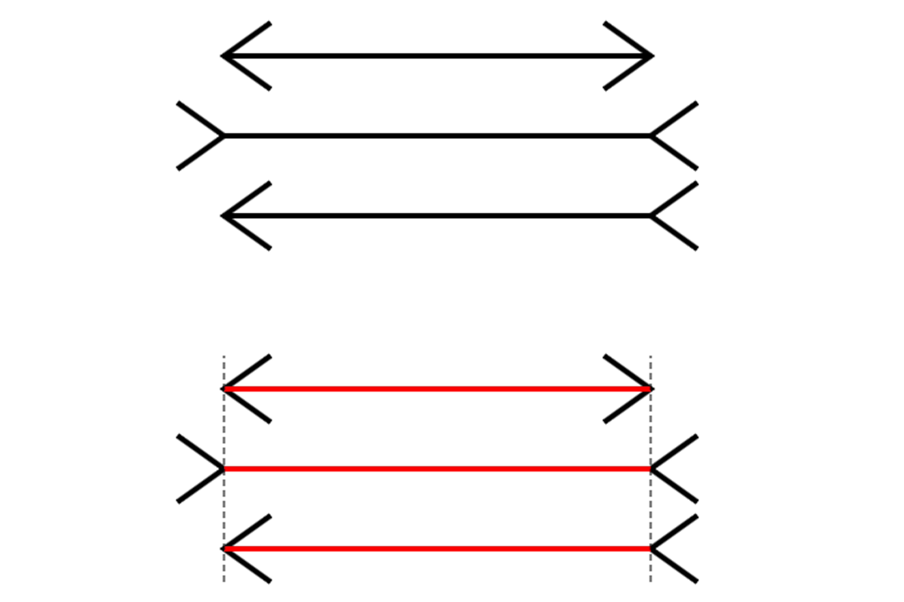
Müller-Lyer illusion

Slide 13
Intermediate processing
Kanizsa triangle
Orientation selectivity
Motion

Slide 14
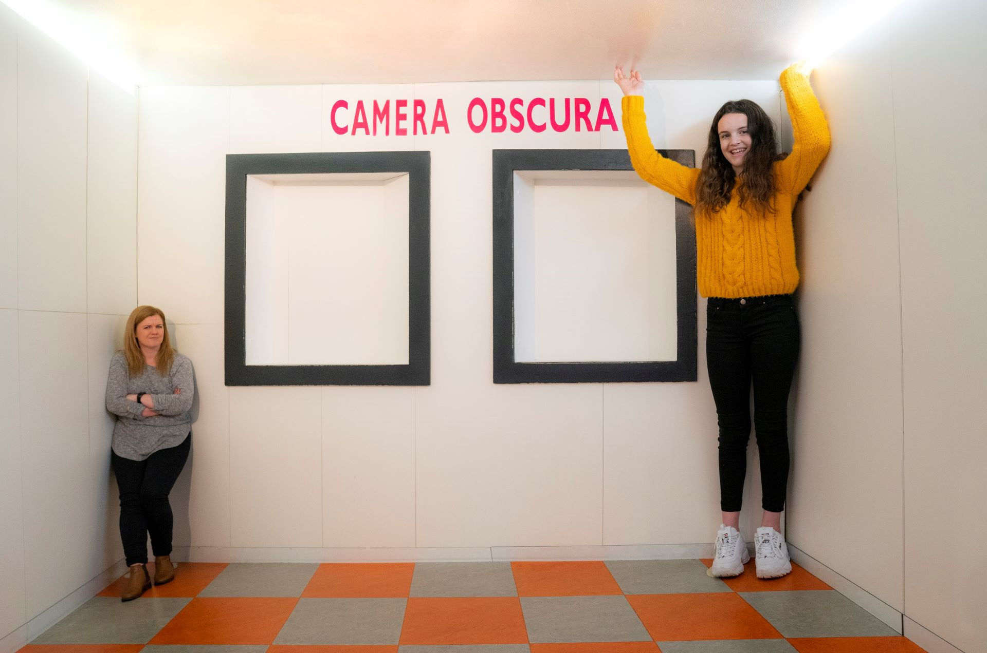
Depth perception
Disparity (stereo)
Monocular cues

Slide 15
High level
Face recognition

Slide 16
Brain waves
Alpha rhythm

