Slide 1
Pablo Picasso
Guernica

Slide 2
Introduction
Guernica is one of Pablo Picasso’s most famous works. Many within the art world consider it as one of the most moving and influential anti-war paintings ever. The piece is currently exhibited at the Museo Reina Sofia in Madrid, Spain.

Slide 3
Why is Guernica so famous?
The artist created this painting from his Paris home in response to the bombings of the town of Guernica by Italian and German warplanes during the infamous Spanish Civil War.
The artwork was first exhibited at the Paris International Exposition of 1937 and put on several world tours to raise relief funds for the victims of the Spanish war. Due to its powerful message, the painting immediately became famous around the world and played a crucial role in bringing the world’s attention to the civil war in Spain. The artwork became a standard for anti-war support and embodiment for peace.

Slide 4
Historical Context of the Painting
The Spanish Republic had approached Pablo Picasso with a request to create an artwork for its exhibition at the 1937 Paris International Exposition. At the time, the Soviet and German pavilions were massive architectural demonstrations of authority and power. Still, the cash-strapped Spanish Republic decided to go for something modest by using powerful modern art.
So the Spanish called upon artists at the vanguard of the 1930s avant-garde, including the likes of Alexander Calder and Joan Miró. In 1937, Pablo Picasso accepted the commission and agreed to create a mural-sized piece for his native country.

Slide 5
Originally, Picasso had a different plan for his painting. What he had in mind was an apolitical piece despite the Spanish Republic insisting that the artwork must convey a strong political statement. The initial idea for the painting was a composition depicting a painter inside his studio facing a naked model lying on a sofa.
But what would happen a few moments in the ancient town of Guernica would change Pablo’s mind and the course of his design.

Slide 6
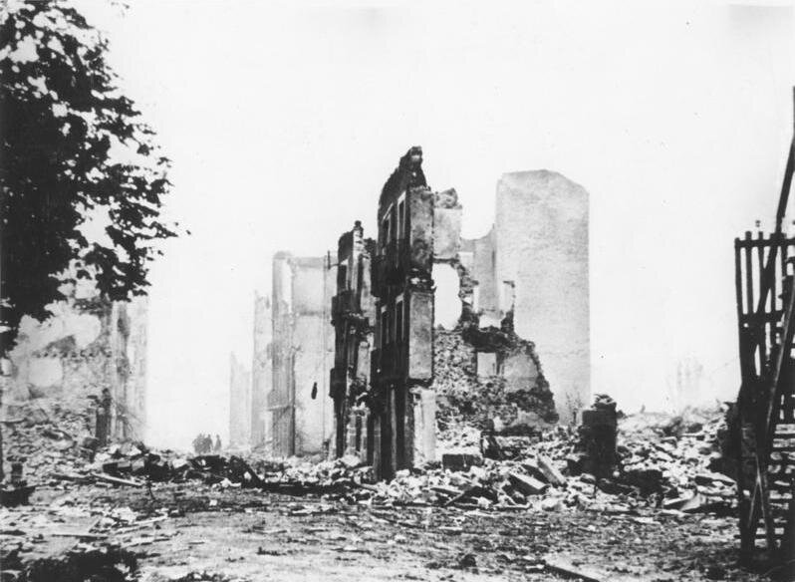
Pablo was a devoted leftist. The bombing of Guernica affected him profoundly, particularly since he received a lot of criticisms for not fighting in World War 1. Several days later, in his Rue des Grands Augustin's studio, Pablo began to work on new sketches for the commission.

Slide 7
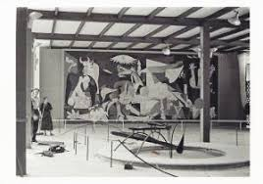
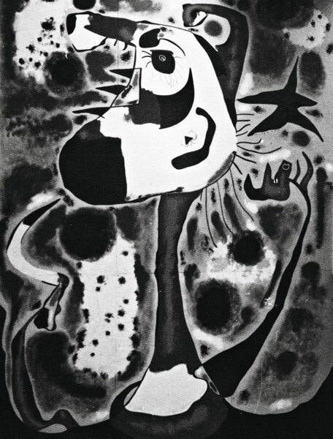
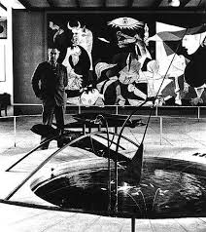
In July 1937, Pablo delivered the completed work to the Spanish Republic pavilion. It immediately became the focus of the exhibition. Guernica was placed in the middle of Calder’s Mercury Fountain and Miro’s The Reaper.

Slide 8
Later in the 1940s, the Fascist Germans invaded Paris.
One officer visited Pablo’s studio and saw a photo of the painting.
“Did you do that?”, he asked Picasso.
Pablo answered, “No, you did.”

Slide 9
Those outside the art world may be wondering what it is about Picasso’s work that moves everyone around the world?
Why is it that many art commentaries still persist on elevating his status as the most influential artist of the past century, even though his work may be mistaken for a drawing of a crayon-crazy 5-year-old?

Slide 10
It is practically impossible to talk about any of Pablo Picasso’s works without mentioning his role in Cubism, Surrealism, and Symbolism and his invention of collage. Above any other medium, Picasso considered himself a painter, even though his sculptures were massively influential and experimented in diverse areas like ceramics and printmaking.

Slide 11
Painting techniques and materials
Though Pablo Picasso is known for his contemporary, abstract work, he had to learn to paint and draw realistically while still very young. His signature style of painting only started to appear when he was around 19 and living in Paris. Beginning with his well-known “Blue Period” and then immediately followed by the “Rose Period,” these phases were named so due to the predominant use of blue and pink colors throughout his work.
Picasso was also famous for discovering less “artistic” paints, such as those used in various industrial applications, and including them to his color palette. He also added some non-art objects. For instance, in Guernica, the artists included pieces of wallpaper for texture as well as some newspaper cuts. Sometimes he would also mix sand into his paints, use sawdust, cardboard, strings, paper, wire, sheet music, fabric and everyday items such as cigarette wrappers and playing cards..

Slide 12
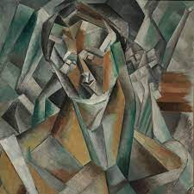
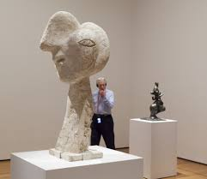
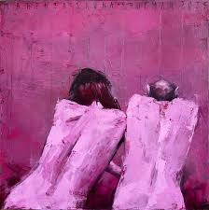
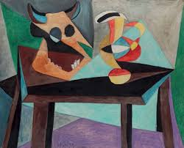
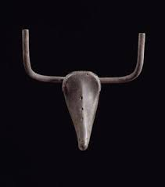
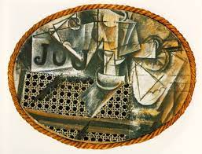
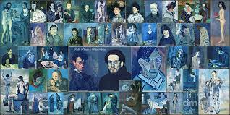

Slide 13
Picasso was once quoted referencing his ever-changing style saying:
It took me four years to paint like Raphael, but a lifetime to paint like a child.

Slide 14
Even though Pablo himself did not like to talk about Guernica’s “meaning” and possibly all of his art, the nationalist symbolism of this painting is undeniable.
If you give a meaning to certain things in my paintings, it may be very true, but it is not my idea to give this meaning. What ideas and conclusions you have got I obtained too, but instinctively, unconsciously, I make the painting for the painting. I paint the objects for what they are.

Slide 15
Guernica is not supposed to have a singular interpretation, as Picasso said.
We all know that art is not truth. Art is a lie that makes us realize truth.
Guernica’s ambiguity and lack of specific historical detail make the painting timeless.

Slide 16
Where is Guernica currently located
Pablo’s wished that the painting must not be returned to Spain until dictator Franco was dead. Apart from Pablo’s personal disdain of Franco’s dictatorship, the painting would have been destroyed if it returned to Spain during Franco’s reign.
After the passing of Franco and many years of negotiations, the Museum of Modern Arts restored the painting to Spain in 1981, to the Cason del Buen Retiro, a branch of the Prado Museum in Madrid, as per the wishes of Picasso. However, Picasso never witnessed the return of the painting to his homeland, as he died in 1973, two years before dictator Franco.
A decade later, the artwork was transferred to the Museo Nacional Centro de Arte Reina Sofia, where it is housed to this day. However, the move defied Picasso’s expressed wish to have the painting placed among the Prado’s great pieces.

Slide 17
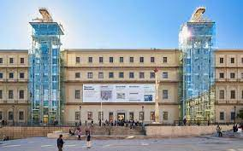
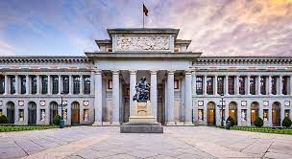
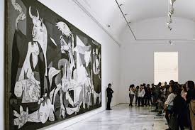

Slide 18
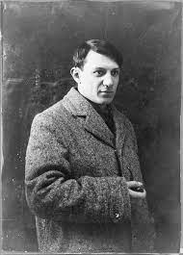
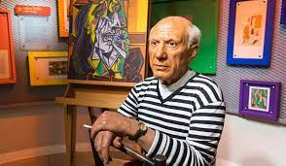
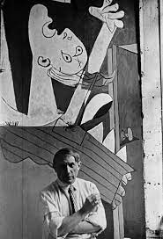
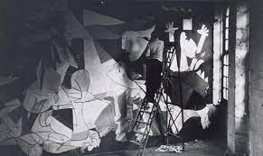
Picasso died in 1973 at the age of 91. He had produced 50,000 works of art, including 1885 paintings, while numerous works by Picasso are masterpieces.

