Slide 1

WRITING A SUCCESSFUL CV

Slide 2
What does the word CV stand for?
CV stands for Curriculum Vitae which is Latin for “course of life”.
A CV is the first thing a prospective employer sees about you.
Employers may take just 30 second to skim a CV and make a decision about whether they want to interview a person. So….

Slide 3
How can you make your CV stand out?
How can you make an employer interested in you?
What can put an employer off from inviting you to an interview?
Play the boss interactive link:
https://interactive.barclayslifeskills.com/module/play-the-boss-student

Slide 4
1. Start strong
Start with a summary of your skills and key accomplishments. This will attract the recruiter and grab their attention from the outset. This personal profile is an important part of your CV and tells the recruiter exactly who you are, so you want to make the right impression.

Slide 5
Personal profile example:
“I am an enthusiastic, hardworking and committed individual with a proven track record of designing websites and creating databases. I have strong technical skills, as well as excellent interpersonal skills. I am eager to be challenged in order to grow and expand on the skillset I have gained through my experience in the IT sector.”

Slide 6
2. Emphasize results rather than responsibilities
Instead of just listing your past responsibilities, make your CV stand out by emphasizing your results, using quantifiable data to show your accomplishments. So for example, instead of saying “I helped to increase social media engagement for Company X”, write “I increased social media engagement by 38% for Company X”.

Slide 7
3. Highlight changes and growth
In your CV you should focus on your personal development. Show how you have grown and changed in your roles, and the accomplishments you have achieved. This will show the recruiter that you have learnt a lot from your past positions, and that you are committed to learning and expanding your skill set.

Slide 8
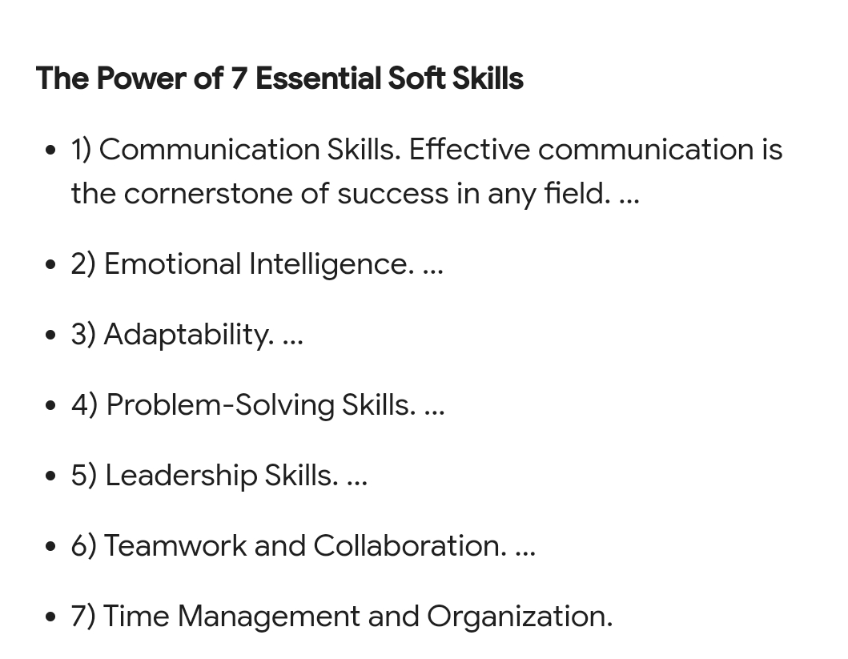

Slide 9


Slide 10

Why your email address matters
Good Practices:
When job searching use an email address that includes your full name, first name / last name, initials, or a minor variation.
If you have a common name or are finding it challenging to create a new email address, try adding a middle name, middle initial, or random number.

Slide 11
Bad Practices:
For both safety and ageism reasons – don’t use your birth year in an email address.
Avoid addresses that include a nickname, hobby, pet’s name, or any other personal information. You don’t want to showcase something that could lead to discrimination or give a wrong impression. And, definitely avoid political, religious, or gender references.
Be aware that where your email is hosted may give off a certain impression too. Hosts such as Yahoo or AOL may open you up to tech-savvy or age discrimination. Although you may disagree, some hiring managers may judge technical relevancy based on your host. Sticking with a Gmail account or other free non-subscription-based providers may be your best bet at keeping these issues at bay.

Slide 12
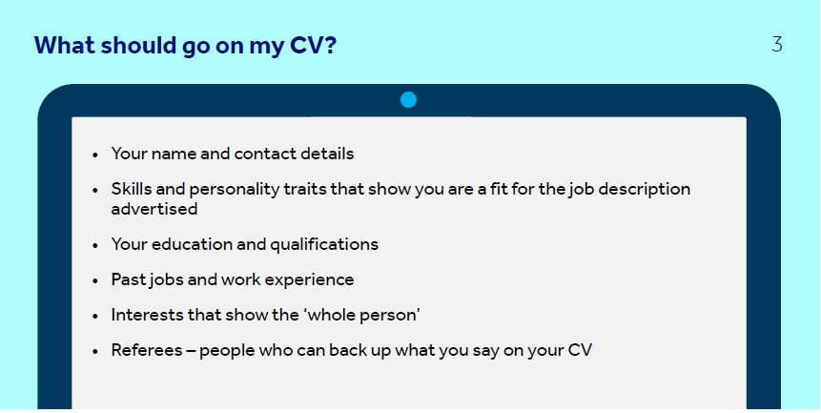

Slide 13
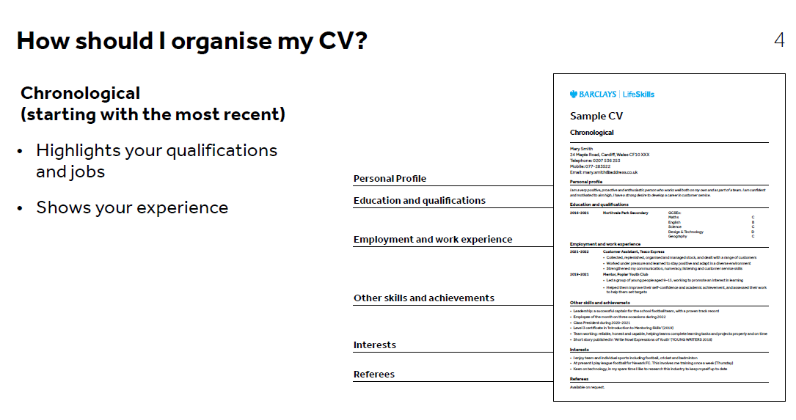

Slide 14
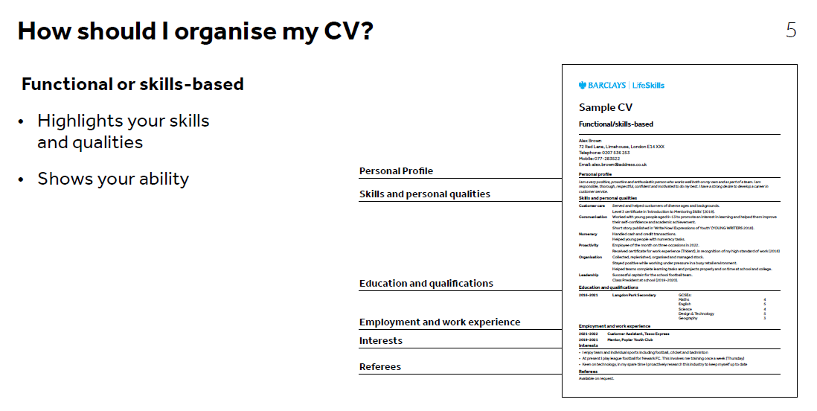

Slide 15
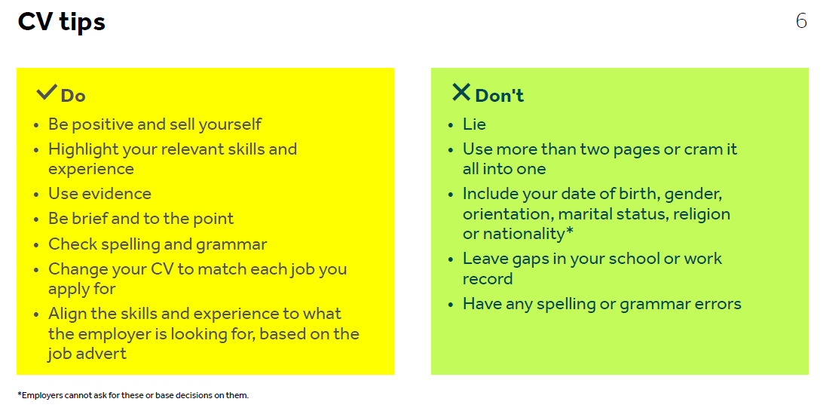

Slide 16
https://www.internhq.com/industries/stem/
https://www.cercaabroad.com/internships-abroad/career-paths/stem/
https://www.gooverseas.com/program-search/intern?f[0]=subjects:1187

