Slide 1
Opinion Essay: Was School Integration the Right Decision?
The Best of Enemies – Essay Ideas & Arguments

Slide 2
Introduction: Introduce the topic and state your opinion clearly.
Body Paragraph 1: Give the first reason and example.
Body Paragraph 2: Give a second reason; acknowledge difficulties.
Conclusion: Restate opinion and final thought.
Useful Phrases:
In my opinion, it was essential to...
One of the main reasons is that...
The film shows that...
Despite the difficulties, integration was a step forward because...
To conclude, I believe...

Slide 3
Introduction
• Present the issue of segregation in the American South
• Mention the historical context (1970s)
• State your clear opinion (e.g. Integration was necessary)

Slide 5
Argument 1: Equal Education for All
• Segregated schools were unfair and underfunded for Black students
• Education is a basic right – everyone deserves the same chances
• In the film, Black students had fewer resources

Slide 6
Argument 2: Building Understanding Between Groups
• Integration allows students from different backgrounds to learn together
• Prejudice comes from fear and ignorance – integration helps eliminate both
• C.P. Ellis changed his views through working with Ann Atwater

Slide 7
Challenges of Integration
• Some white families resisted change
• Black students sometimes faced hostility
• Still, long-term benefits outweighed the problems

Slide 8
Conclusion
• Restate your opinion in a strong way
• Mention the lessons learned from the film
• Integration was a key step towards equality

Slide 9
Solution Essay: Preventing Racism in Schools Today
Ideas and Suggestions for Modern Education

Slide 10
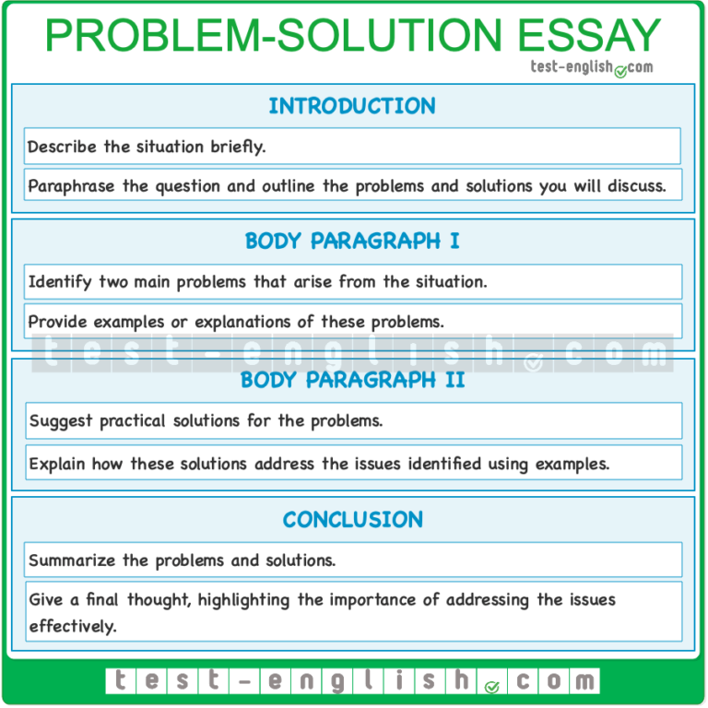

Slide 11
Introduction: Present the problem of racism in schools.
Body Paragraph 1: Identify causes; refer to the film.
Body Paragraph 2: Suggest realistic and meaningful solutions.
Conclusion: Summarize and close with an encouraging message.
Useful Phrases:
One possible solution is to...
Schools should encourage students to...
Another effective approach is...
This could help students understand...
In conclusion, there are several ways to...

Slide 12
Introduction
• Present the issue of racism in modern schools
• Mention that it's still a problem in many places
• State the purpose: suggest effective solutions

Slide 13
Causes of Racism in Schools
• Lack of education about diversity and history
• Influence from home or social media
• Cultural stereotypes and fear of the 'other'

Slide 14
Solution 1: Inclusive Teaching
• Include diverse voices in curriculum (books, history)
• Discuss social issues openly in class
• Use projects that require collaboration across cultures

Slide 15
Solution 2: Anti-Racism Programs
• Invite guest speakers, hold workshops
• Create safe spaces for discussion
• Involve students in awareness campaigns

Slide 16
Conclusion
• Summarize the proposed solutions
• Emphasize the importance of school responsibility
• Promote a hopeful, respectful future for all students

