Slide 1
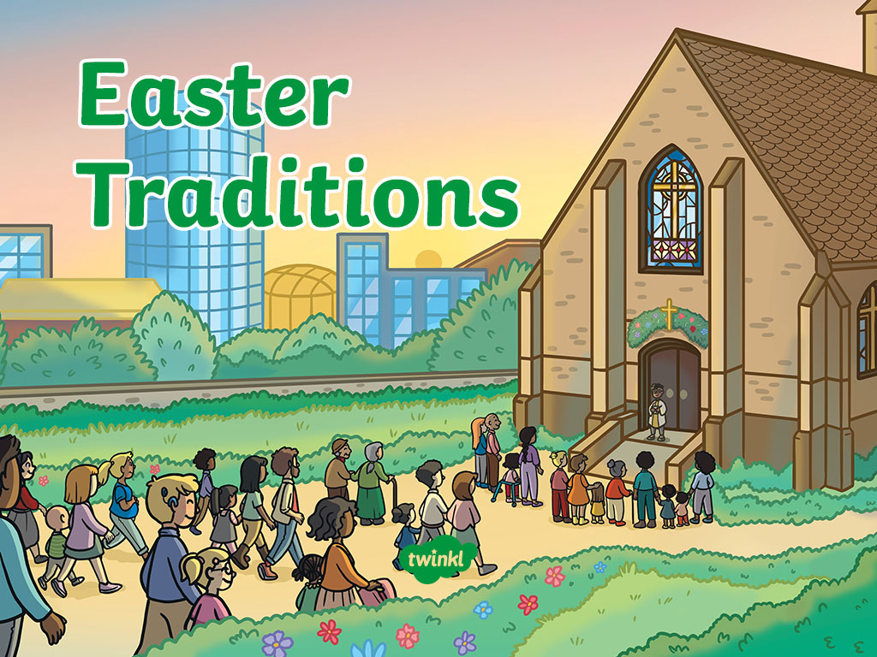

Slide 2
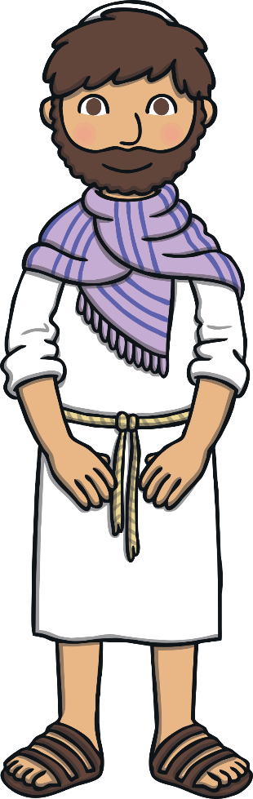
What Is Easter?
Easter is a Christian celebration.
Christians believe that Jesus died on a Friday. Each year, this is remembered on Good Friday.
In the UK, Good Friday is known as a ‘bank holiday’. This means it is a national holiday and lots of businesses and schools are closed.
Christians also believe Jesus returned to life two days later, on a Sunday (the resurrection). Each year, this is remembered on Easter Sunday.
Because of this, at Easter, Christians also celebrate new life.

Slide 3
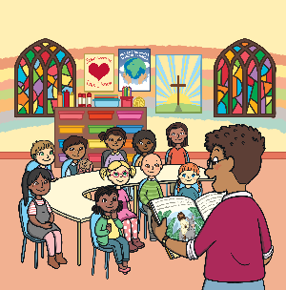
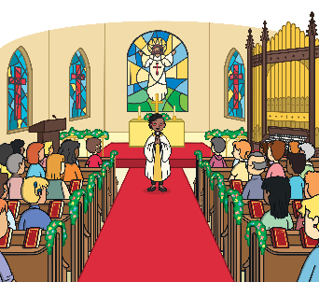
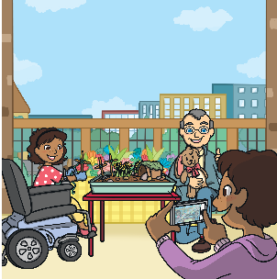
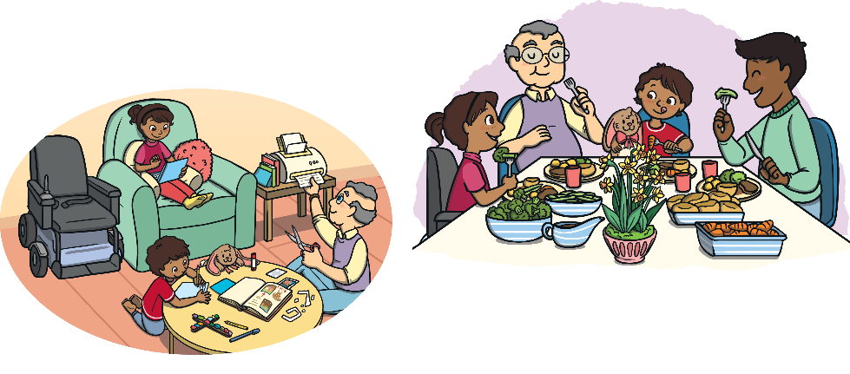
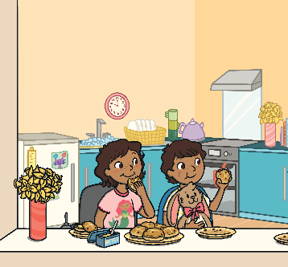
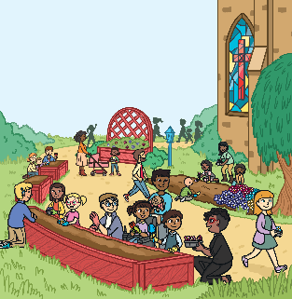
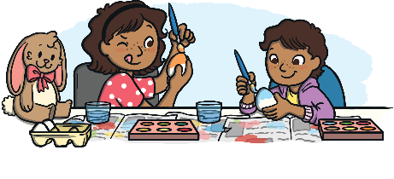
Celebrating Easter
There are many ways Christian people celebrate Easter.
These are just a few Easter traditions.
Read or listen to
The Easter Story
Visit
church
Make an
Easter garden
Decorate
Easter eggs
Eat
hot cross buns
Plant
flowers
Eat a
special dinner

Slide 4
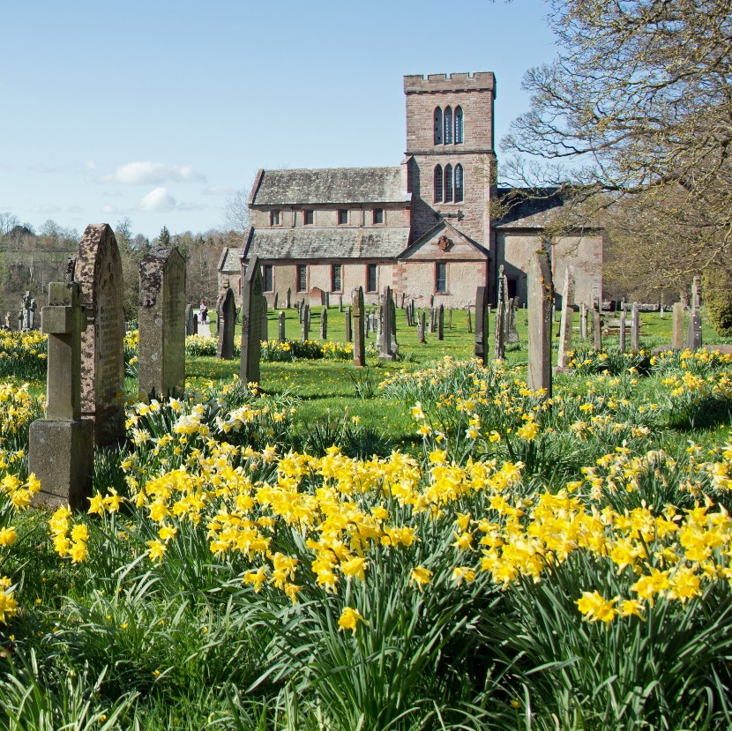
Church
Lots of Christian people will visit church at Easter time.
Some churches will hold a special service at midnight on the night before Easter Day. Some churches also hold a service at sunrise.
At church, Christian people will sing hymns and read special prayers. They will also listen to stories of Jesus’ life or the Easter story.
“Lowther St. Micheal” by [ARG_Flickr] is licensed under CC BY 2.0

Slide 5
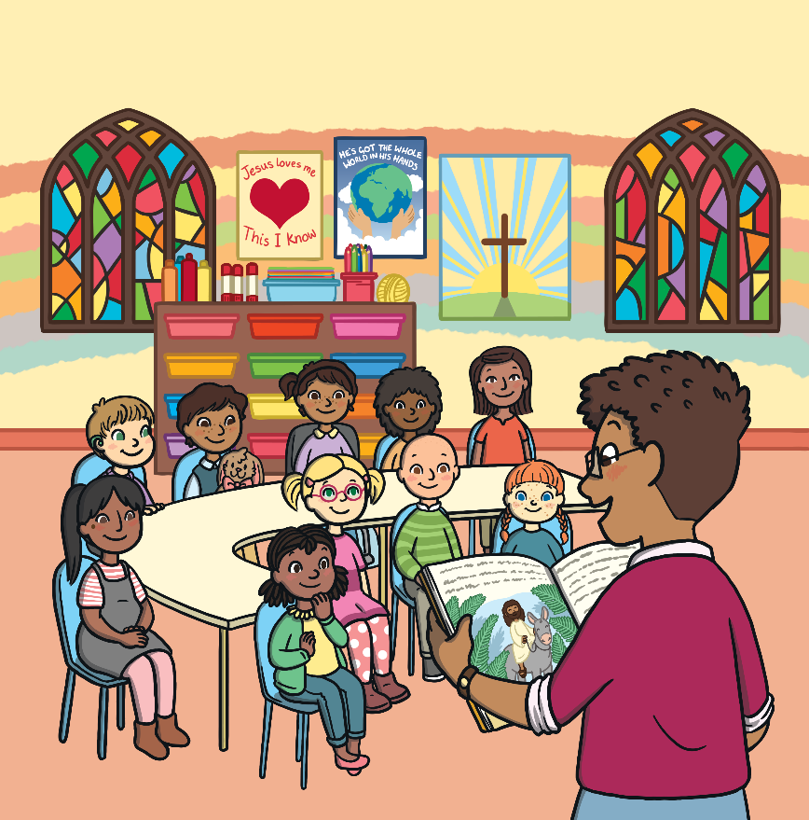
The Easter Story
During Easter, Christian people think about the story of Easter. They might listen to the story at church too.
The Easter story tells of Jesus’ crucifixion on the cross and his return to life (resurrection).

Slide 6
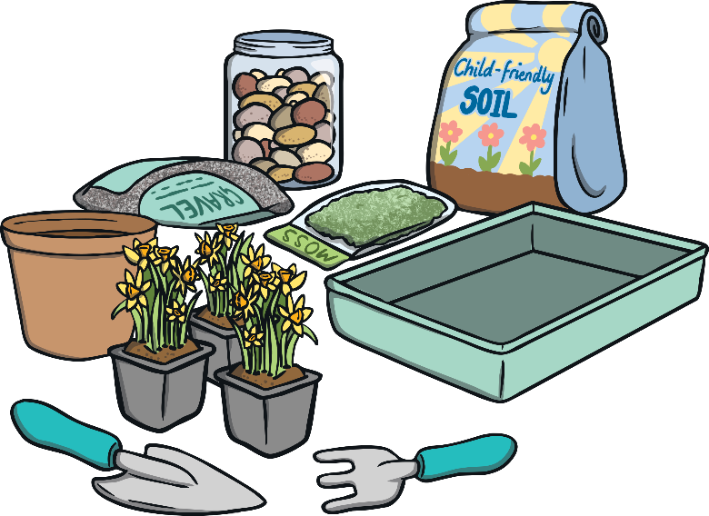
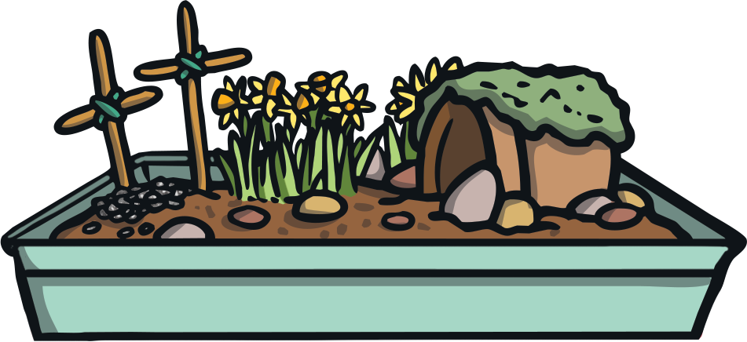
Easter Garden
Some Christian people make an Easter garden at Easter. This is a fun activity to do to help retell the Easter story.
An Easter garden is usually made using a tray, soil, moss, gravel, flowers, a plant pot, sticks and a stone.
Soil and moss is used to cover the tray and plant pot.
The plant pot then acts as Jesus’ tomb.
Sticks are then tied together in the shape of a cross to remind people of the crucifixion of Jesus.

Slide 7
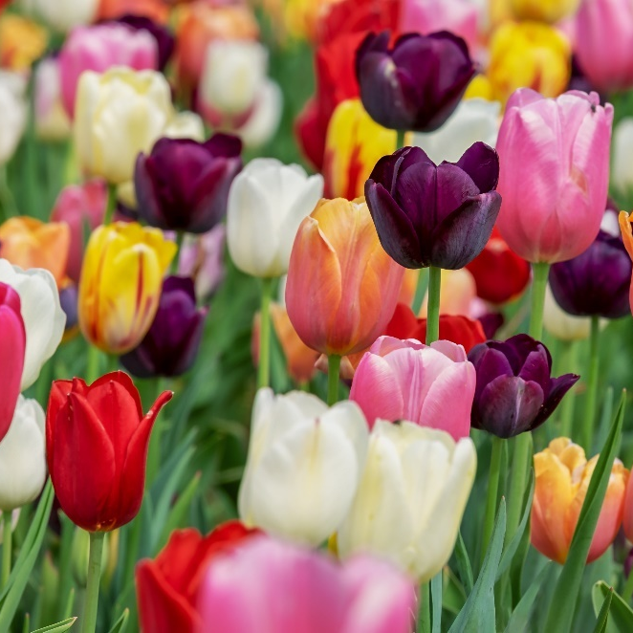
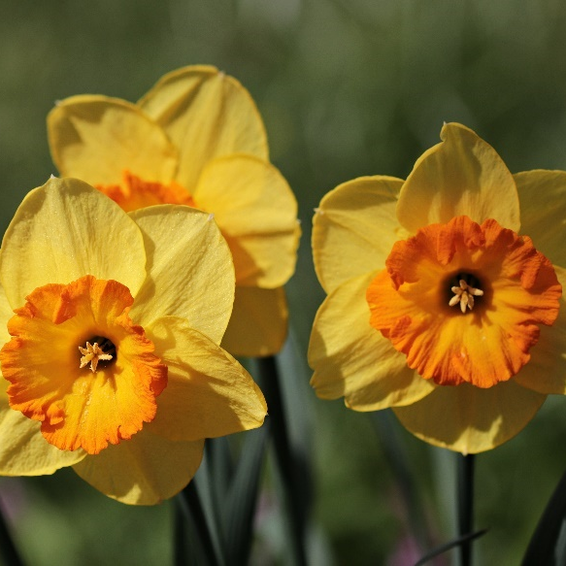
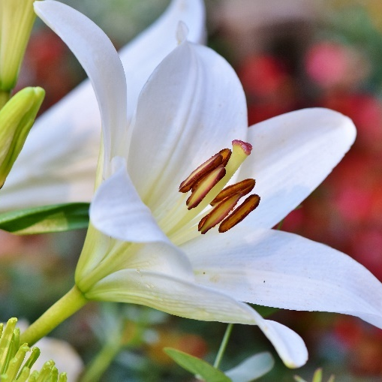
Flowers
Lilies, daffodils and tulips are most often used to decorate at Easter.
Flowers remind people of new life. Christian people will often plant flowers or bulbs at Easter.

Slide 8
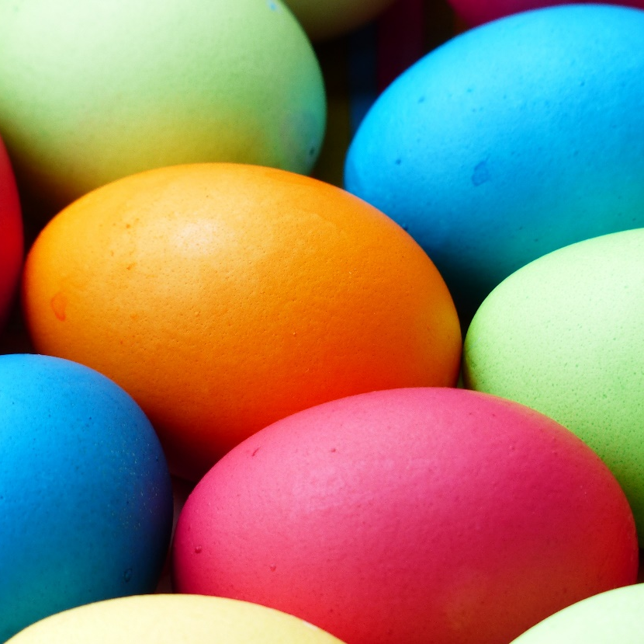
Easter Eggs
Many people celebrate Easter with Easter eggs. A lot of the time, the eggs are made of chocolate but sometimes, they are real eggs.
People will often boil eggs so that they are hard and then they will decorate them using paints or felt-tip pens.
Eggs are an important part of Easter because they remind Christian people of new life. They also remind Christians of the stone used at the entrance of Jesus’ tomb.

Slide 9
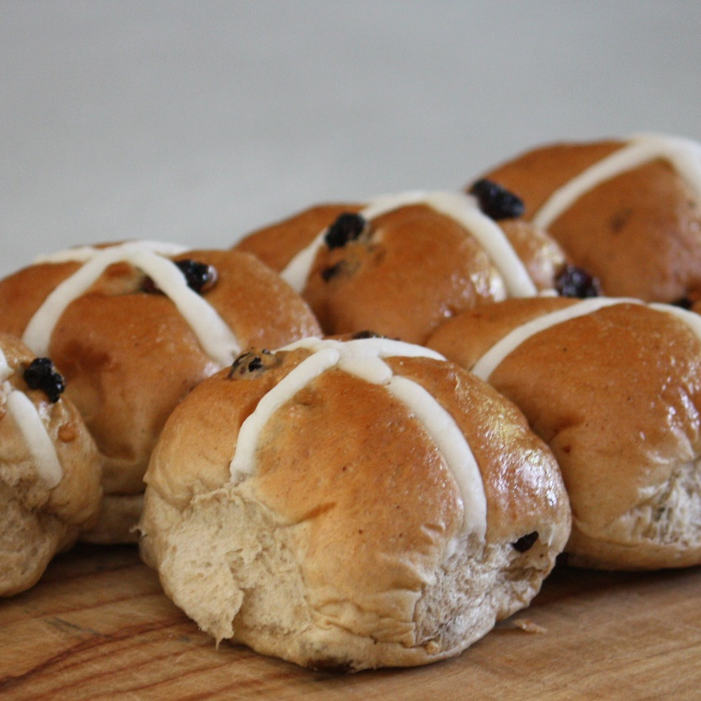
Hot Cross Buns
A hot cross bun is a sweet bun made with spices, currants and raisins.
Normally, hot cross buns are eaten at the end of Lent. This is because they are made with foods that traditionally wouldn’t have been eaten during Lent.
The cross decoration on top of the bun reminds Christians of the crucifixion of Jesus.
It is tradition to eat hot cross buns on Good Friday but lots of people will have them at any time during Easter.
“Hot Cross Bun” by [jemasmith] is licensed under CC BY 2.0

Slide 10

Easter Dinner
Many people will eat a special dinner on Easter Sunday. Usually, family and friends will get together to celebrate.
The dinner is usually a roast dinner with roast lamb, potatoes and vegetables.

Slide 11
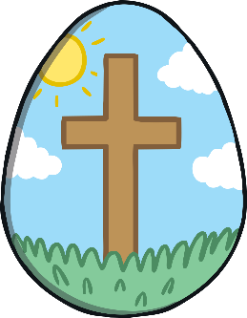
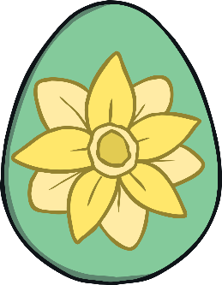
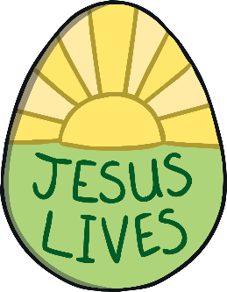
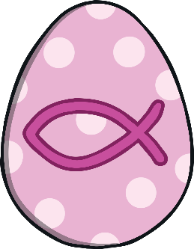
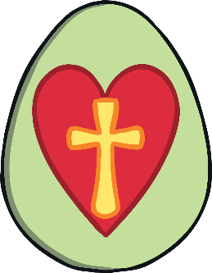
Glossary
Christian a person who follows the religion of Christianity
resurrection when Jesus came back to life
tradition a special activity, repeated over many years
Lent the 40 days leading up to Easter
bulb an underground shoot that grows into a plant

