Slide 1
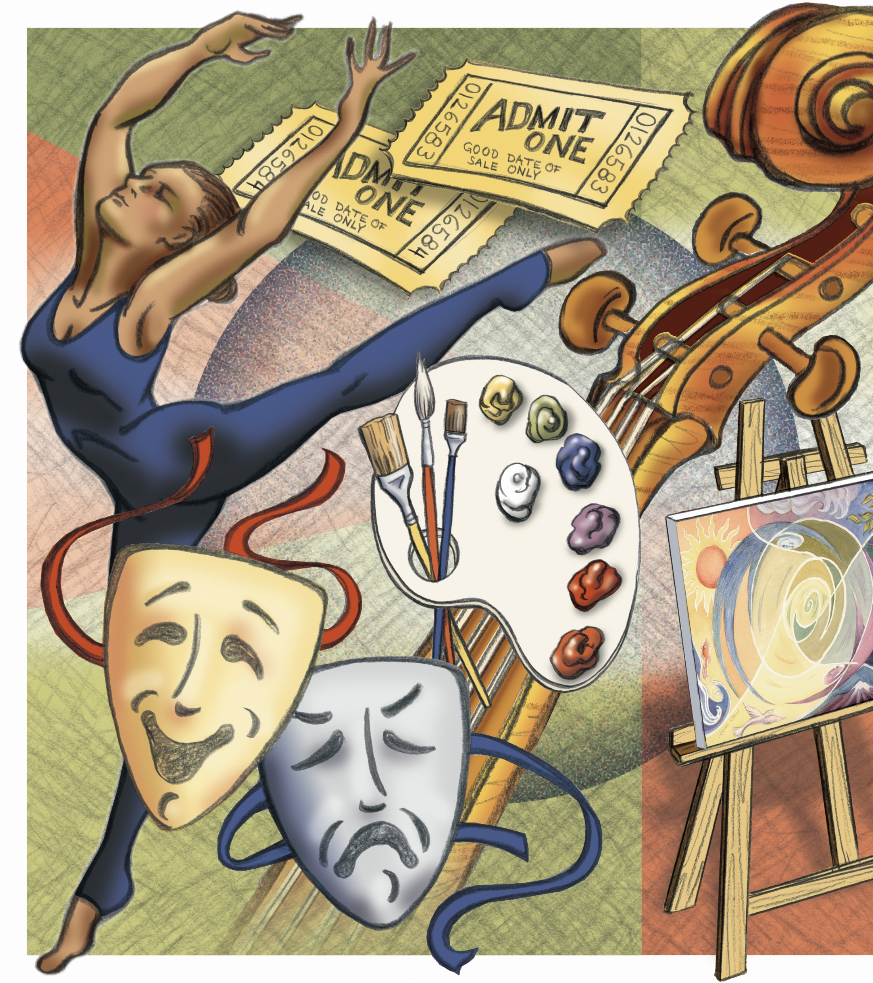

My favourite artist
The voice of a generation
B Class, Kastoreio Junior High School
Creator: Sofia Georgiadou

Slide 2
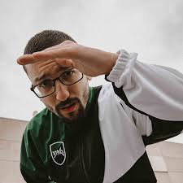
What do you know about him?
Tick the correct statements:
1. He was born in Athens.
2. He has more than 700,000 listeners on Spotify.
3. He used to sing with a band.
• What’s his art?
• Where is he from?
Can you name one of his works?

Slide 3

Pre-reading
Play this WORDWALL game to check what you know: https://wordwall.net/resource/106145801

Slide 4
Worksheet 1: Comprehension &Vocab
In groups read the text about Bloody Hawk.
Then do the activities in Worksheet 1 according to your team’s color.

Slide 5
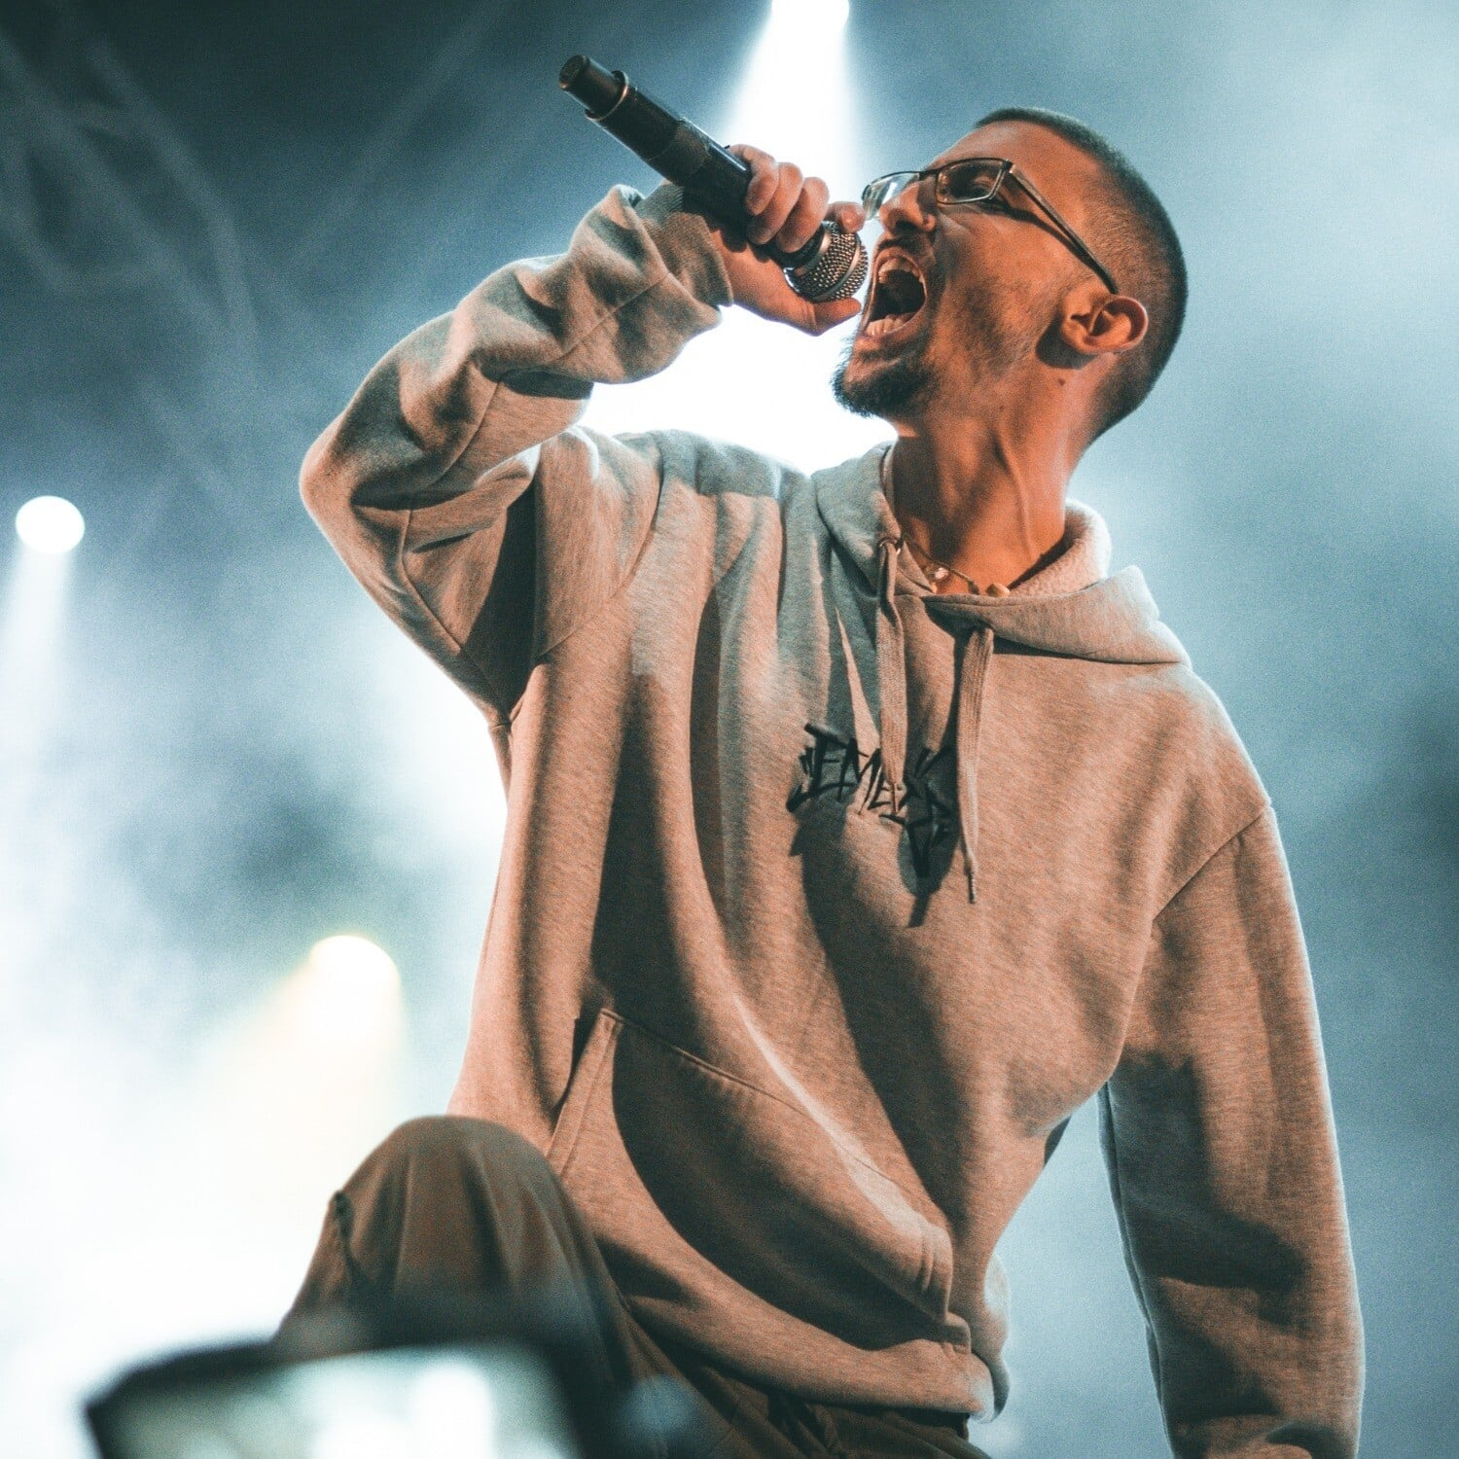
Activity 1: Multiple Choice Activity
Circle the correct answer.
1. Where was Bloody Hawk born?
A. In Athens
B. In Thessaloniki
C. In Xanthi
2. What was he interested in from a young age?
A. Acting
B. Rap music
C. Pop music

Slide 6
3. How did he start his career?
A. He uploaded his songs on YouTube
B. He took part in international competitions
C. He signed a contract with a record company
4. Why did he become popular with young people?
A. His songs focus on the negative side of life
B. His songs focus on the positive side of life
C. His songs focus on life’s difficulties

Slide 7
5. How did his album “Komplexiko” affect his career?
A. It ended his career
B. It had no result
C. It brought him great success and recognition
6. How is Bloody Hawk described in the text?
A. Dedicated and creative
B. Shy and insecure
C. Careless and impatient

Slide 8
Activity 2: True or False
Read the text about Bloody and decide if the sentences are True (T) or False (F).
Bloody Hawk grew up in Xanthi. ________
He came from a rich family. _______
He signed a contract with a record company at the beginning of his career. ________
His first album was “Komplexiko”. ________
His big concert in 2020 was attended by 40,000 fans. ________
Today, he is recognised as a popular artist who inspires young people. ________

Slide 9
Activity 3: Vocabulary
Choose the most appropriate word.
When Bloody was young, he grew up / participated in many music competitions.
Bloody Hawk’s lyrics are not usual, they are unique / interested.
After his album “Komplexiko”, Bloody gained / composed popularity.
His success was the result of hard work and dedication / audience.

Slide 10
5. Many fans recognise / release his unique style and lyrics.
6. Boody’s songs teach us to overcome / attend difficulties.
7. Artists need confidence to collaborate / perform successfully on stage.
8. After his success, he continued to perform / inspire young people through her music.
9. When Bloody Hawk signed / released a contract with a record company, he reached a larger audience.

Slide 11
Worksheet 2: Pre-writing
Read the text about Bloody Hawk one more time.
Then do the activities in Worksheet 2 according to your team’s color.

Slide 12
Activity 1: Sequencing Activity
Put the sentences in the correct order to tell Bloody Hawk’s story. Write 1 for the first event, 2 for the next, and so on.
☐ A. He released his first solo album, “Komplexiko,” and later signed a contract with a record label.
☐ B. He was born in Xanthi and grew up in a working-class neighbourhood, where he became interested in rap music.
☐ C. He began his career by uploading songs on YouTube and participating in local rap competitions.
☐ D. Today, he is recognised as an important figure in Greek hip-hop and inspires young people with his music.
☐ E. Over the years, he collaborated with other artists and performed in major concerts, including one at OAKA in 2025.

Slide 13
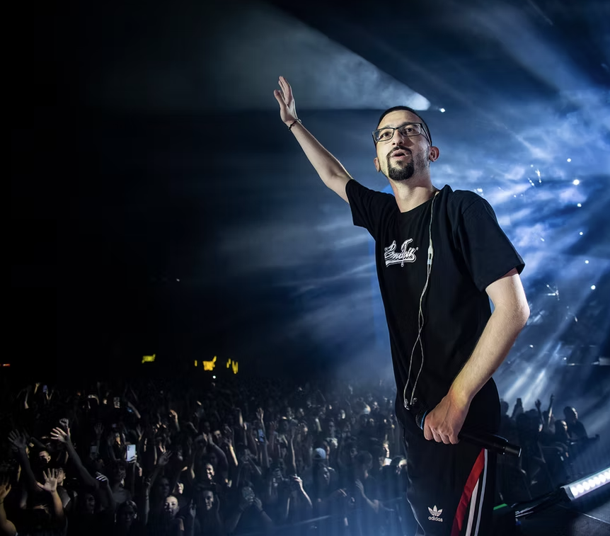
Activity 2: Structure
Write the number of the paragraph next to each title.
______ Achievements
______ Early career
______ Birth
______ Collaborations and concerts
______ Present day

Slide 14
Paragraph number | Linking Words
1st paragraph | From an early age, …
2nd paragraph
3rd paragraph
4th paragraph
5th paragraph
Activity 3: Linking words
Find the linking words that show when and in what order the events happened.

Slide 15
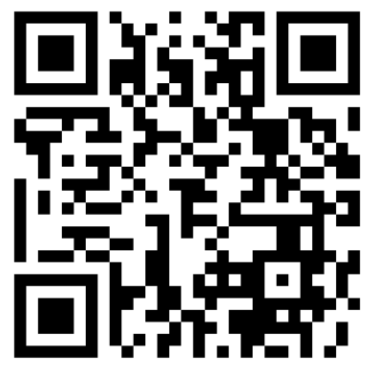
Assessment
Scan the QR code and do the QUIZ about Bloody.

Slide 16

Exit ticket
Answer the questions anonymously, saying what you think about the lesson!

