Slide 1
Conscious
Environmental
Protectors
Online Meeting
14 February 2025 Time: 10-11 CET
Link: https://meet.google.com/uny-ekjj-wvg
GREECE - ITALY - ROMANIA- TURKEY

Slide 2
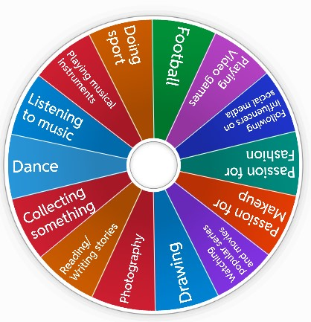
LET’S KNOW EACH OTHER BETTER
Ice- Breaking Activity N 1
When the wheel stops on a topic you're passionate about, please unmute your microphone and share your thoughts
https://wordwall.net/resource/86107202

Slide 3
…🌿 ENVIRONMENT… 🌿
Ice- Breaking Activity N 2
https://www.menti.com/alz7u5ik6vue

Slide 4
…🌿 Welcome to the Energy-Saving Quiz Challenge! 🌿
In this quiz, you will answer fun and simple questions about how we can save energy every day. These tips help us protect the environment, reduce waste, and create a greener future. Get ready to test your knowledge and learn how small actions can make a big difference!
https://wordwall.net/resource/86695391

Slide 5
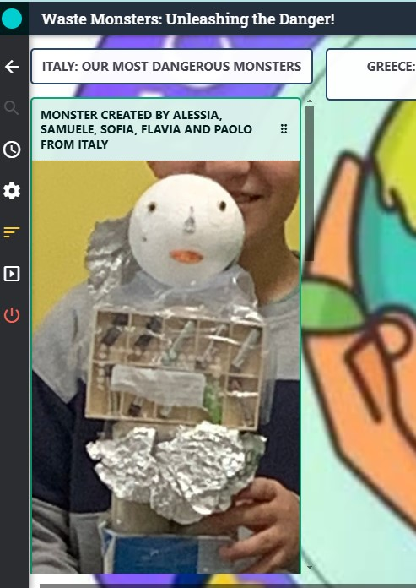
…What’s the most dangerous waste monster?
You've created incredible waste monsters – now, present yours and explain why it's the most dangerous.
https://digipad.app/p/1115635/16f311750fdfe

Slide 6
THE SWITCH OFF CAMPAIGN
HOW CAN WE ENCOURAGE PEOPLE TO SAVE ENERGY?
SHARE YOUR IDEAS! UNMUTE YOUR MICROPHONE OR WRITE IN THE CHAT.
THE LEADING TEACHER WILL RECORD YOUR ANSWERS IN THE BOX BELOW
Slogan,
posters,
paintings,
presentations,
songs,
videos

Slide 7
A BADGE FOR OUR SWITCH OFF CAMPAIGN
2) Which Criteria Should We Use to Award the Badge?
Let's Decide.(unmute the microphone or write in chat)
1) WHICH CHARACTERISTICS SHOULD THE BADGE HAVE?
LET’S DISCUSS (unmute the microphone or write in chat)
Example of badge
who likes and comments at least 3 etwinners’ works
Plants, stars (natural elements),
Add a title like: “you’re a hero”
Write something to invite other people to consume less electricity

Slide 8
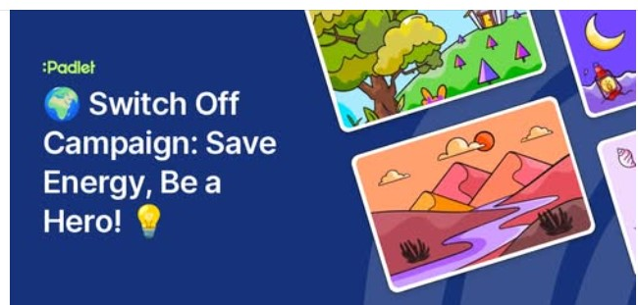
THE SWITCH OFF CAMPAIGN
3) Once you all have created your badge, upload it to Twinspace. And then we will hold a poll to vote for the best badge
Link to the Switch Off Campaign
The members from each partner school will create products for the campaign and will upload them to this Digipad.
Then we will launch the campaign and participants can earn the badge

Slide 9
Are you a wise web user? Play and find out
https://saferinternet.org.uk/safer-internet-day/safer-internet-day-2025/quiz-for-7-11-year-olds
https://create.kahoot.it/share/safer-internet-day-2025/607fe226-f96e-4726-9c7e-02555a567feb

Slide 10
