Slide 1
Άραβες ΙΙ

Slide 2
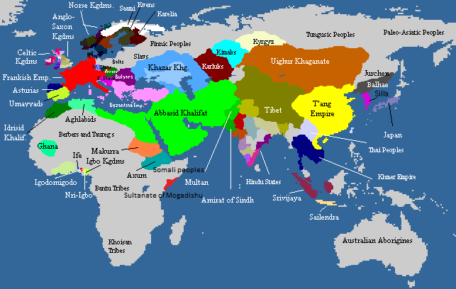
https://thinkafrica.net/abbasid/

Slide 3
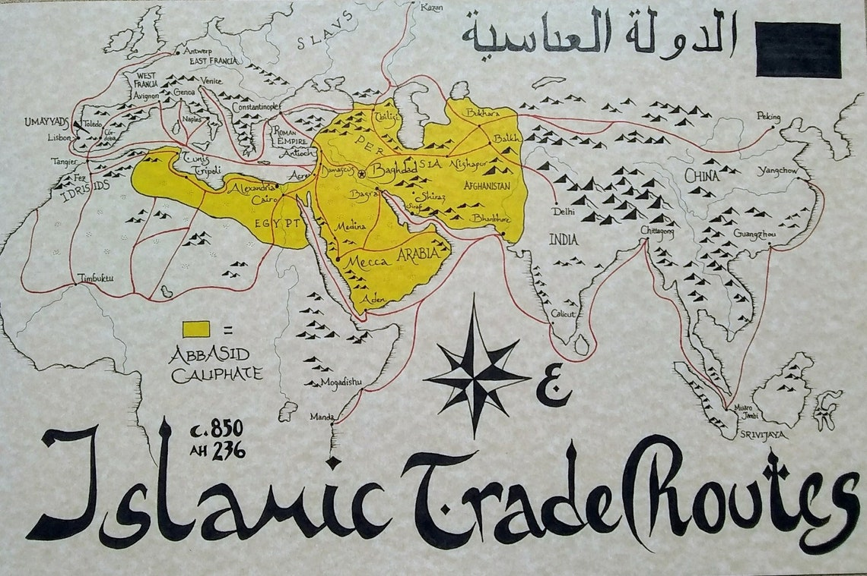
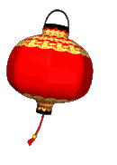
Εμπόριο Αράβων 9^{ος} αι.
https://www.etsy.com/uk/listing/846017435/islamic-trade-routes-map

Slide 4
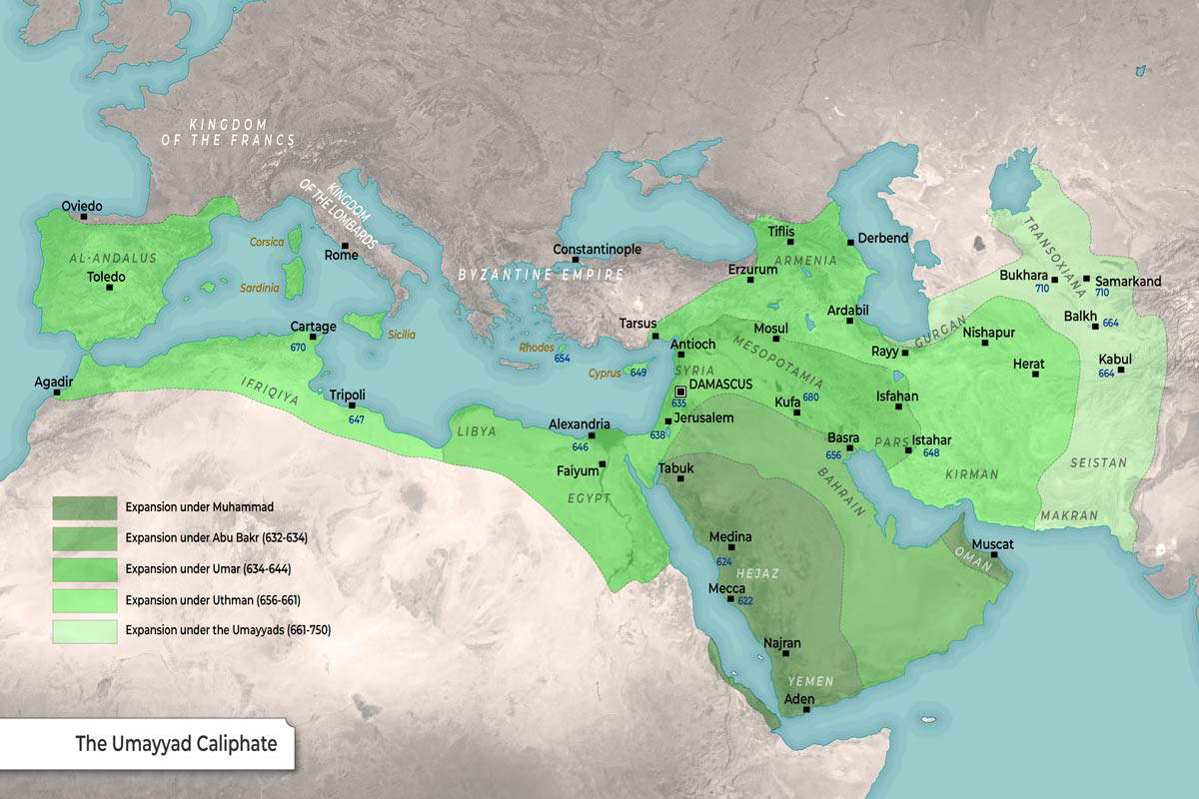
Map: The Umayyad Caliphate provided by <a href="https://www.thecollector.com/">TheCollector.com</a>

