Slide 1


DIGITAL HEALTH
High School of Kastoreio
Lakonia, Greece

Slide 2

Digital well-being: the ways in which we use technology in a manner that benefits us and does not negatively affect our health, psychological well-being, and relationships
More specifically:
Balance in device use: mobile phones, computers, social media
Healthy habits: limiting screen time, avoiding excessive information exposure
Safety & protection of personal data
Mental health: no anxiety, FOMO, or addiction
Good use of technology: productivity, learning,wise communication

Slide 3
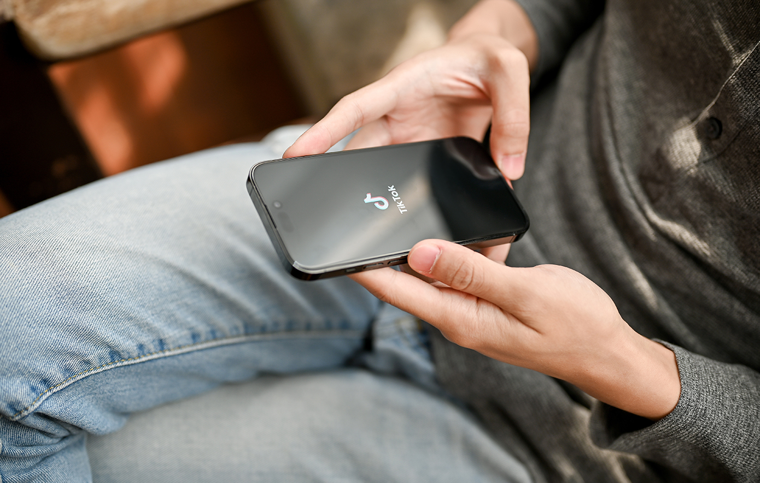
Why digital health matters:
• Mental health: excessive social media use is linked to anxiety, stress, and low self-esteem
• Productivity: constant distractions reduce focus and efficiency
• Relationships: screens can distance people when they get “lost” in them
• Sleep: screen use before bed affects the sleep cycle
• Physical health: prolonged sitting and eye strain

Slide 4
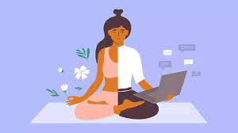
How Our Digital Well-Being Is at Risk
• Excessive screen time → fatigue, headaches, disorientation, reduced social interaction
• App and social media addiction → platforms are designed to keep users engaged
• Negative impact on mental health → comparison, cyberbullying, FOMO
• Poor sleep → blue light delays melatonin production
• Poor posture and physical problems → text neck, back pain, wrist strain
• Personal data risks → oversharing, phishing, account breaches

Slide 5
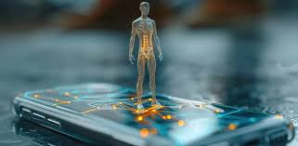
🔐 What does “Online Safety” mean for Digital Well-Being?
Online safety supports digital well-being because it:
Protects our personal data
Reduces anxiety from risks (hacking, scams)
Maintains mental stability when using social media
Protects us from misinformation, harmful contacts and cyberbullying

Slide 6
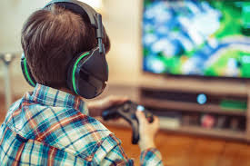
Main Online Risks
• Phishing (fake emails/links that steal passwords)
• Account breaches
• Malware (viruses, spyware)
• Oversharing personal information
• Cyberbullying & harassment
• Addiction and excessive use of social media or gaming

Slide 7
Practical Ways to Stay Protected
Strong passwords:
• Mix of letters, numbers, symbols
• Different password for each app
• Use of 2FA (Two-Factor Authentication)
Protect personal data:
• Avoid sharing personal information publicly
• Check privacy settings on social media
Be careful with suspicious links:
• Do not open emails/messages from unknown senders
• Verify addresses and senders
Deal with cyberbullying:
• Do not respond
• Report it
• Speak to an adult /authority
Healthy screen use:
• Set screen time limits
• Avoid phone use before sleep
• Take regular breaks for eyes and posture

Slide 8
How to recognize fake news:
Check the source. Is it known and reliable?
Read the full article (sensational headlines may be clickbait)
Check the date (old news may be presented as current)
See if other reliable media report it
Check writing quality (many mistakes or extreme tone are warning signs)
Verify images: use reverse image search (Google or TinEye)
Look for evidence (sources, statistics, experts)
Be cautious of strong emotional reactions (anger, fear, shock, hate): often intentional to encourage sharing without verification

Slide 9
Physical health
  Eye strain (blurred vision, dry eyes, headaches)
  Poor posture (neck, back, shoulder pain)
  Sleep disturbances from blue light
Mental health
  Increased anxiety and stress
  Reduced concentration & attention span
  Device addiction / difficulty disconnecting
Other
  Reduced real-life social interaction
  Lower academic performance due to poor concentration
  Security & privacy risks (data leaks, misinformation)

Slide 10
Practical solutions for healthier screen use
• Short breaks → rest for eyes & body
• Turn off the notifications → less stress
• Usage limits → more real social interaction & time for other activities

