Slide 1
Smartphone Screen Detox

Slide 2
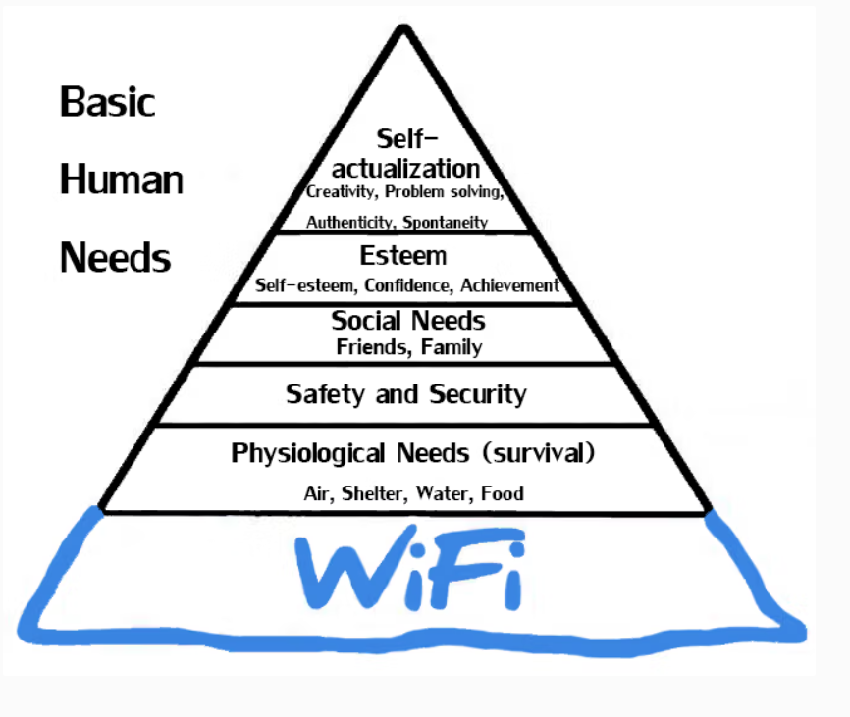
What do you think this picture is about?
Do you identify with the picture?
How often do you check your social media?
Do you think you’re addicted?

Slide 3
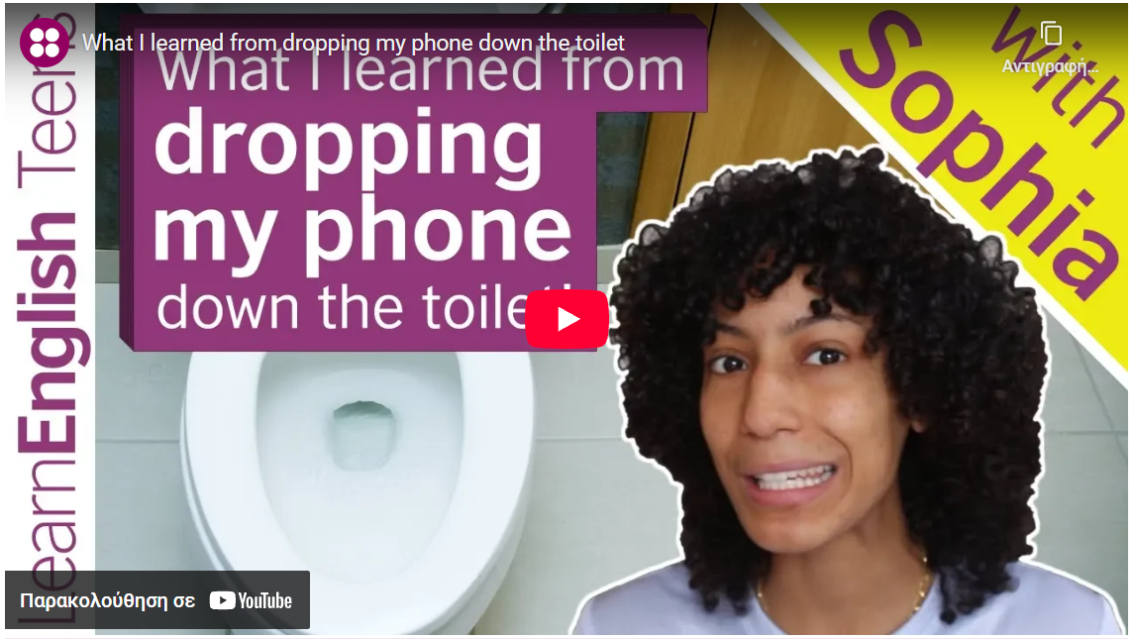
Watch Sophia talking about what she learned from dropping her phone down the toilet and answer the pop-up questions!
https://edpuzzle.com/media/696b6facba8b64ffdc7410a7

Slide 4
Jigsaw Reading
Φύλλο εργασίας 1
Read the text in groups. The red group reads the red part, the green group reads the green part and the blue group reads the blue part.
Fill the respective part of the table with the missing information.
Present your findings to the rest of the class.

Slide 5
Question | Key information from the text
Red Group | The Problem
1. How much time do teens spend on screens? (approx.)
2. Name two negative effects of excessive smartphone use.
Green Group | The Balance
3. Why aren’t smartphones considered completely negative?
4. What is a “phone-free zone”? Give one example.
Blue group | The Solutions
5. Mention two detox strategies from the text.
6. What is the final message about smartphone control?

Slide 6
Vocabulary Practice
Play this WORDWALL to practice the text’s vocabulary:
The words are highlighted in your text!
https://wordwall.net/resource/105695292

Slide 7
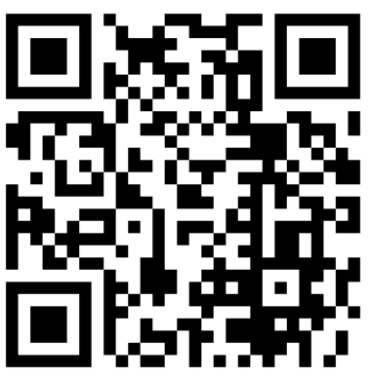
Evaluation (in groups)
Scan the QR code with your tablet and do the quiz!
Don’t forget to write your Group’s name (Red group, Green group, Blue group) before your start!

Slide 8
Evaluation 2: Find a slogan!
Φύλλο εργασίας 2
In groups, think and write one slogan that better represents your part of the text (red, green or blue). Your slogan will be used in a screen DETOX campaign addressed to teenagers.
RED GROUP: ………………………………………………….
GREEN GROUP: ………………………………………………
BLUE GROUP: …………………………………………………

Slide 9

Exit ticket
Answer the questions anonymously, saying what you think about the lesson!

