Slide 1
A message in a bottle
ΑΓΓΛΙΚΑ Β΄ ΓΥΜΝΑΣΙΟΥ

Slide 2
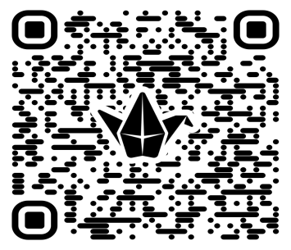
Padlet Link and QrCode
https://padlet.com/eleni_venianaki86/padlet-3ihi0iwic9ryqbim

Slide 3
Look at the photo below. What do you see in this picture? What crosses through your mind when you see this picture?
Have you ever found or sent something like that? If yes, where were you? Did you ask for help or lend a hand?
What do you think someone would write in a message in a bottle?

Slide 4
Reading
Today we are going to become STORY EXPERTS!! Each group is going to read a different story written for a competition with the topic “Message in a Bottle”.
a. Can you give a title to your story?
b. Now, read the story again and fill in the chart that follows with the information from the story. Don’t forget that you have to fill in the gaps only for your story!
c. Now, a member of each group, will share their story with the whole class while the members of all the other groups are taking notes. Your goal is to complete the table with key information about all five stories.
Feel free to ask questions to your classmates if you need explanations!!!

Slide 5
Stories | Setting | Main Characters | Problem and Events | Ending / Feelings
Story A
Story B
Story C
Story D
Story E

Slide 6
Use these questions to help you:
Where does your story take place?
Who are the main characters?
What was the main problem?
What happened after the bottle was sent/found?
How did the story end?
How did the characters feel at the end?

Slide 7
Speaking Task
Now, a member of each group will share their story with the class while the members of all the other groups are taking notes. Your goal is to complete the table with key information about all five stories.
Feel free to ask questions to your classmates if you need explanations!!!

Slide 8
Writing Task
a. Can you give an alternative main body and ending to your story? You can also change its title depending on the twist you add to your version of the story.
Scan the QrCode and post your story on Padlet!!!!

Slide 10
Writing task
b. Read the stories of your classmates on Padlet and make them comments. You can use the Evaluation Criteria and the Peer- Evaluation Criteria to help you!!!

Slide 12
This piece of writing was: __________________________________________________________________________________________________________________________________________________________________________
The part I liked the most was: __________________________________________________________________________________________________________________________________________________________________________
This piece of writing can be improved by: __________________________________________________________________________________________________________________________________________________________________________

