Slide 1
MY SCHOOL- ARSANIO LYCEUM
eTwinning project “Slow healthy living” 2020-21

Slide 2
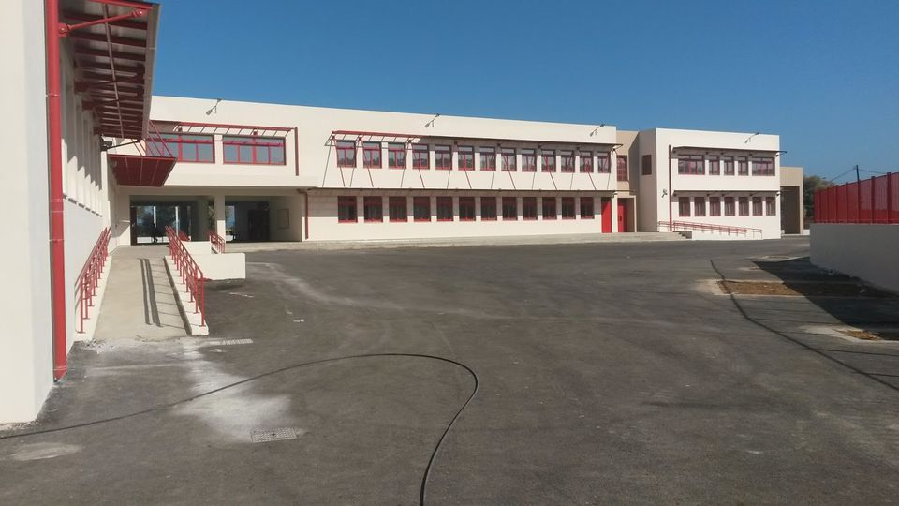
My school is located in Sfakaki in Rethymno. It's red and white it has a huge playground, a basketball pitch and it has 110 students. I really like my school, because the environment is really friendly and most of the professors are kind, caring and nice. I would also like to add that school classes are fully equipped and modern. They are clean, the walls fully painted, the radiators work as they have to. One thing I really like and find interesting is that, the school has different classes for chemistry, physics, physical education and for theater classes if you want to count it as a lesson, The last thing I want to mention is that we are taking part in programs and European projects or even we start are owns with a specific purpose. To sum up, I really like my school and i think that it's easily one of the best and organized in Rethymno, I am glad I am a student of this school.

Slide 3
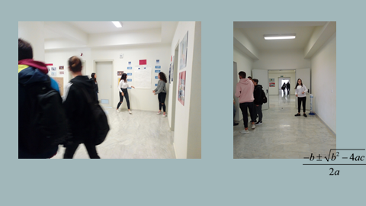
My school is located in Sfakaki, Greece . It’s a big building with two roofs, painted red and white . There are classes for every subject like Maths ,Chemistry ,Physics , English, Greek, Social studies and Computer science. My favourite thing about my school is that it has a football court , a volleyball court , a basketball court and inside our school an amphitheatre, an Erasmus+ room, a lending library and a table tennis area . Moreover, we have some kind teachers that I love and enjoy having lessons with them but also we have some teachers that they aren’t so kind and I don’t like having lessons with them. All in all , I like everything about my school!!!

Slide 4
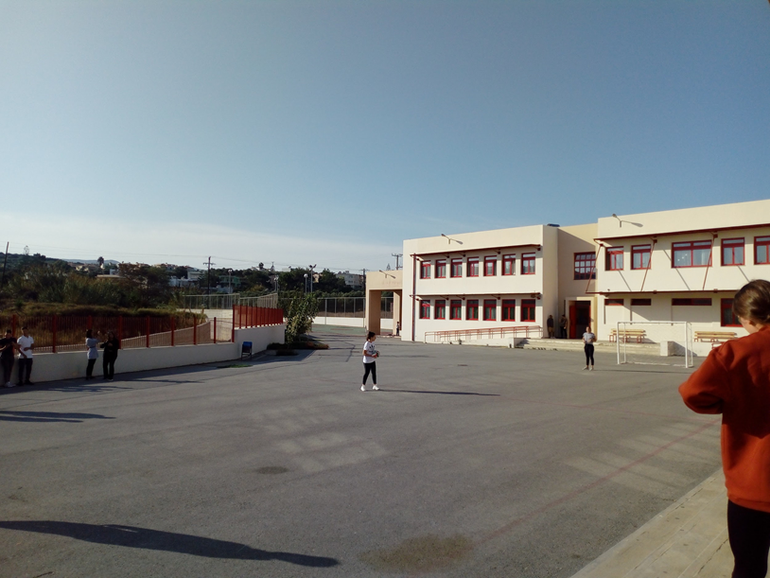
All schools are different but what i know is that my school is different from others. We have many classrooms which are very large and comfortable. We are glad that we are in such a wonderful school with strict but at the same time nice teachers. In the canteen they pay attention to the food the give us because I know many schools which in the canteen are more free , this automatically tells us that they do not pay so much attention to the students of the school. Also, we have three big courts. basketball, football and volleyball. Our yard is very large and on the ground there are constructions made by my classmates.
In addition, we have a lot of fun outdoors because there are many interesting exercises to fill the free time we have .
When we have a break i talk with my friends and we enter the class in a happy mood.

Slide 5
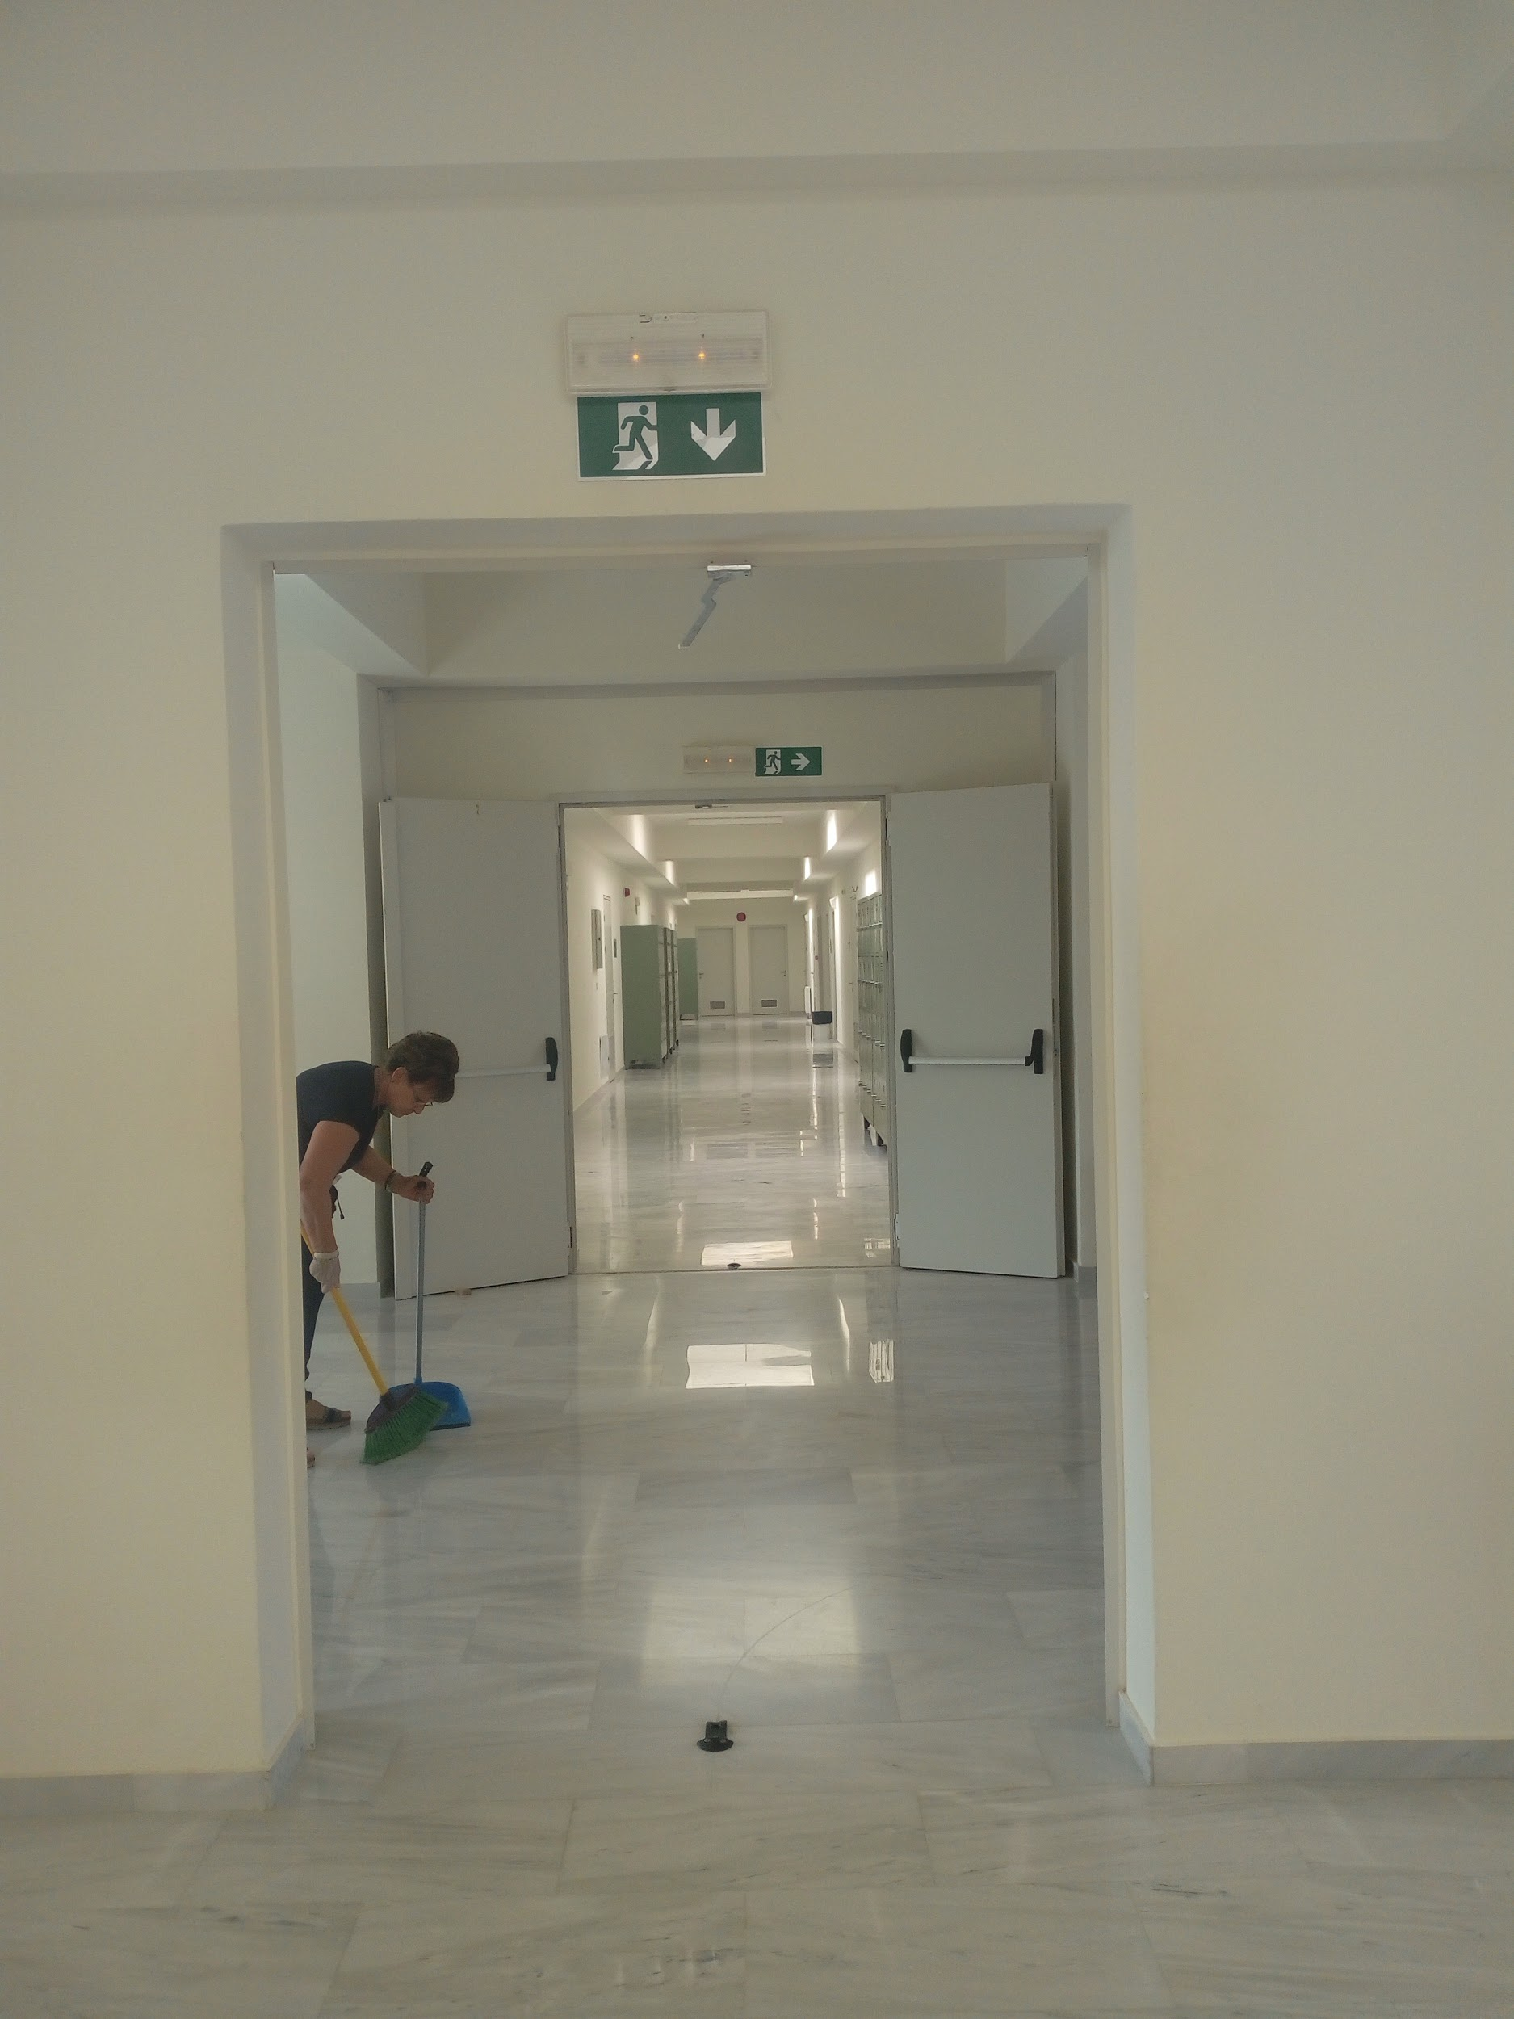
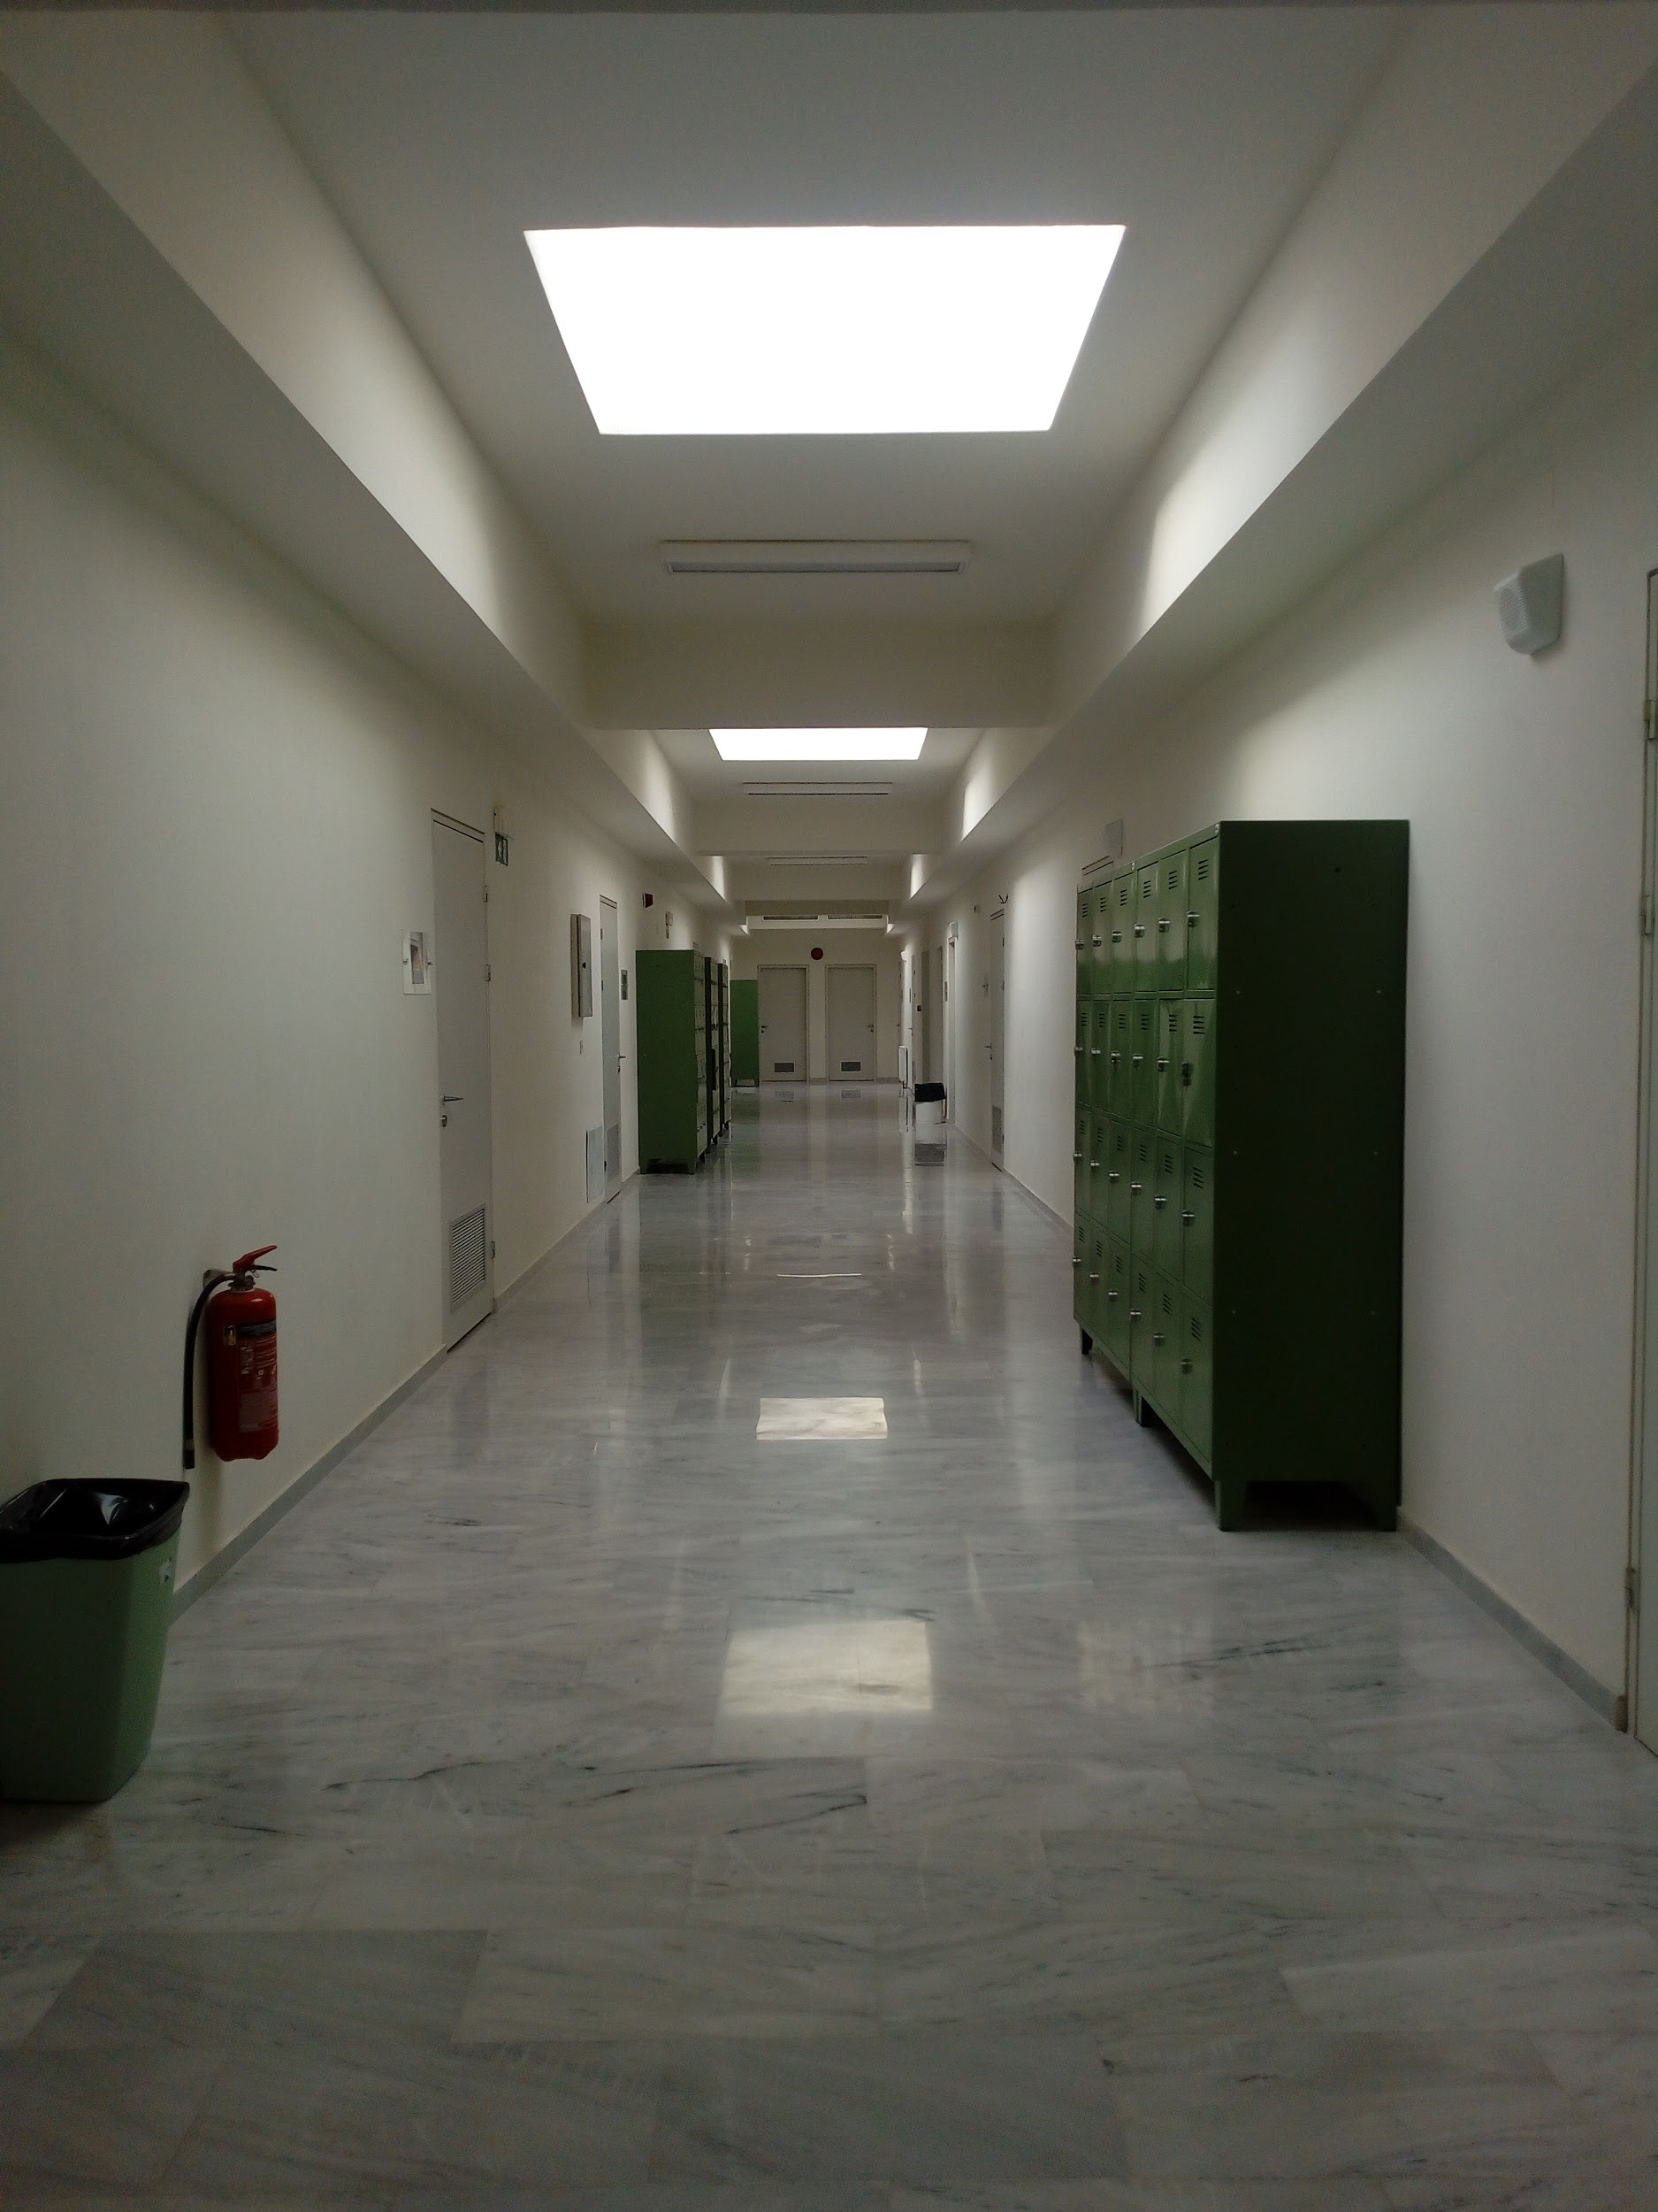
when the bell rings the corridor is full of life

Slide 6
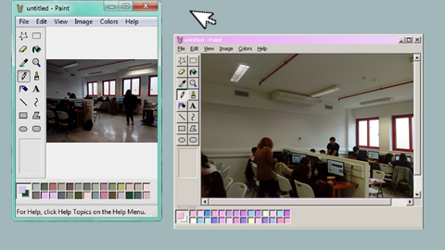
I like the fact that there are some students from different countries and that is a wonderful opportunity for the rest of us to learn about different types of culture and history. Another thing that I appreciate is that it is well equipped with computers, science stuff for our experiments and interactive boards. Furthermore our teachers treat us with kindness and respect. They try their best and that's why we own them a huge "Thank you". I appreciate that I am part of this school.
My school has a very beautiful building which is located in Sfakaki. Our school has a football court, a volleyball court and a basketball court. My school's classrooms are very beautiful and airy. There is also a computer lab where we use computers. Finally all of the teachers of my school are very kind and cooperative. 🏫😁

Slide 7
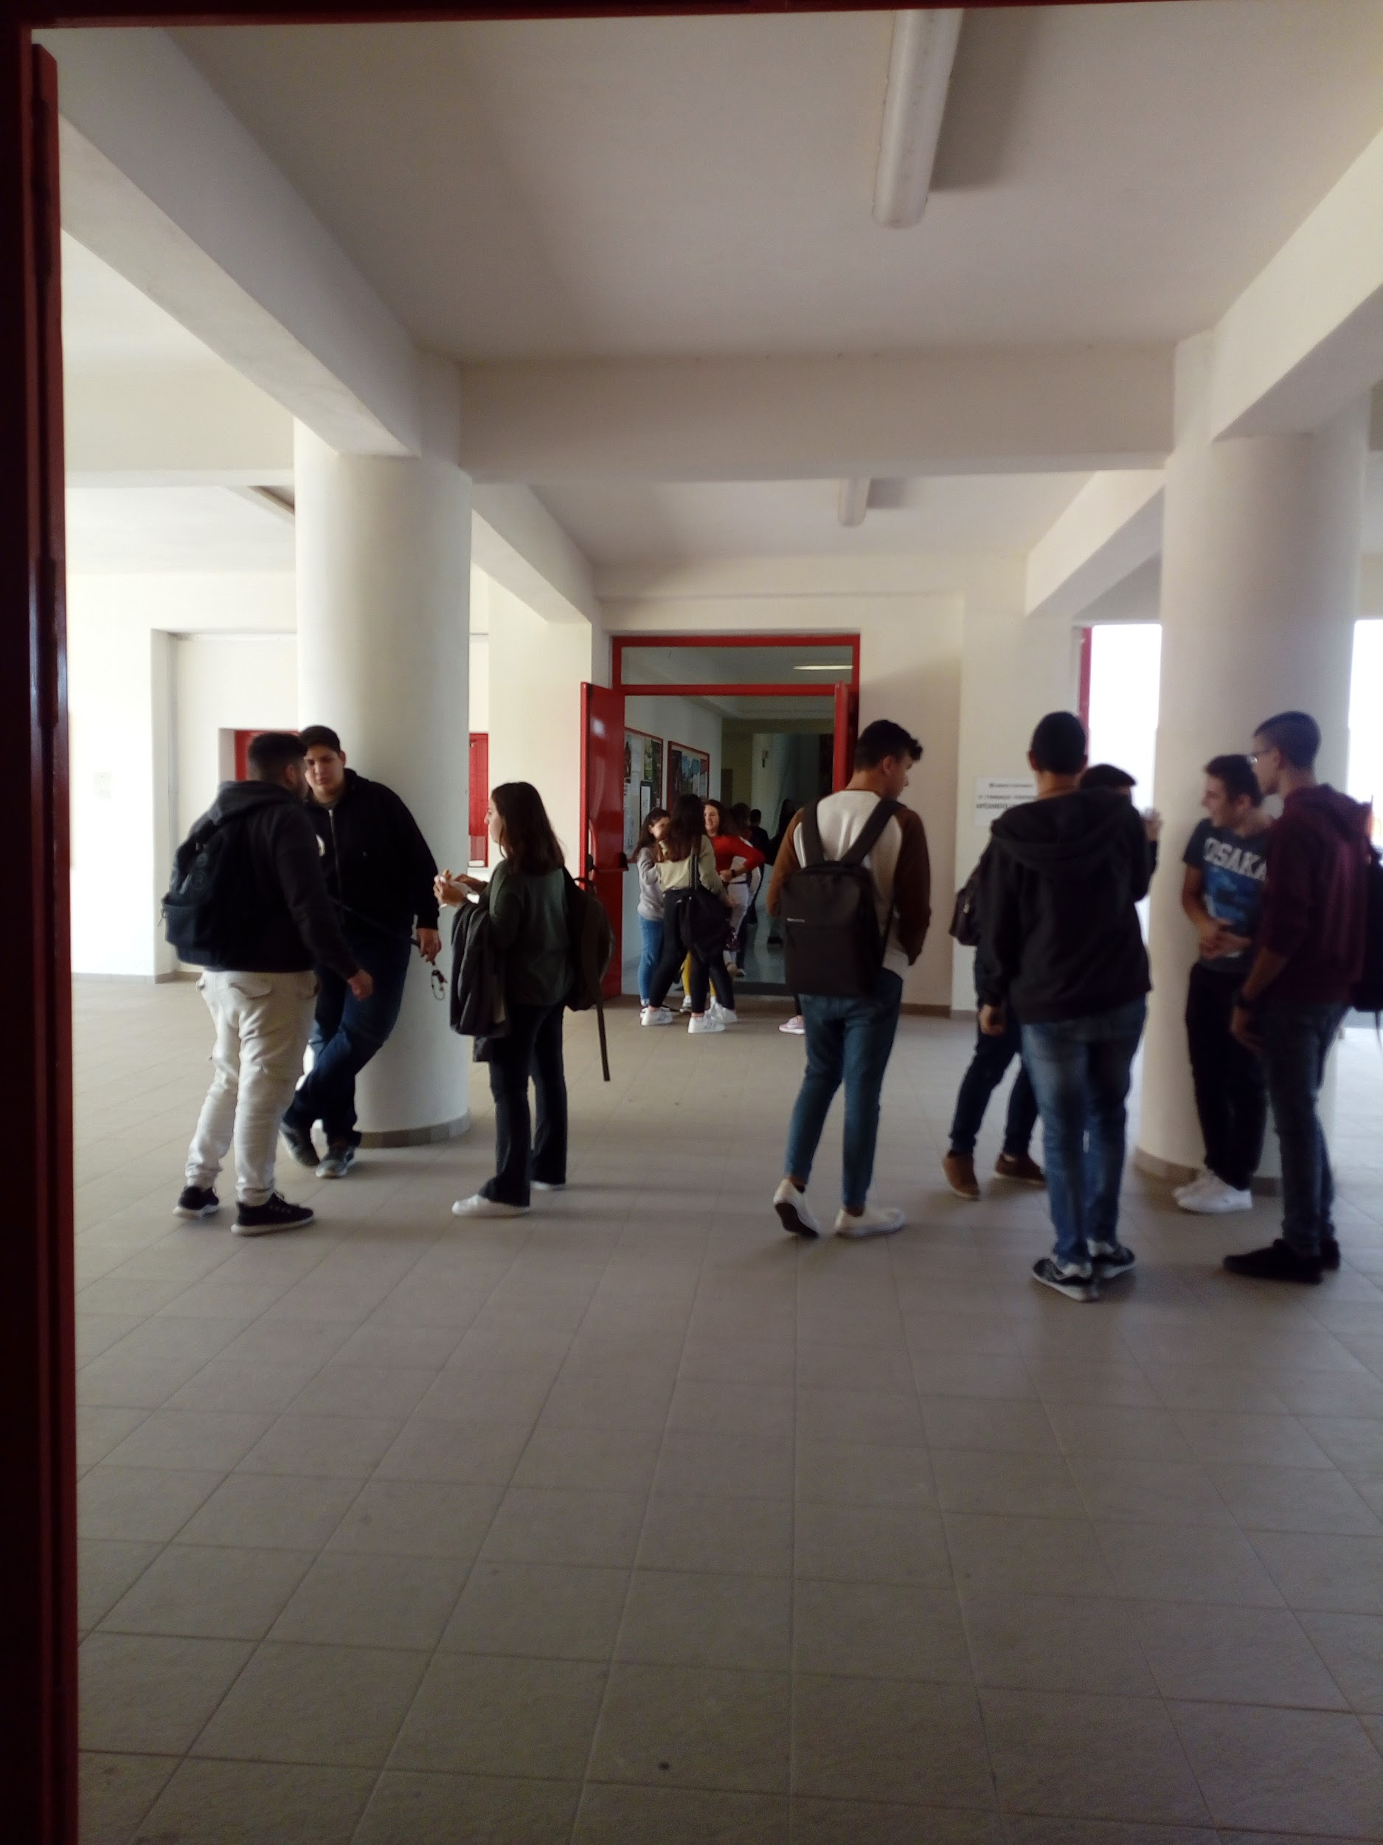
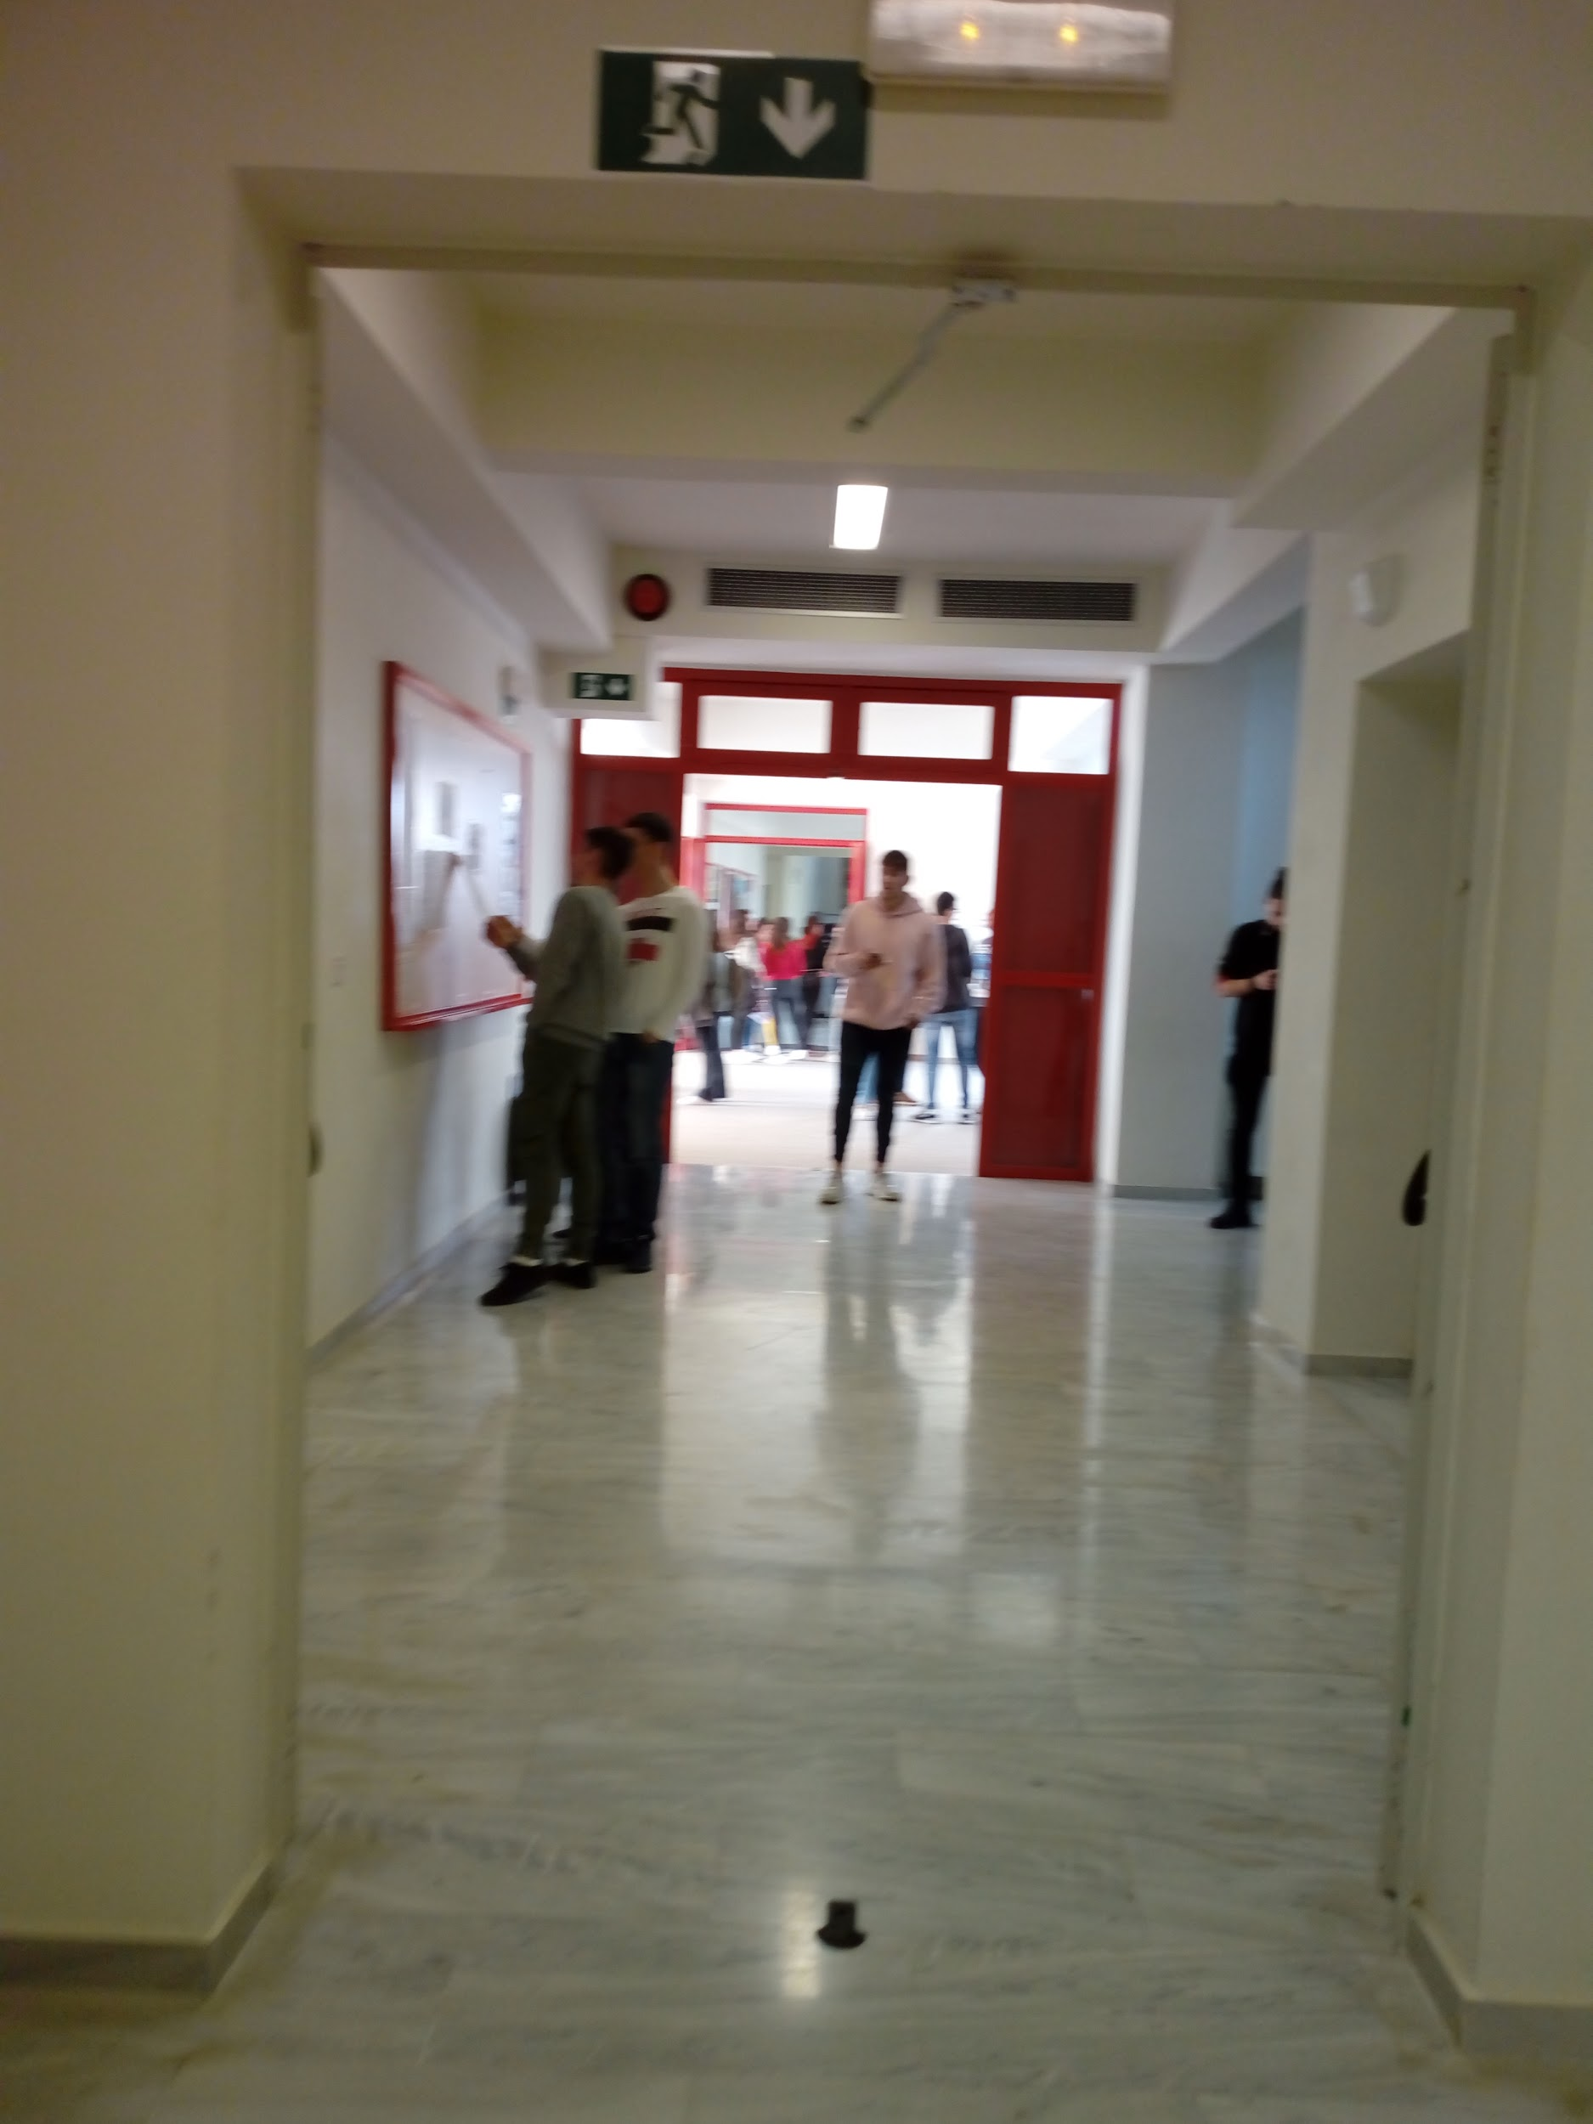

Slide 8
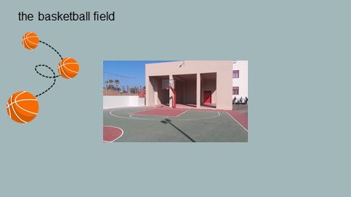
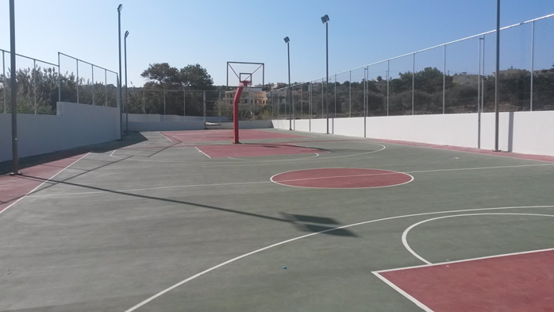

Slide 9
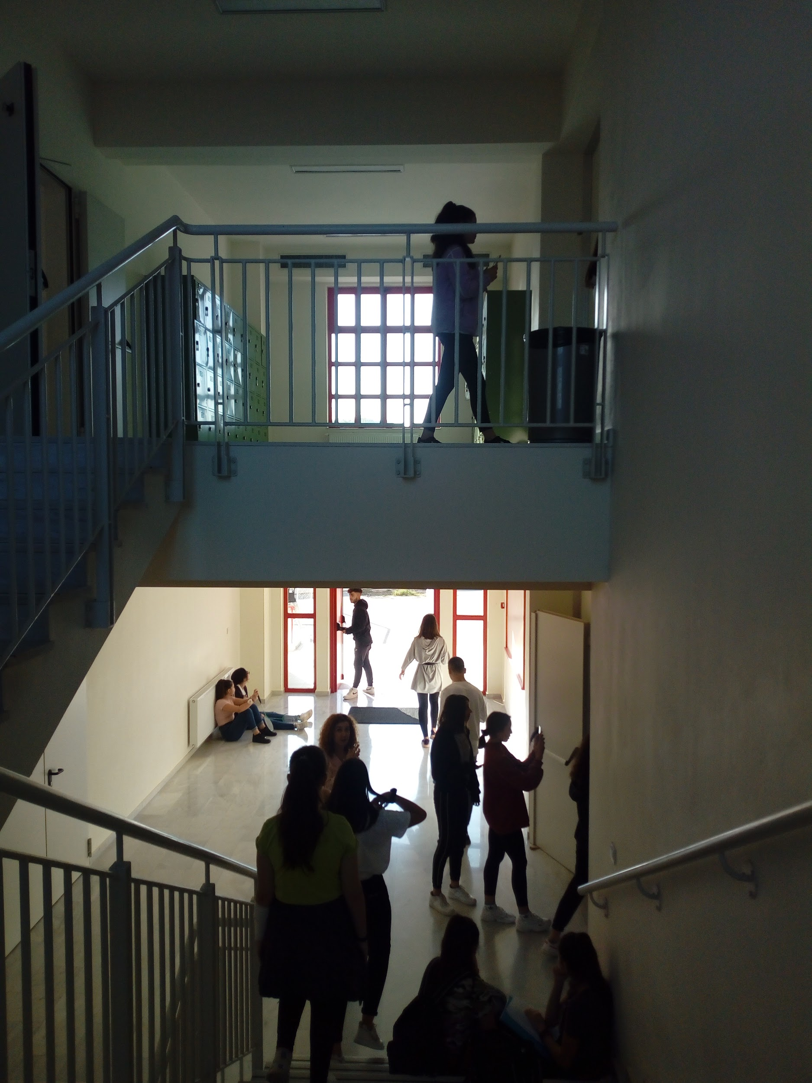
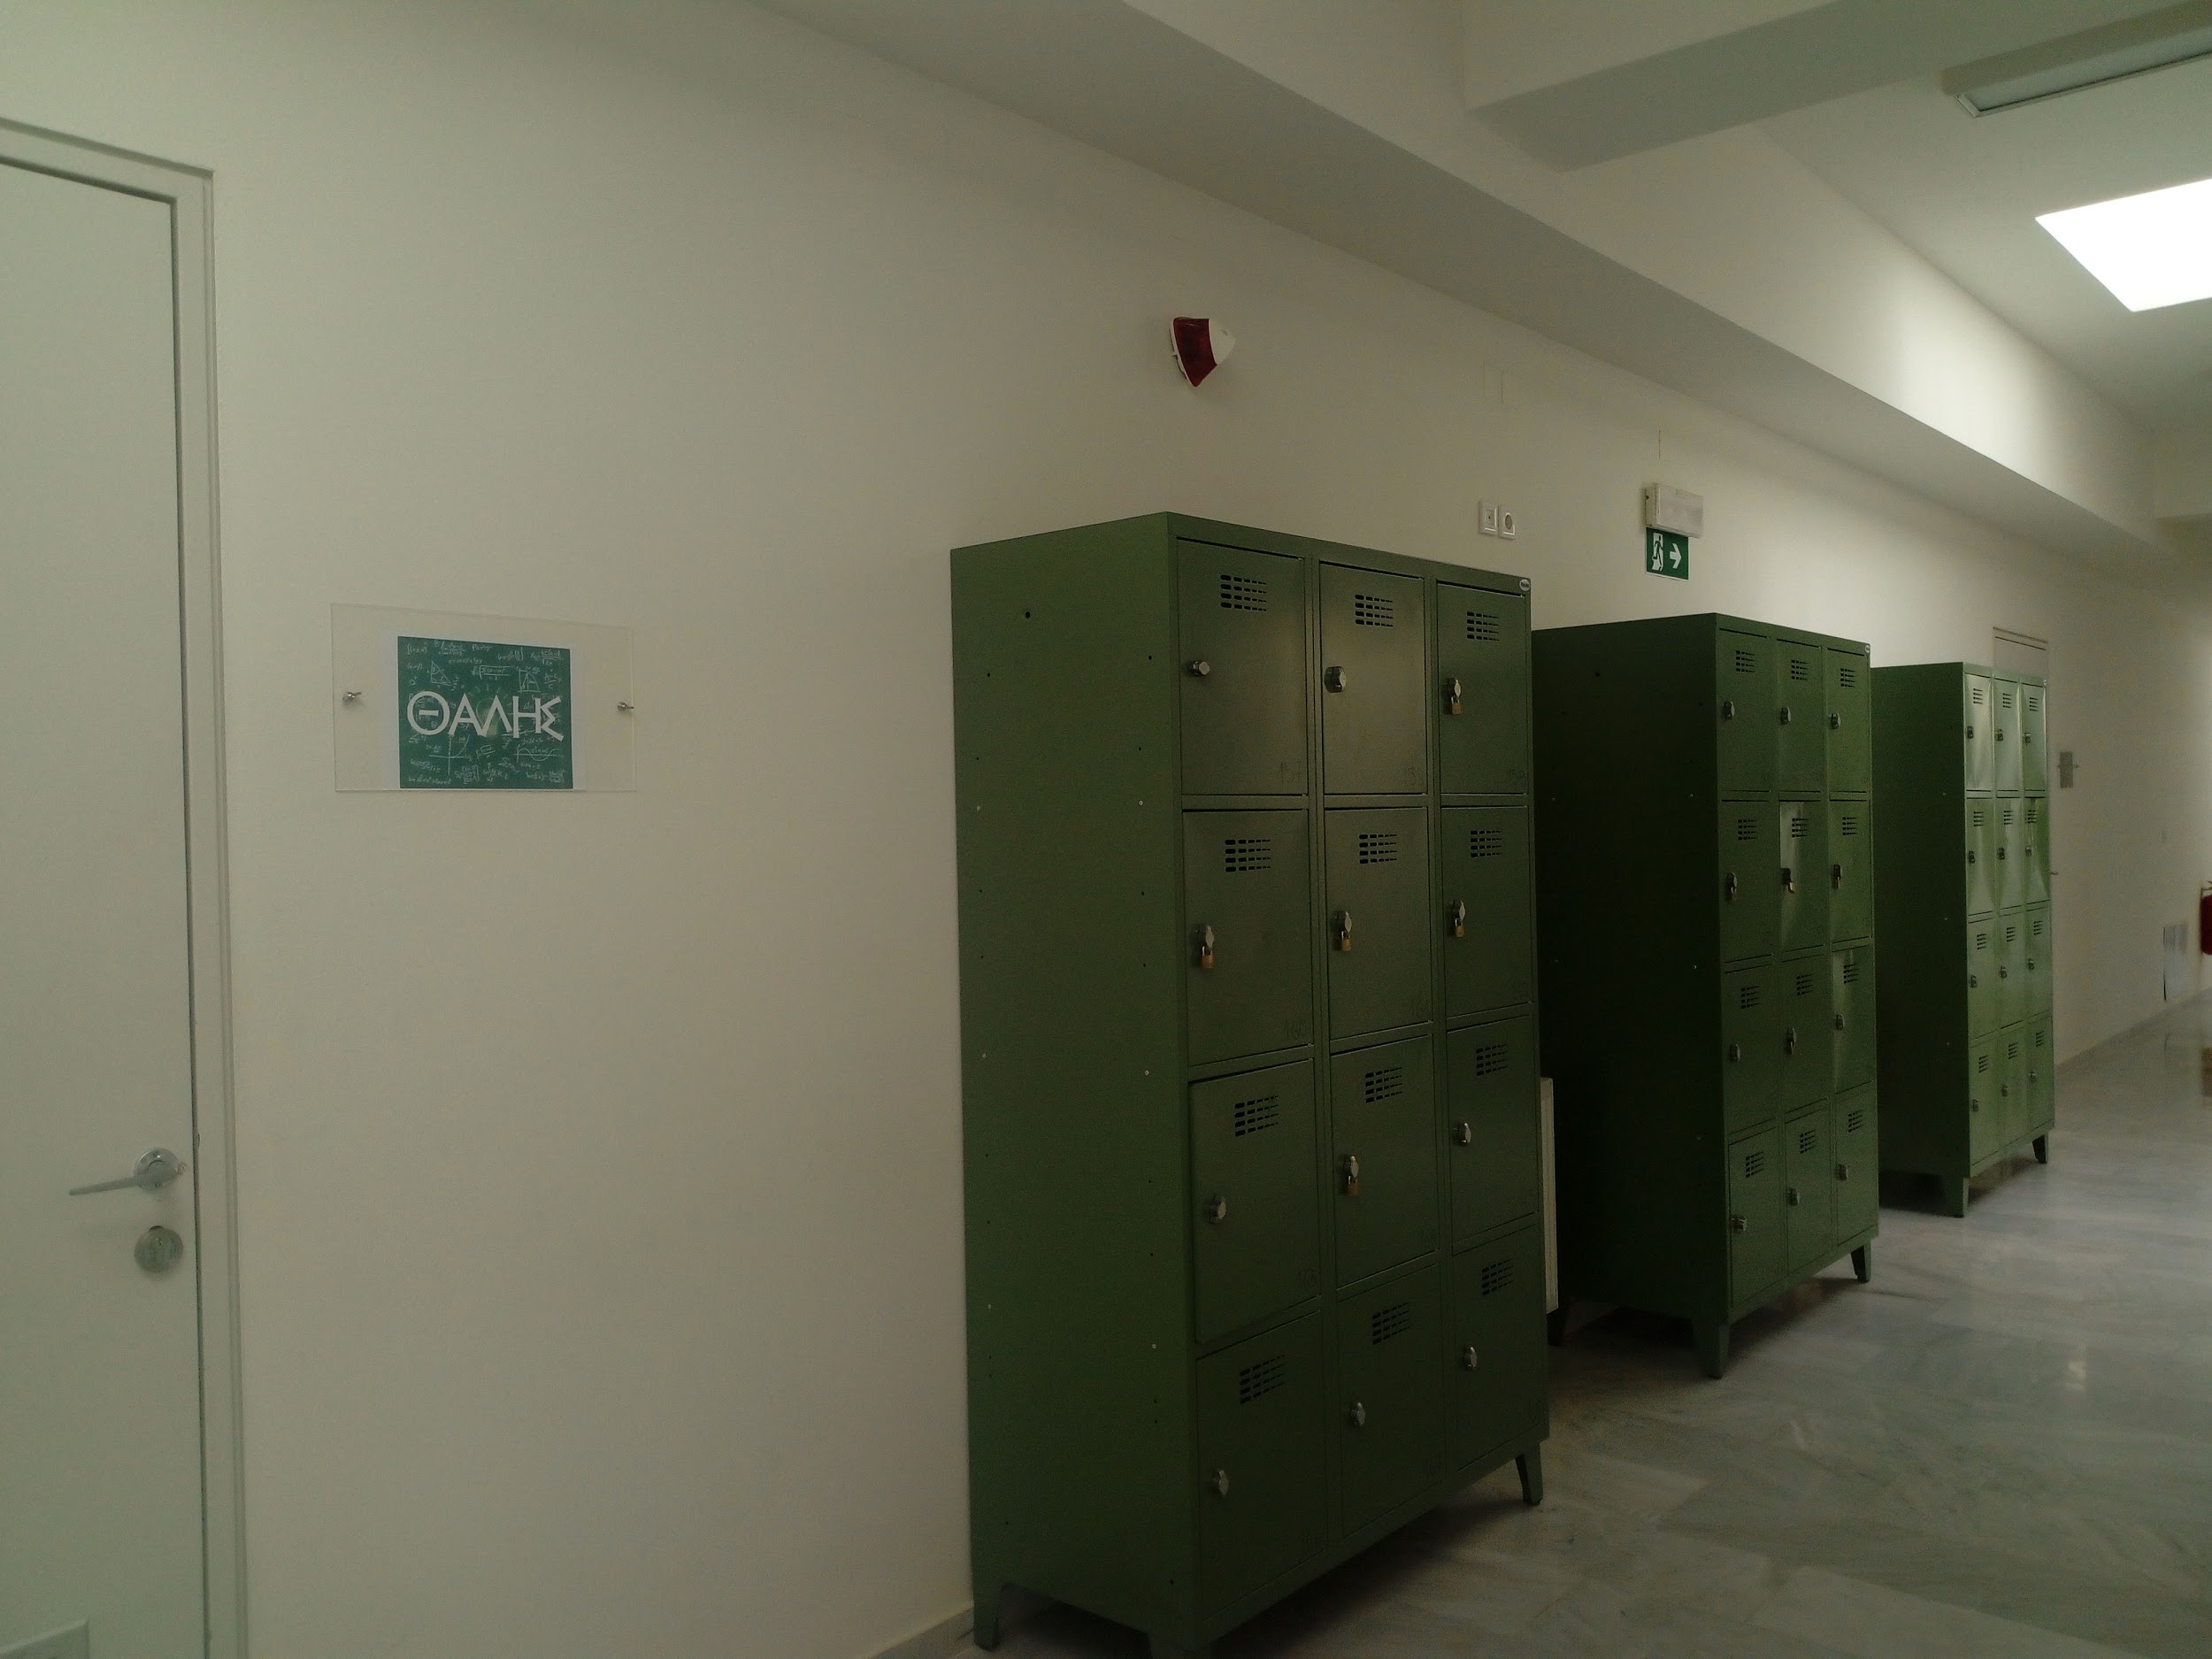
INSIDE THE SCHOOL BUILDING

Slide 10
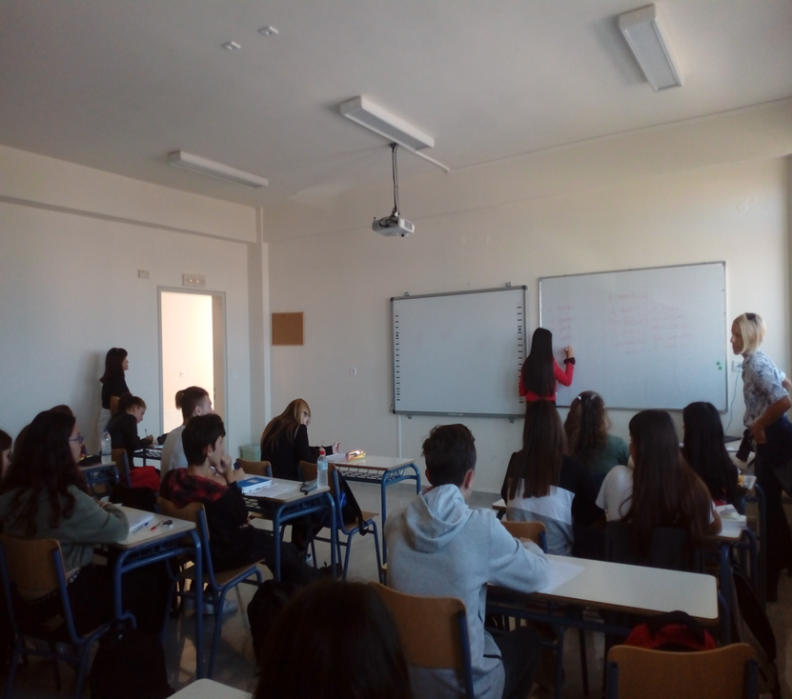
It is said that schools shape us to become more responsible adults. We must treat our schools with respect they are the places of worship .My school has excellent teachers who help students with studies, sports, and other activities. They are the building blocks of the school and teach us important lessons that we must apply in our daily lives.
Schools teach us to communicate with our friends and classmates. We have different classrooms where the teachers teach us different subjects. Equal weight is given to both studies and extra-curricular activities so that we develop into better individuals. Our schools will always try to focus on our overall growth and transform as healthy adults.

Slide 11
Unfortunately, due to Co-vid 19 pandemic we have to stay at home and have online school since 9th November 2020 and we want to say that
WE MISS OUR SCHOOL VERY MUCH !!!!!!!!

