Slide 1
The History of Aeroplanes
Unit 4, 6th grade primary school English

Slide 2
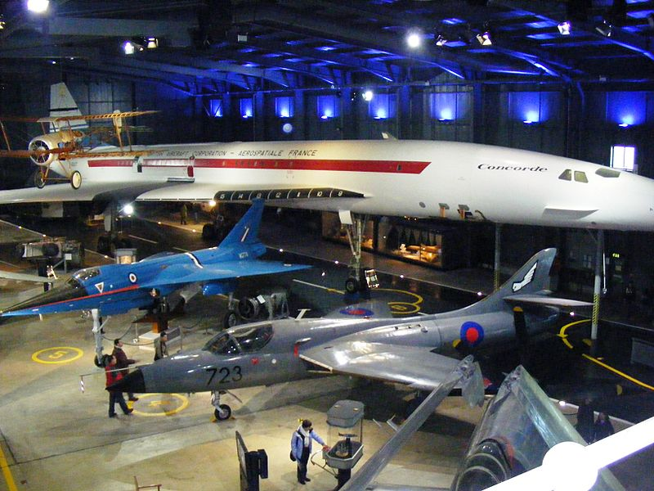
Lesson 1
A Day at the Museum

Slide 3
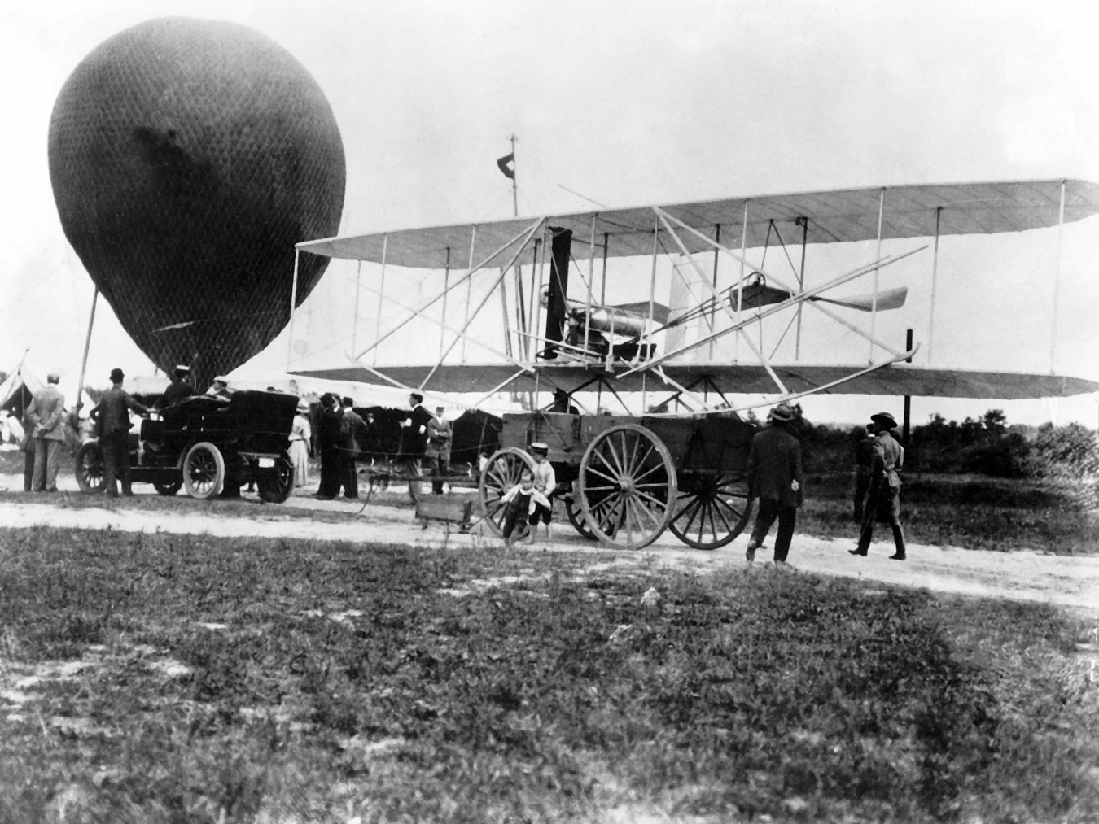

Slide 4
Lesson 2
https://www.youtube.com/watch?v=o333_U-27vs
An air pocket

Slide 5
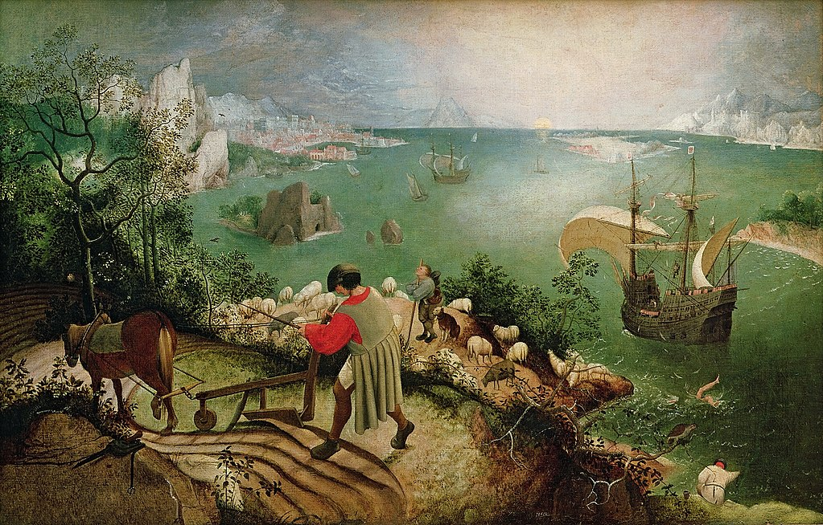
Lesson 3
The Fall of Icarus

