Slide 1

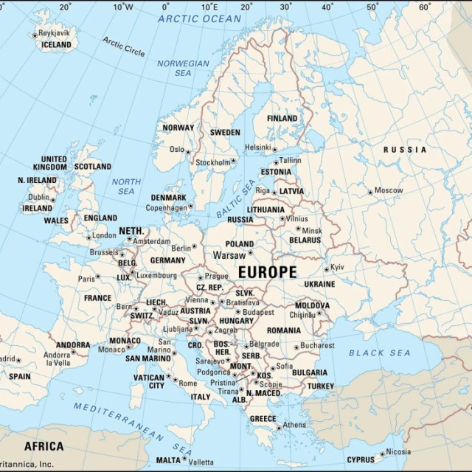
Internet Friends Around Europe
Discovering European countries, capitals and daily lives online

Slide 2

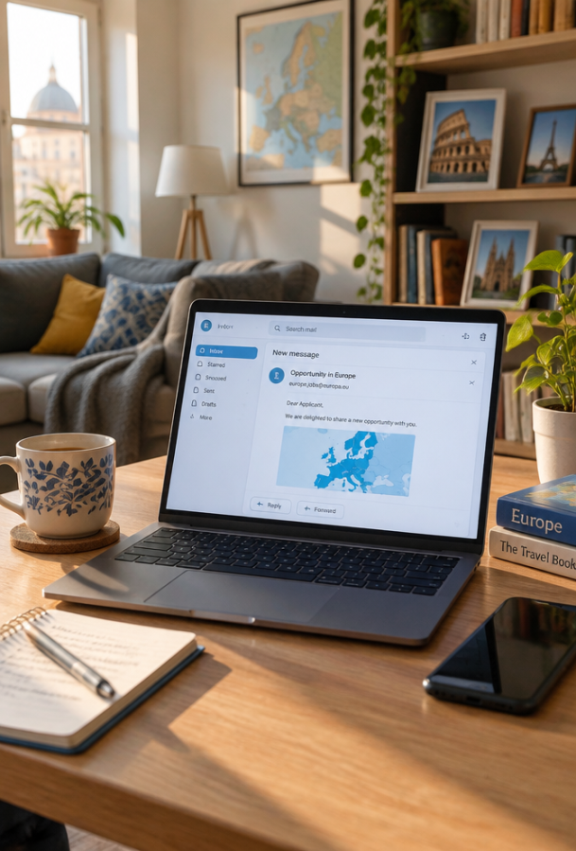
A Message Across the Sea
Imagine opening your computer screen in Thessaloniki and instantly receiving a friendly greeting from someone living over two thousand kilometres away on an Atlantic island!

Slide 3
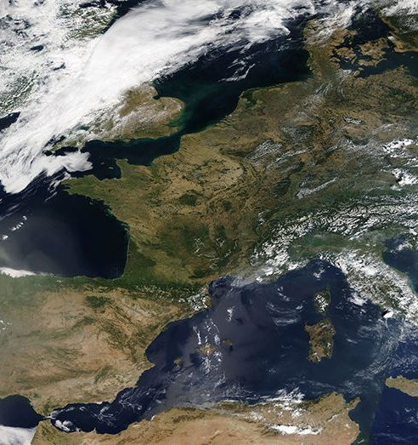
Today's Learning Goals
By the end of this lesson, you will be able to:
Identify European countries such as Ireland and the United Kingdom on a map.
Describe how digital tools help young people across Europe share culture.

Slide 4
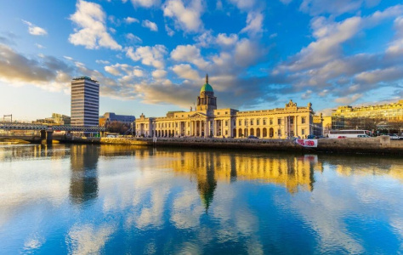
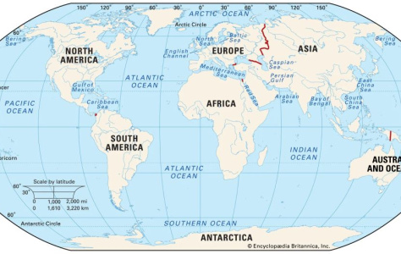
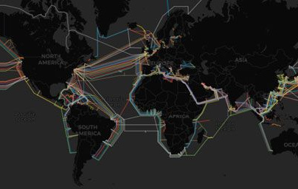
Key Geography Words
Capital City
The primary administrative centre and seat of government in a nation.
Continent
A massive continuous expanse of land containing many sovereign countries.
Digital Network
Connected computer systems allowing people to exchange messages across borders.

Slide 5
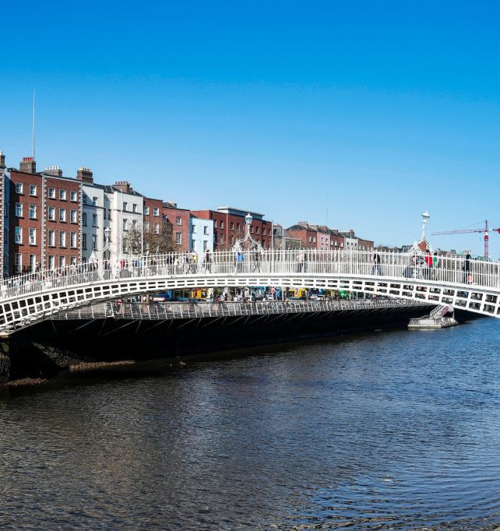
An Email from Ireland
Kostas in Greece receives an email from Connor, who lives in Dublin, Ireland. Connor checks his messages every Friday afternoon when he arrives home from school.
🔍
Example
Connor uses the Internet to research homework, message classmates and play computer games.

Slide 6
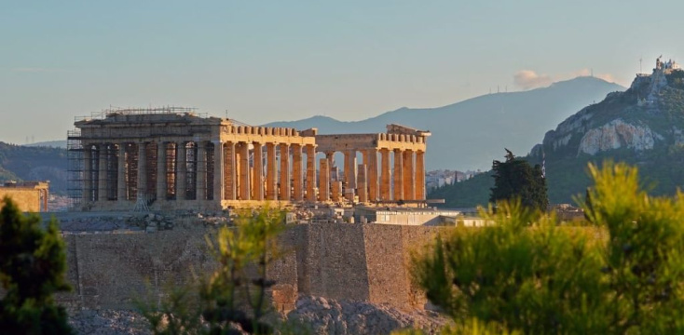
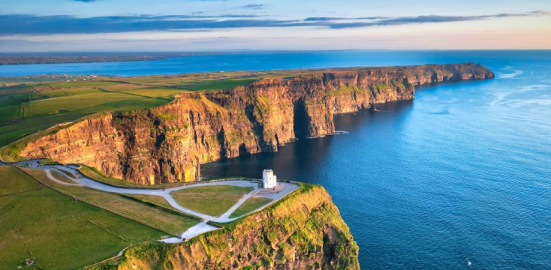
Comparing Greece and Ireland
Greece
Located in southeastern Europe along the warm Mediterranean Sea. Its capital is Athens.
Ireland
An island nation in northwestern Europe bordering the North Atlantic. Its capital is Dublin.

Slide 7
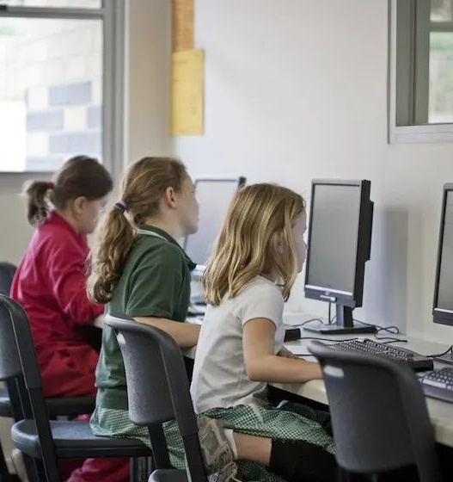
How We Connect Across Borders
Digital Connections
The Internet allows pupils from different European nations to communicate instantly without travelling.
Sending fast electronic emails
Taking virtual museum tours
Sharing music and sports hobbies
🧠
Remember
Even though our landscapes and climates differ, young people share many favourite hobbies!

Slide 8

Voices from England
Listen to the audio and answer the questions
Pupils from England Talk About Free Time
▶ Play audio
1
Which country do Liam and Sophie live in?
2
What sport does Liam play after school on Tuesdays?
3
What is Sophie's favourite indoor activity?
4
What do both pupils enjoy doing at the weekend?

Slide 9
Voices from England
✅
Check your answers below
Pupils from England Talk About Free Time
▶ Play audio
1
They live in England.
2
Liam plays football.
3
Sophie loves drawing colourful animals.
4
They both enjoy playing online computer games with their friends.

Slide 10
Check Your Knowledge
Which city is the capital of Ireland, where Kostas's friend Connor lives?
1.
London
2.
Dublin
3.
Athens
4.
Paris

Slide 11
Check Your Knowledge
✅
Which city is the capital of Ireland, where Kostas's friend Connor lives?
1.
London
✓
2.
Dublin
3.
Athens
4.
Paris

Slide 12

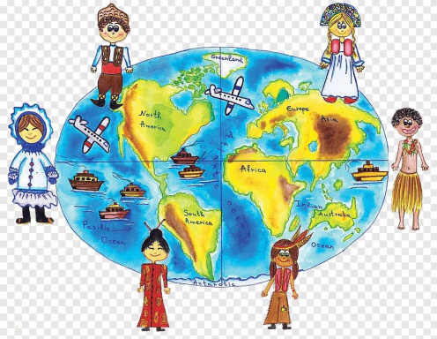
European Pen Pals
If you could send an email to a new school friend in another European country, which country would you choose, and what three things about your life in Greece would you describe to them?

Slide 13
European Pen Pals
✅
You might have said...
Pupils might choose countries like Ireland, the United Kingdom, France, or Italy.
They could describe the sunny Greek climate, historic monuments such as the Acropolis, local food, or their favourite sports and digital pastimes.

