Slide 1
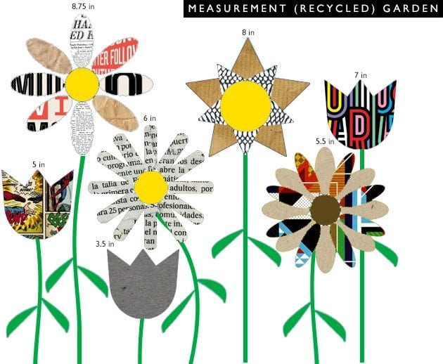
Environment
How can we protect it?

Slide 2
THE 3 Rs: Recycle- Reuse-Reduce
RECYCLE
Paper (cartons, boxes, newspapers)
Aluminium (cans, tins)
Plastic(bottles)
Glass(containers)
Metal
Electronic devices
REDUCE
Litter
Energy
Water
REUSE
Clothes
Boxes
bags

Slide 3
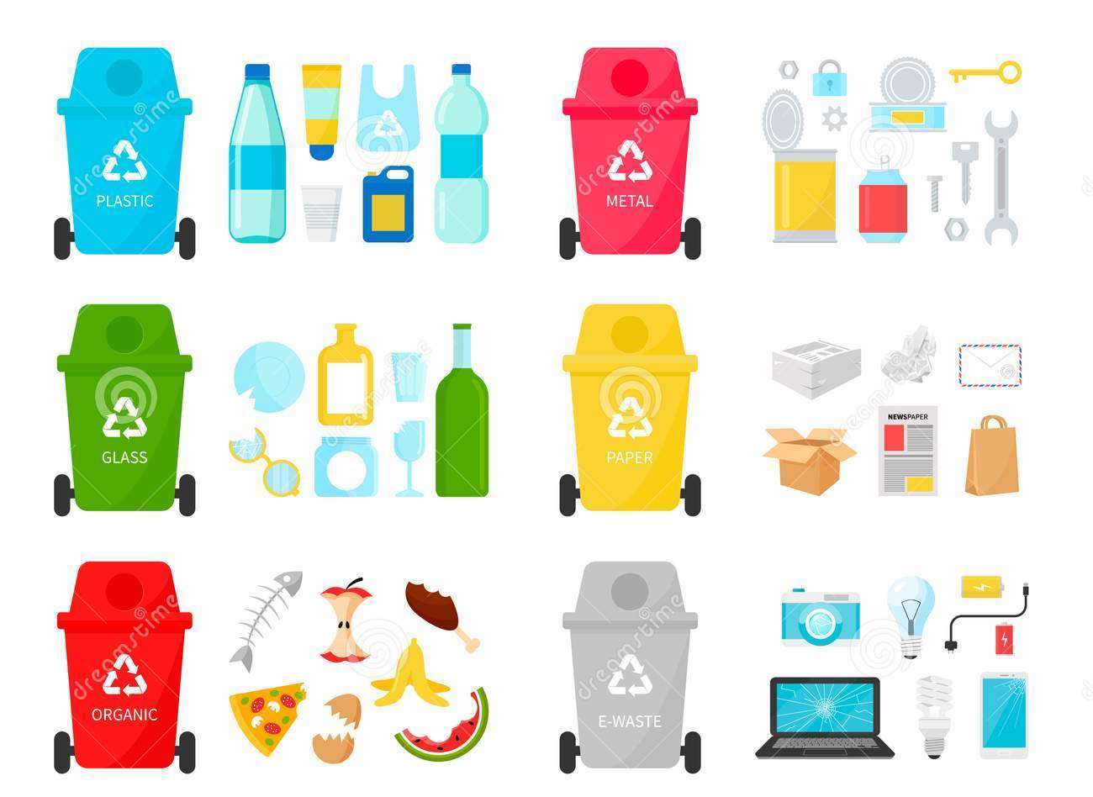

Slide 4
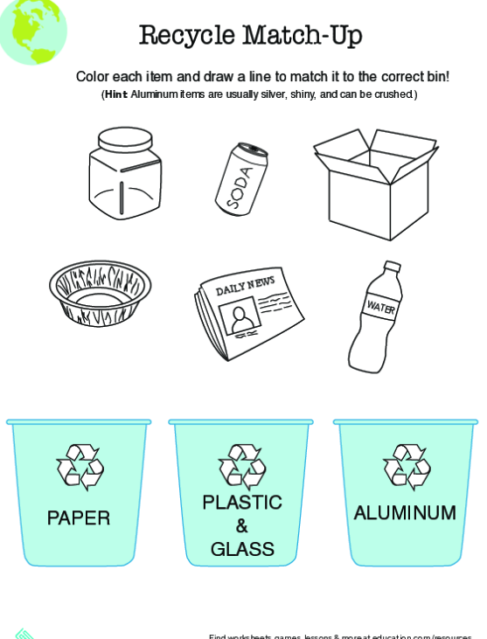
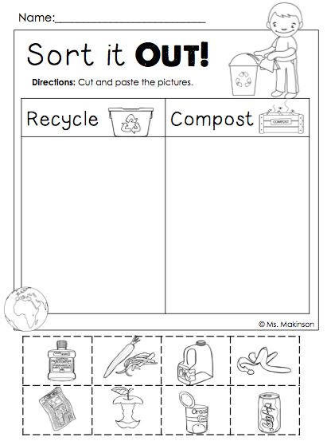

Slide 5
